Slide 1
Unit No.1 Overview of metrology & Linear measurement
By :- Prof. Y.J. Potdar
Mechanical Engineering Department,
Polytechnic, YTC, Satara

Slide 2
1.1a. Definition of Metrology
Metrology is the science of measurement and is primarily concerned with the establishment, reproduction ,conservation and transfer of units of measurements and their standards.
1.1b Objectives of Metrology
1. It can be used for selection of proper measuring instrument in industries.
2. It can be used for deciding the proper measuring standards.
3. It is used for minimizing cost of inspection.
4. To decide or find out tolerances.
5. To achieve standardization.
6. To maintain accuracy and precision at the time of inspection

Slide 3
1.1c Types of metrology
Legal Metrology
It is that part of metrology which relates units of measurements, methods of measurements and instruments to the statutory, technical and legal needs.
Applications
a. Commercial transitions related with net quantity.
b. Industrial measurements, accuracy , interchangeability.
c. Measurement of health, human safety.
2. Scientific Metrology
Scientific Metrology refers to development of new measuring technology
and scientific methods

Slide 4
1.1c Types of metrology
3. Deterministic Metrology
Deterministic Metrology is that in which part measurement is replaced by process measurement.
This will be useful for machines under automatic control.
This technology is used for very high precision manufacturing machines.
4. Industrial Metrology
Industrial Metrology is the industry related development of inspection for
specific industrial need.
1.3d Need of Inspection
Inspection is defined as checking of quality characteristics of given job.
Need of Inspection
Quality output
Change in technology.
Mass production
Save money
Interchangeability
To develop reputation

Slide 5
1.1e Methods of Measurement
Direct method
In this method , the quantity to be measured is directly compared with known standard.
The result is expressed as numerical number
This method is common for measurement of physical quantities like length, mass & time.
Example – To measure a length of steel bar by comparing it with steel rule
Determination of weight by balance
Measurement of speed of shaft by tachometer
2. Indirect method
Measurements by direct method are always not possible.
Direct method is inaccurate hence rarely used
In indirect method of measurement, measurand is converted into some form which can be measured

Slide 6
1.1e Methods of Measurement
2. Indirect method
Primary measurement :- Is one that can be made by direct observation without
involving any conversion or transition of measured quantity.
E.g. Matching of two lengths when determining the length of an object with ruler.
ii. Secondary measurement:- The indirect measurement involving one translation are called secondary instruments.
E.g. The conversion of pressure into displacement by means of bellows.
iii. Tertiary measurements:- The indirect measurement involving two conversions are c
called tertiary measurements.
E.g. The measurement of static pressure by bourdon tube pressure gauge
3. Contact & Non-contact Type measurement
i. Contact type where the sensing element of the measuring device has a contact with the medium whose characteristics are being measured.
ii. Non-contact type where sensor does not communicate physically with the medium
E.g. Optical, radioactive and some electrical/electronic measurements.

Slide 7
1.2 Characteristics of Instruments
1.2a Static Characteristics
i. Least count (Resolution) :- Is the smallest dimension that can be measured by using particular instrument.
All instrument are having some or other least count.
It may change from manufacturer to manufacturer.
Vernier has L.C. 0.02mm
Micrometer has L.C. 0.01mm
ii. Range & Span :- The region between the limits within which an instrument designed to operate for measuring a physical quantity is called the range of the instrument.
Span represents the algebraic differences between the upper & lower range values of the instrument.
iii. Accuracy & precision
Precision is defined as the repeatability of measuring process.
( Readings of a jobs with true value 10.00 mm which are accurate are 10.001,10.000,10.001, 9.999,10.000,9.999)
The closeness of the measured value with true value is called as accuracy.
( If a true value of job is 10.25 and the measured values are 10.15,10.14,10.29, then they are not accurate compared with 10.24)

Slide 8
Difference between Accuracy & Precision
Accuracy
Precision
1.Precision is defined as the repeatability of measuring process.
2. Can be used for one measurement ,but set of readings needed.
3. It is related with group of readings, and it is spread.
4. Precision cannot indicate accuracy.
The closeness of the measured value with true value is called as accuracy.
Can be used for one measurement
It is related with true value.
Accuracy can indicate precision.

Slide 9
1.2 Characteristics of Instruments
1.2a Static Characteristics
iv. Reliability :- It is defined as the probability that the system will operate to an agreed level of performance , for specified period subject to specified environmental condition
v. Reproducibility:- Reproducibility of measurement is the quantitative measure of the closeness of the agreement between the results of measurement of the same measured, carried out by changing the method of the measurement ,observer, measuring instrument, location, condition of use, time etc.
vi. Repeatability:- The ability of an instrument is the to reproduce output readings when the same measurand value is applied to it consequently under the same condition.
vii. Calibration :- Is defined as the comparison of measured value with standard
Need of Calibration
1. To take into account the error producing properties of each component.
2. To take into account environmental errors.
3. To understand / detect error generated due to frequent use of equipment.
4. To assure quality of inspection during manufacturing processes.
5. To get meaningful result from measurement.

Slide 10
1.2 Characteristics of Instruments
viii. Sensitivity :- It is the ability of measuring instrument to detect small variations in a quantity being measured.
ix. Hystresis :- Is the maximum difference for the same measured quantity between the upscale & downscale readings during full range transverse in each direction.
x. Dead zone:- Is the largest range through which an input signal can be varied without initiating any response from the indicating instrument.
xi. Threshold:- If the input quantity is slowly varied from zero onwards, output is
not shown until some minimum value of the input is exceeded. This minimum value
of input is called threshold of instrument.
xii. Linearity:- Is defined as ability to reproduce the input characteristics symmetrically
xiii. Amplification:- is the process of increasing the strength of an electrical signal, such as voltage or current, using an amplifier.
1.2b Dynamic Characteristics
Speed of response :- Is defined as the rapidity with which an instrument indicates changes in measured variable without dynamic error
Fidelity :- Is defined as the degree to which an instrument indicates the changes in measured variable without dynamic error.
Overshoot :- Is defined as the maximum amount by which the pointer moves beyond the steady state.

Slide 11
1.3 Standards
Standards are the fundamental reference for a system of weights and measures, against which all other measuring devices are compared.
A. Line standards
Is the standard in which distance is measured between two lines, which are generally marked on measuring instruments.
It is for quick measurement and easy to use understand.
During measurement, parallax error can be generated.
They are not much accurate. E.g. steel rule
B. End standards
When distance is measured between two surfaces , by using an instrument, it is called as end standard.
End standard are accurate up to 0.005mm is measurable.
They are costly, and takes more time to use.
The surfaces of end standard are to be protected .
End standards are important as they are used for calibration. E.g. Slip gauges, end bars.

Slide 12
1.3 Standards
C. Wavelength standards
Material standard like Meter and Yard may be subjected to destroy day by day.
To find out solution to this problem leads to generate wavelength standard.
Initially for few years, simple light rays are used as source of wavelength standard.
Cadmium 114,Krypton 86 and Mercury 198 can also be sources of light wave lengths.
It was decided that Krypton-86in a hot cathode discharge lamp at 68k, generates orange radiations and they can be used as ultimate wavelength standard.
According to this standard
1 meter = 1650763.73*Wavelength kr 86
Advantages of Wavelength standards
It is not affected by environment.
It is not required to be stored.
It cannot be destroyed.
Easy to transfer as needed.
Easily available in laboratories.
Used for comparison with high accuracy.

Slide 13
Difference between Line and End Standard
Line Standard
End Standard
When measurement is of distance between two line, it is line standard.
They are accurate up to
+,- 0.2 mm
Quick and easy
Less costly
Parallax errors can occur
Manufacturing is simple
E.g. steel rule
When measurement is of distance between two surfaces, it is end standard.
They are accurate up to
+,- 0.001 mm
3. Time consuming
4. Higher cost
5. Environmental errors can occur
6. Manufacturing is complex
7. E.g. slip gauges.

Slide 14
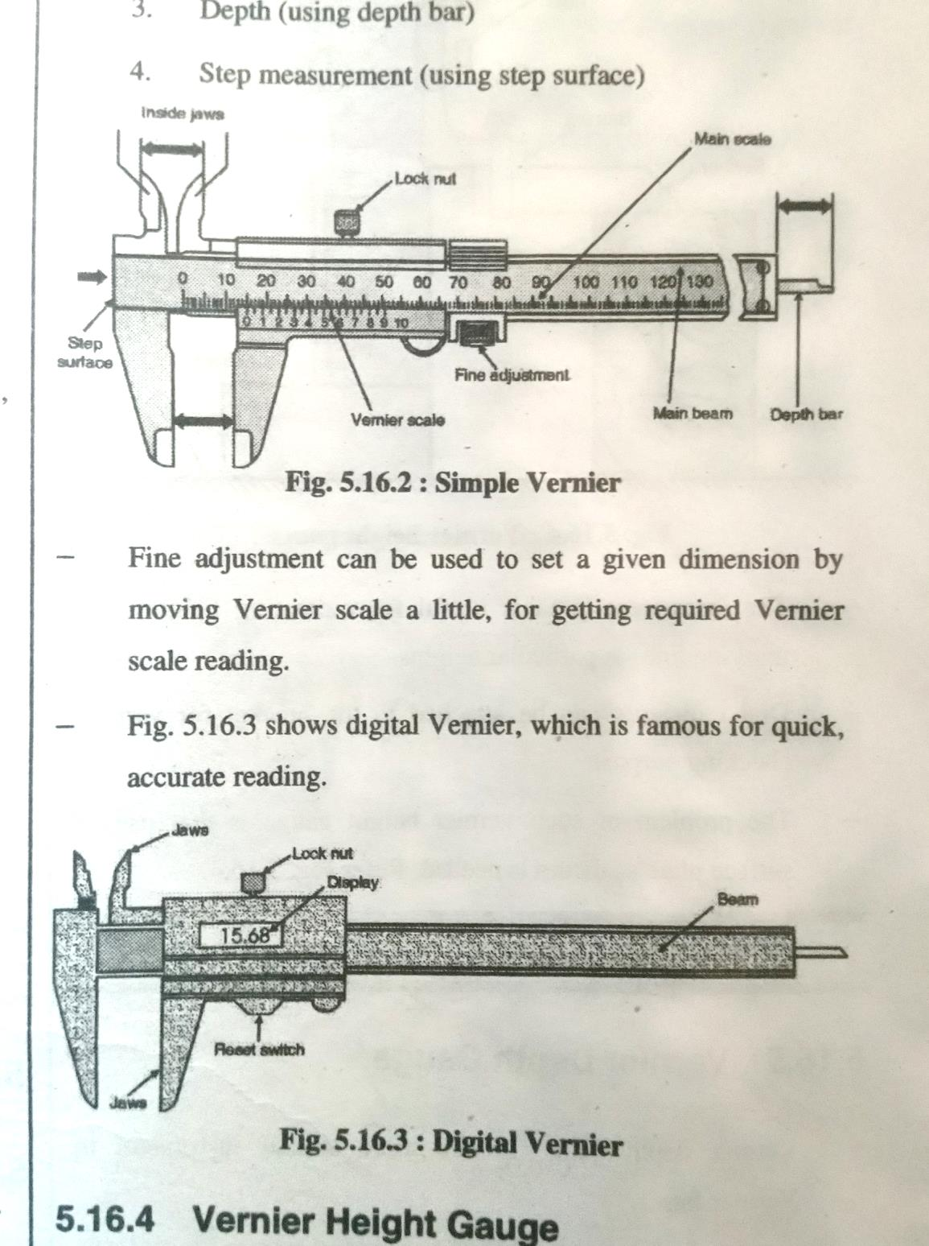
1.4 Linear Measuring Instruments
1.4 a Vernier Caliper
Simple Vernier Principle
Statement :- When two scales have slightly difference in sizes are used, the difference between them can be utilized for increase in accuracy of measurement.
The least count can be calculated as
L.C. = Smallest division of main scale/ No. of divisions on vernier scale
L.C. = 1/50 = 0.02mm
Vernier's can be of least count of 0.02,0.05 & 0.1 mm or as per the requirement, they can be designed.

Slide 15
1.4 Linear Measuring Instruments
1.4 a Vernier Caliper
Simple vernier consist of three main elements, beam, fixed jaw & movable jaw’s vernier beam. Main scale is engraved on the beam & vernier scale is engraved on movable jaw’s beam. The sliding jaw moves along the beam. Fine adjustment can be used to set a given dimension by moving Vernier scale reading.
By using vernier , following measurements can be done.
1`Outside dimensions (outside jaws)
2. Inside dimensions (inside jaws)
3. Depth (using depth bar)
4. Step measurement ( using step surface)
.

Slide 16
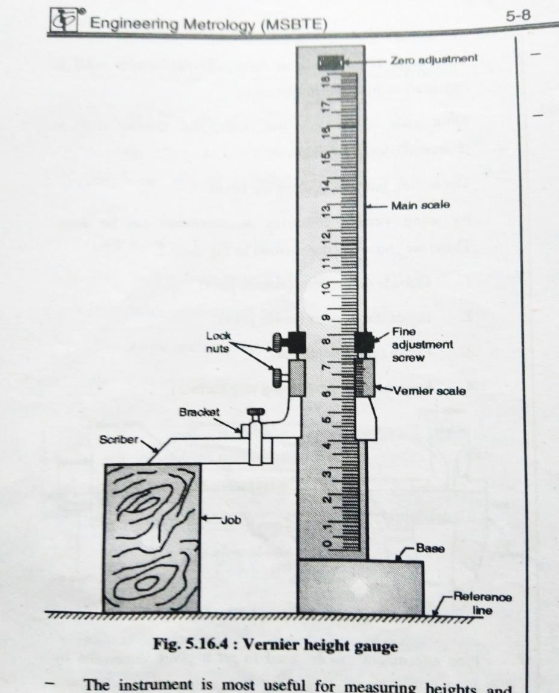
1.4 Linear Measuring Instruments
1.4 b Vernier Height Gauge
It works on the similar principle as that of vernier and also the measurement process is similar. This vernier is attached suitably with base block and marker for height measurement. The sliding jaw assembly is attached with a Vernier scale & a removable clamp with scriber.
The instrument is most useful for measuring heights & marking lines at particular heights. Dial indicators can be attached to the bracket for various checking purposes.
The problem of such vernier height gauge is that use of surface plate as datum is needed.

Slide 17
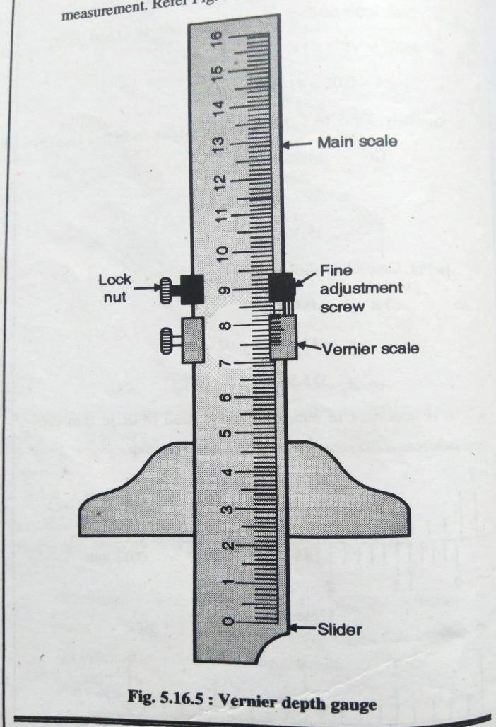
1.4 Linear Measuring Instruments
1.4 c Vernier Depth Gauge
Vernier depth gauge is one more similar instrument in vernier family.
It also consist of main scale, Vernier scale, jaws, fine adjustment, etc. The process to find out least count and taking readings are same as that of vernier.
It is specially used for measurement of depth of holes, recesses. In Vernier depth gauge , graduated scale can slide through the base and Vernier scale remains fixed.

Slide 18
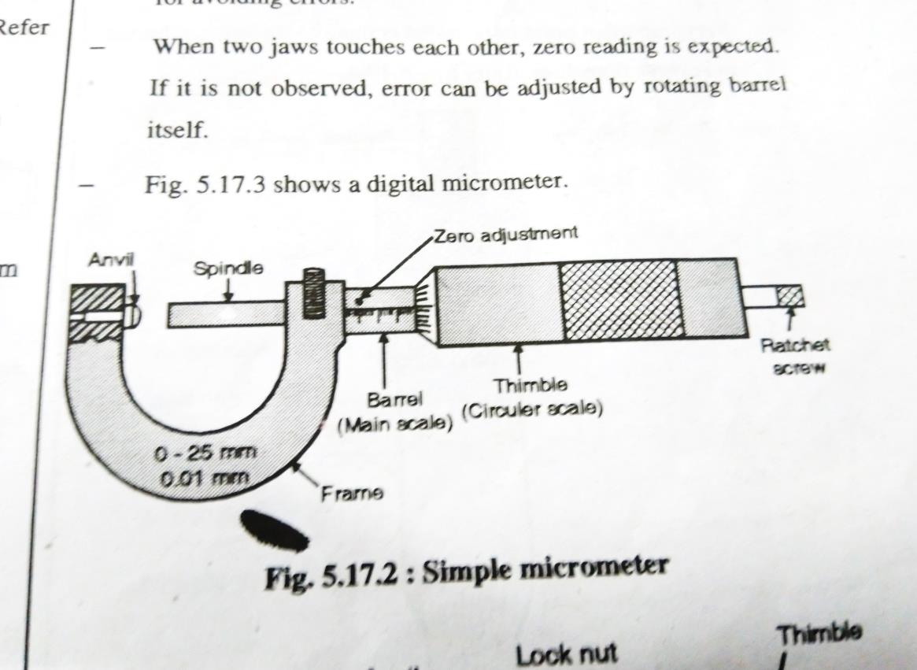
1.4 Linear Measuring Instruments
1.4d Micrometer
Principle of micrometer
Micrometer screw gauge works on the principle of nut & bolt. It consist of an accurate screw with about 10 or 20 threads per cm & revolves in a fixed nut. The location of thread is measured, which is already calibrated.
The least count can be calculated as
L.C. = Smallest division of main scale/ No. of divisions on circular scale
L.C. = 0.5/50 = 0.01mm
Micrometers can have least count of 0.01mm, 0.001mm, etc. as per requirement & manufacturer.
Simple micrometer consists of a screw with fixed pitch & nut arrangement. The end of screw acts as a spindle/anvil in the base of the frame. Spindle can be advanced or retracted by using thimble connected to the spindle. The barrel has engraved lines of main scale which is true scale.

Slide 19
1.4 Linear Measuring Instruments
1.4d Micrometer
Ratchet screw provide a stop, if excessive pressure is applied by the anvils, which is one of the most important part for avoiding errors.
When two jaws touches each other, zero reading is expected. If it is not observed, error can be adjusted by rotating barrel itself
Applications of Simple Micrometer.
1. Measurement of outside diameter.
2. Measurement of thickness.
3. Measurement of width

Slide 20
1.5 a Sources of Error
Error :- Error is the difference between the true value of the size being measured and the value found by measurement.
Sources of Error
1. Defect in instrument.
2. Adjustment of an instrument.
3. Imperfection in instrument design.
4. Method of location of instrument.
5. Environmental effects.
6. Error due to properties of object.
7. Observation error.
1.5 b Types of Error
1. Systematic Error ( Controllable error)
1. The systematic error are in the form of experimental mistakes.
2. These are controllable in magnitude & sense.
3. These errors have a definite value at the time of measurement.
Examples :- Calibration error, ambient condition error, stylus pressure error.

Slide 21
1.5 b Types of Errors
2. Random Errors
1. These type of errors occurs randomly and they cannot be determined.
2. These errors are generated due to large number of unpredictable & fluctuating causes
Examples :- Positioning standard or work piece, slight displacement of the jaws, fluctuation of instruments, operator error at the time of readings and frictions.
3. Instrumental Errors
Instrumental error are the type of systematic error.
There are many factors in the design & construction of instrument that limit the accuracy attainable
Instrumental errors due to defective or worn-out parts, friction in bearings of meter movement, incorrect spring tension, improper calibration.
These errors can be reduced by proper maintenance & careful handling of instruments
4. Environmental errors
Environmental errors are the type of systematic errors.
Instrument reading are largely affected due to changes in surrounding such as temperature, pressure change, change in humidity.
To reduce these errors provide air-conditioning, shielding, proper earthing & spring mounting.

Slide 22
1.5 b Types of Errors
5. Observation Errors
When an instrument has been properly selected , carefully installed & faithfully calibrated , shortcomings in measurement occurs due to certain fallings on
the part of the observer.
The observation errors may be due to
Parallax i.e. apparent displacement when the line of vision is not normal to the scale
Inaccurate estimates of average reading
Wrong scale reading & wrong recording of data
Inexperience & carelessness of the observer
6. Operational Errors
The instrument should be properly used. These errors caused by poor operational techniques such as
A thermometer will not read accurately if the sensitive portion is insufficiently immersed
7. Random Errors
By taking all care still we cannot reach towards true value & the error exists for unknown reason called random error.

Slide 23
1.5c Factors affecting accuracy
Factors affecting accuracy of jobs/production
Machines used for production.
2. Equipment used for production.
3. Environmental condition.
4. Skill of operator.
5. Raw material used for job.
Factors affecting accuracy of an instrument
1. Make of an instrument
2. Calibration of an instrument.
3. Handling of instrument
4. Proper method of using an instrument.
5. Reading taking style of an instrument.
6. Environmental conditions

Slide 24
1.6a Selection of instrument
1.Range of measurement carried out by the equipment.
2.Scale spacing on the scale.
3.Sensitivity of the instrument.
4.Reading accuracy of an instrument.
5.Error generated during measurement.
6.Effect of environmental conditions on the instrument.
7.Parallax error during reading an instrument.
8.Repeatability of measurements.
9.Requirement of the customer related to job details.
10.Cost of an instrument.

Slide 25
1.6b Precautions while using an Instrument for getting Higher Precision and Accuracy
1. Mishandling to be avoided.
2. Highly finished surfaces should not be touched by hand for avoiding corrosion.
3. Wash hands and apply petroleum jelly before
handling instrument.
4. Instruments like slip gauges are to be handled using piece of chamois leather.
5. Instruments are packed and placed properly after use.
6. Instruments are to be used in dust free rooms.
7. Brushing is not recommended for the instruments.
8. Place for instruments should be moisture proof.
9. Very precise instruments are to be handled as less as possible

