Slide 1
Unit No. 3d Angle, Screw thread Gear & Surface finish measurement
BY:- Prof. Y. J. Potdar
Mechanical Engineering Department
YTC, Satara

Slide 2
3.4 Importance of Surface Finish
Number of times need of highest as well as rough surface finish is generated by the designers.
For example, highest surface finish is need in ball bearings, pistons, cylinders etc.
Similarly rough surfaces are needed in some cases like liners, grips, tyres, etc.
It is the most important part of metrological science to know about types of surface finish, terms used & instruments for their measurement.

Slide 3
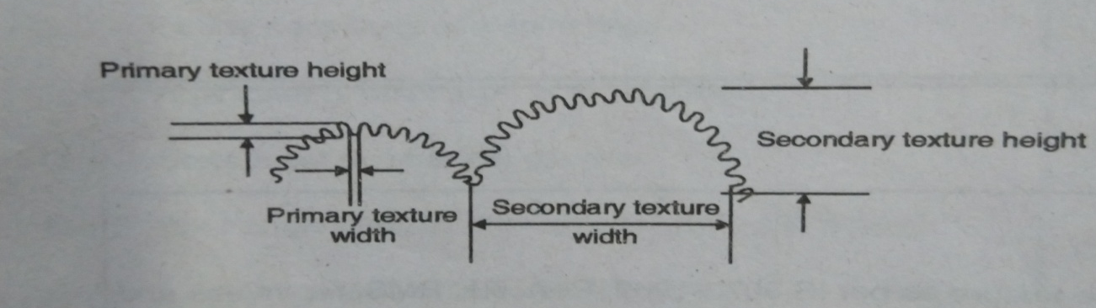
3.4a Primary & Secondary Texture
1. Primary Texture
Irregularities of small wavelength called primary texture.
These are caused due to :- direct action of cutting tool, friction, wear, corrosion, tool feed rate. These are also called as roughness.
2. Secondary Texture
Irregularities of considerable wavelength are secondary texture.
These are caused due to disturbance in set up, misalignment of centers, lack of straightness in guide ways, nonlinear feed motion, These are also called as waviness.

Slide 4
3.4b Terminology as IS 3073-1967
1.Texture:- Repetitive or random deviations from the nominal surface, which forms a pattern , is called as texture.
2. Flaws:- Flaws are irregularities which occur at one place or at infrequent
( like scratches, cracks etc.)
3. Center line:- The line about which roughness is measured is called as center line.
4. Sampling Length:- Sampling length is the length of profile necessary for evaluation of surface roughness.
5. Lay:- Lay is the direction of ‘predominant surface pattern’.

Slide 5
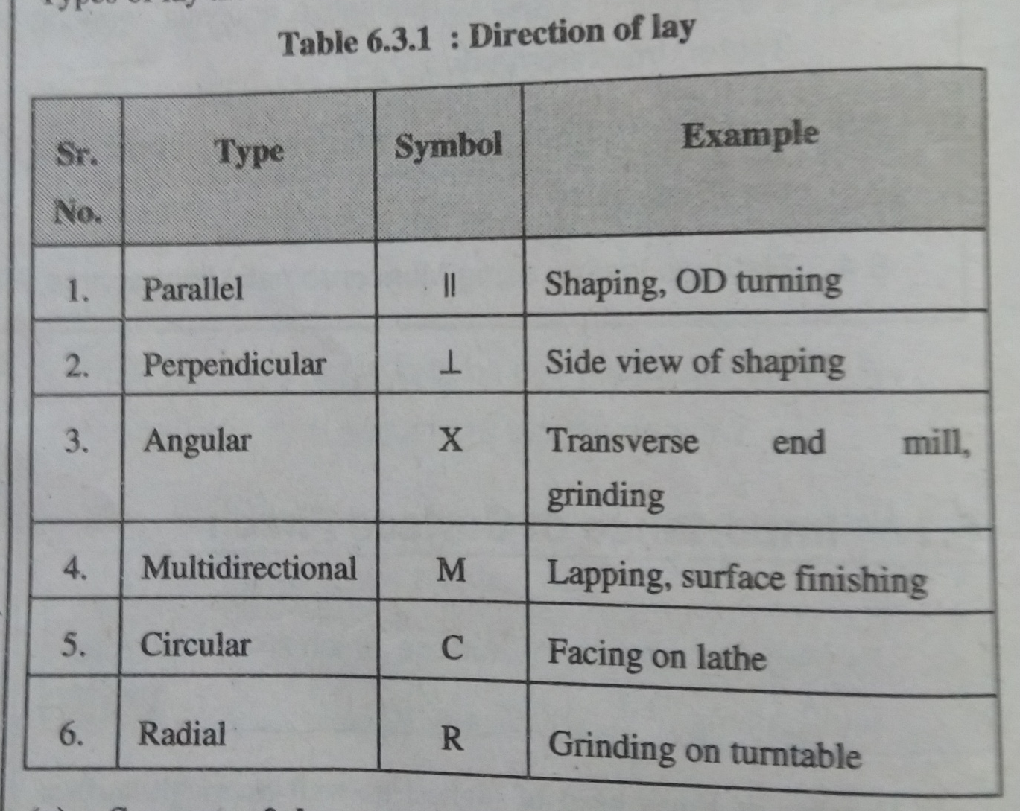
3.4b Terminology as IS 3073-1967

Slide 6
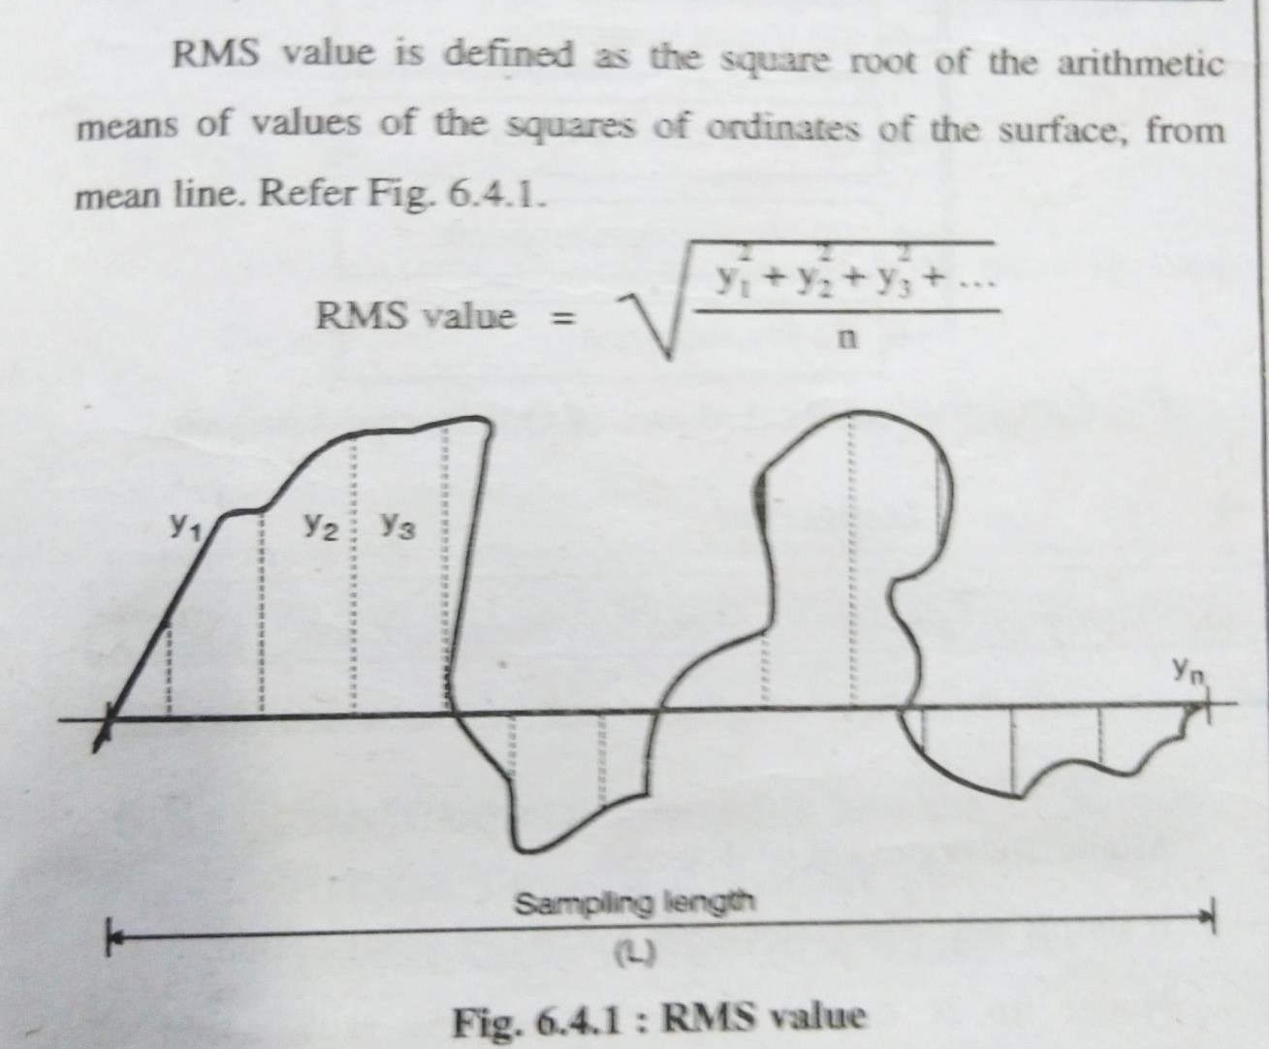
3.4b Terminology as IS 3073-1967
(RMS Value)

Slide 7
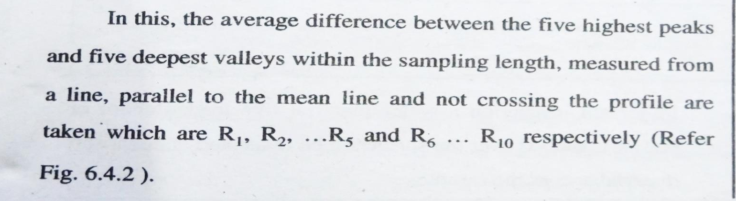
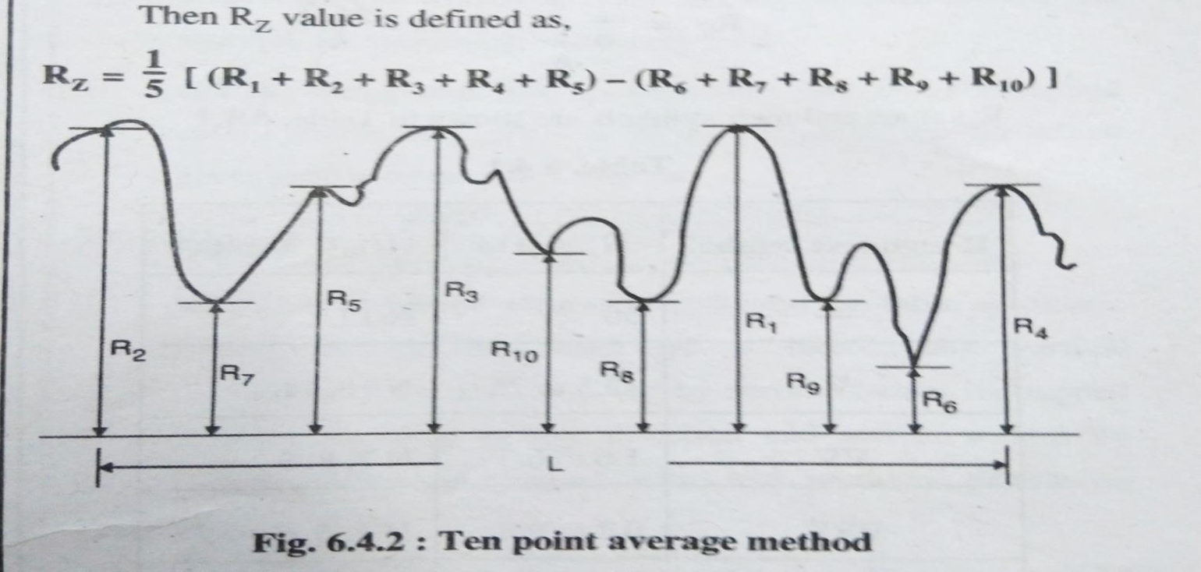
3.4b Terminology as IS 3073-1967
(Rz value)

Slide 8
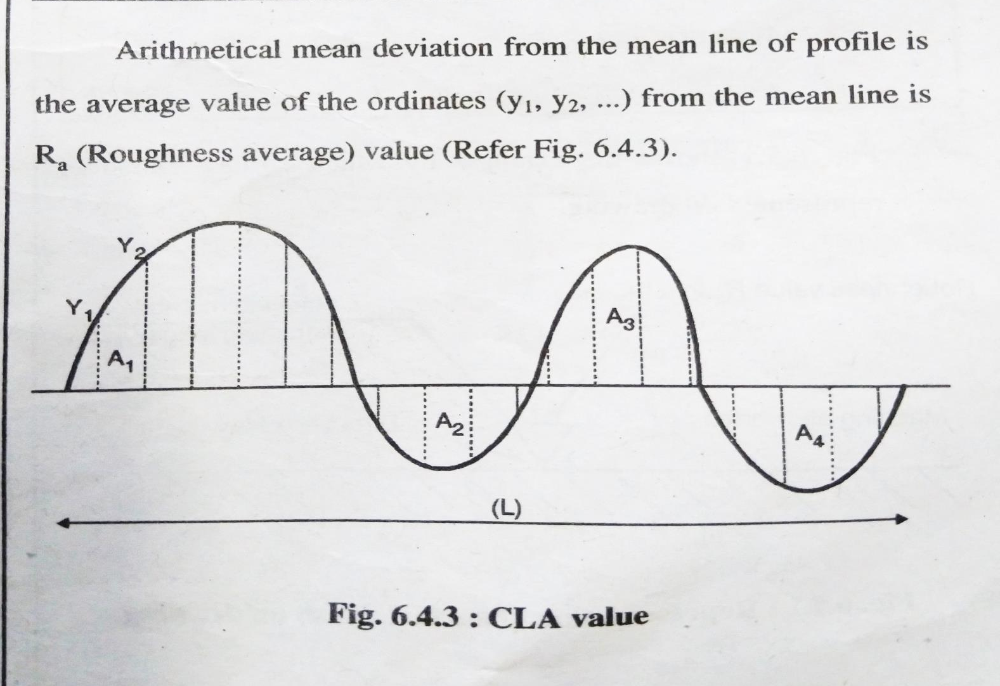
3.4b Terminology as IS 3073-1967
(CLA Value,[Ra Value])

Slide 9
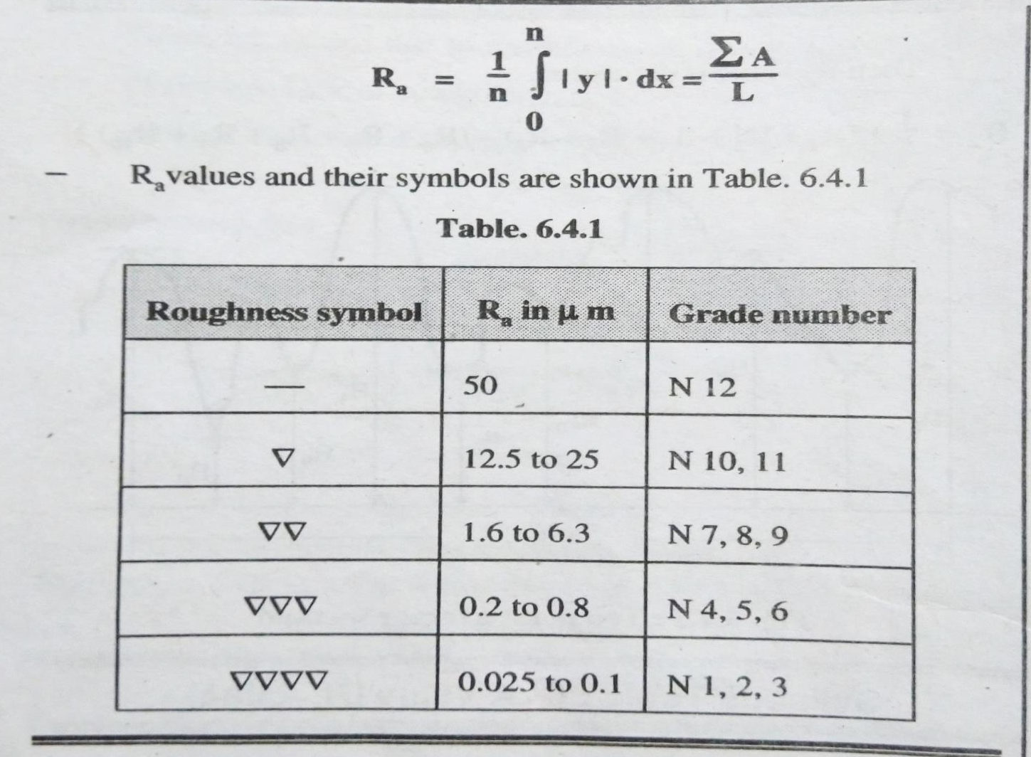
3.4b Terminology as IS 3073-1967
(CLA Value,[Ra Value])

Slide 10
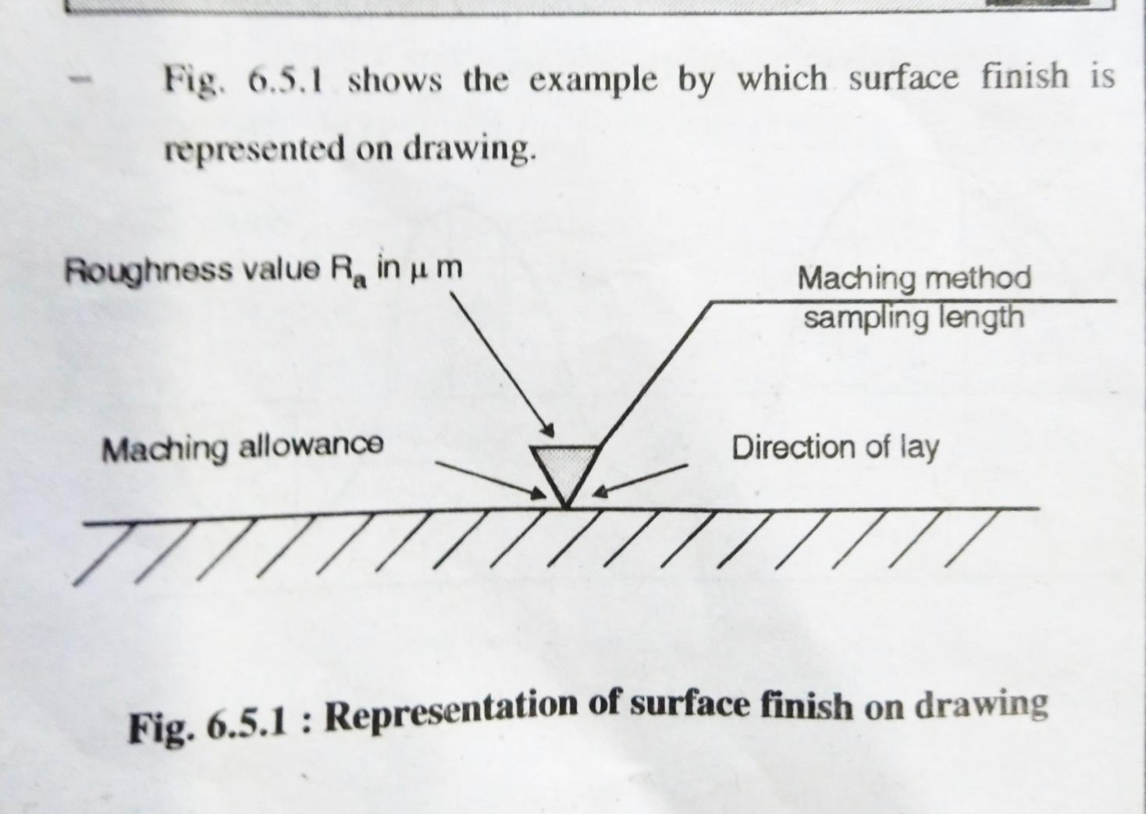
3.4b Terminology as IS 3073-1967

Slide 11
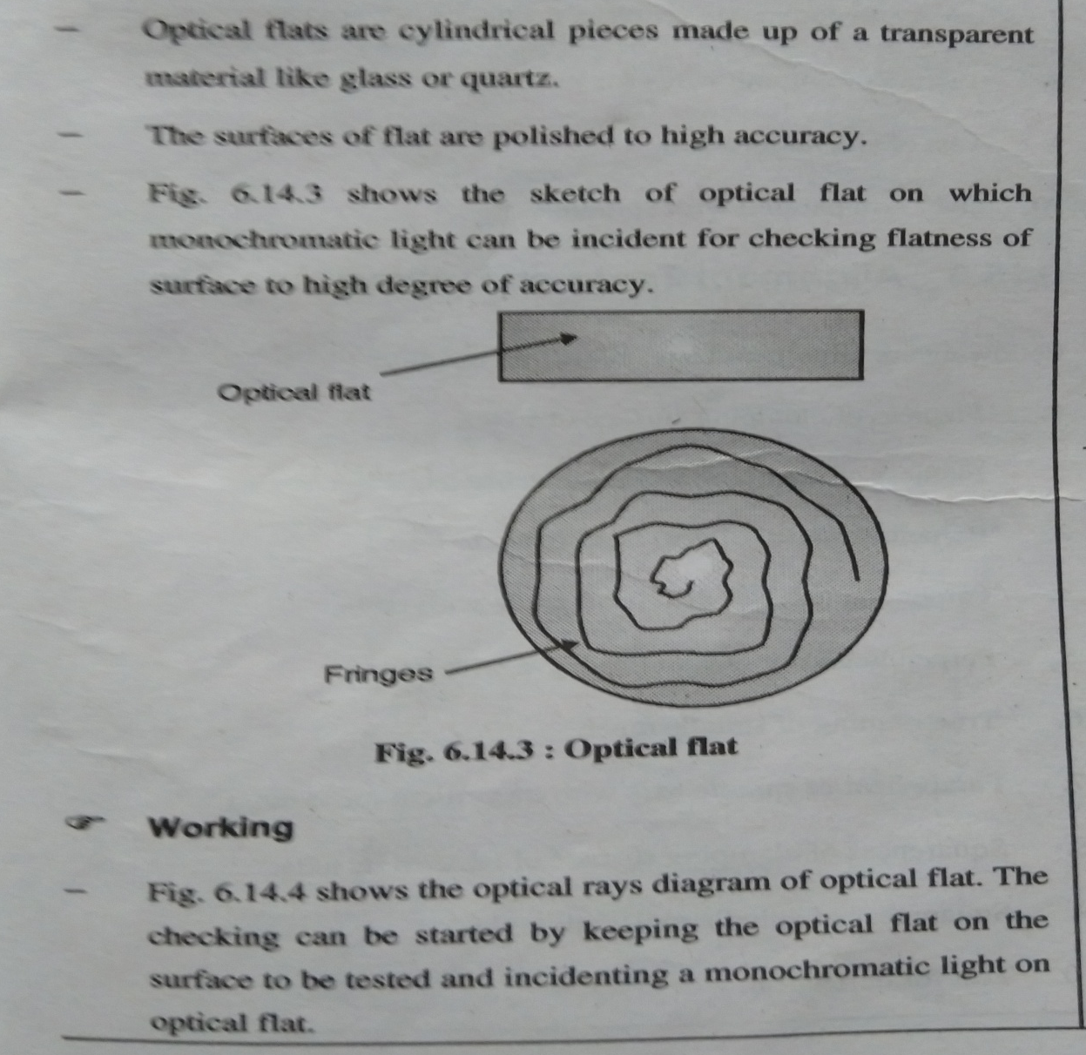
3.4c Principle of Interferometry

Slide 12
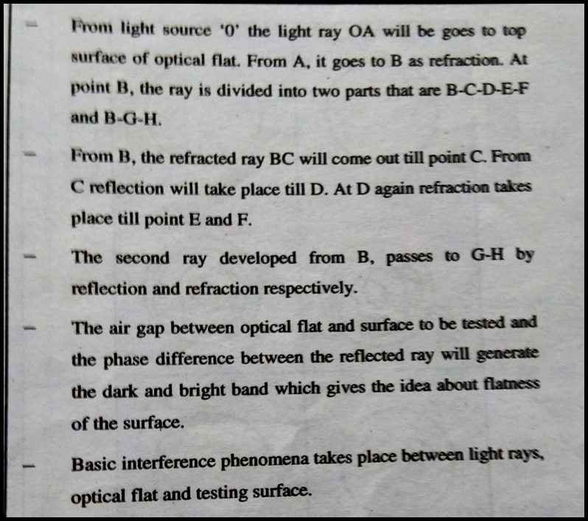
3.4c Principle of Interferometry

Slide 13
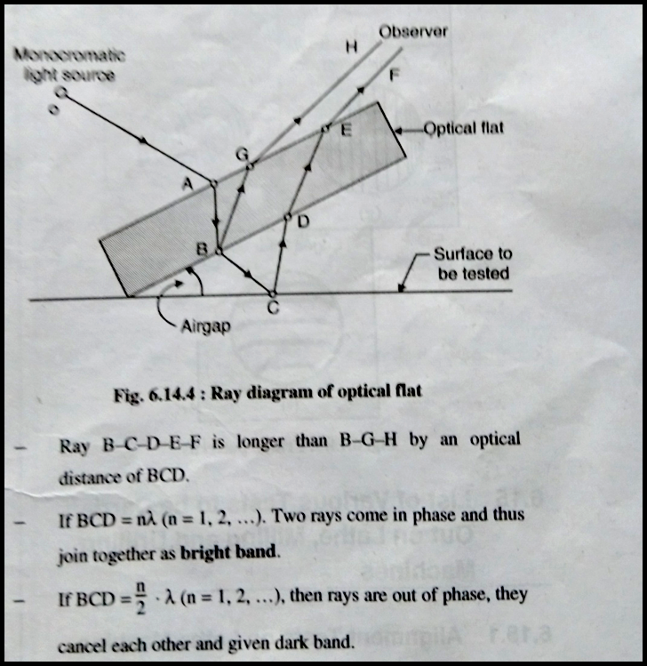
3.4c Principle of Interferometry

Slide 14
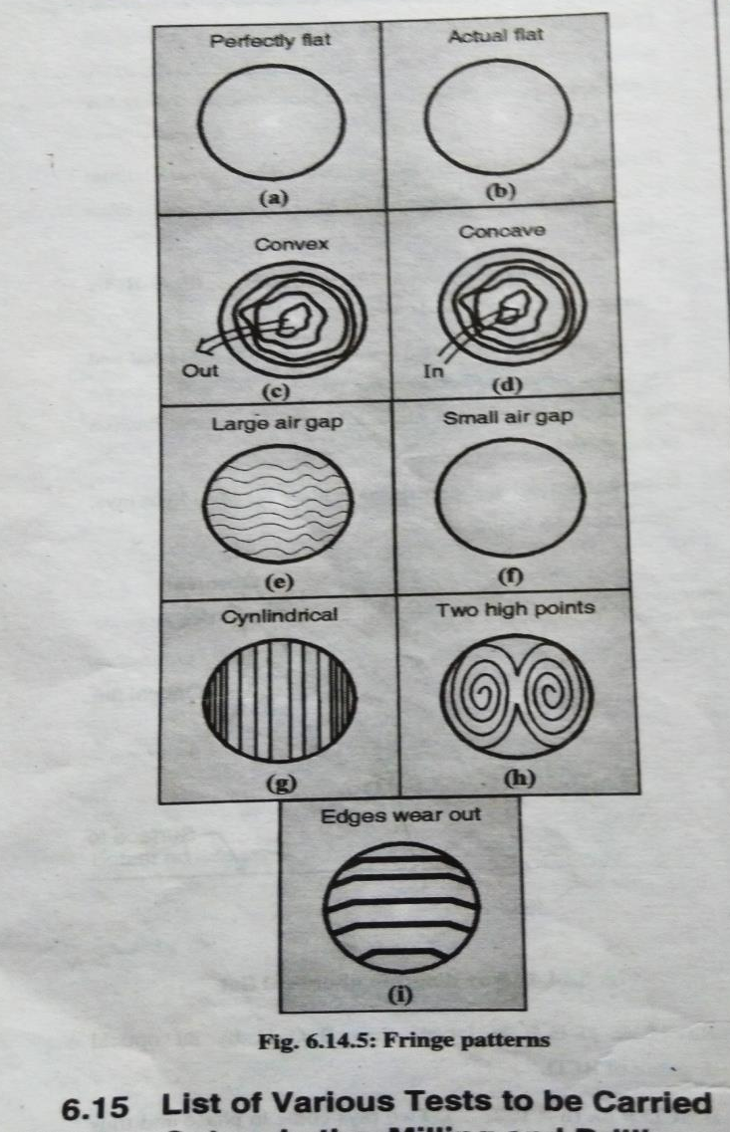
3.4c Principle of Interferometry

Slide 15
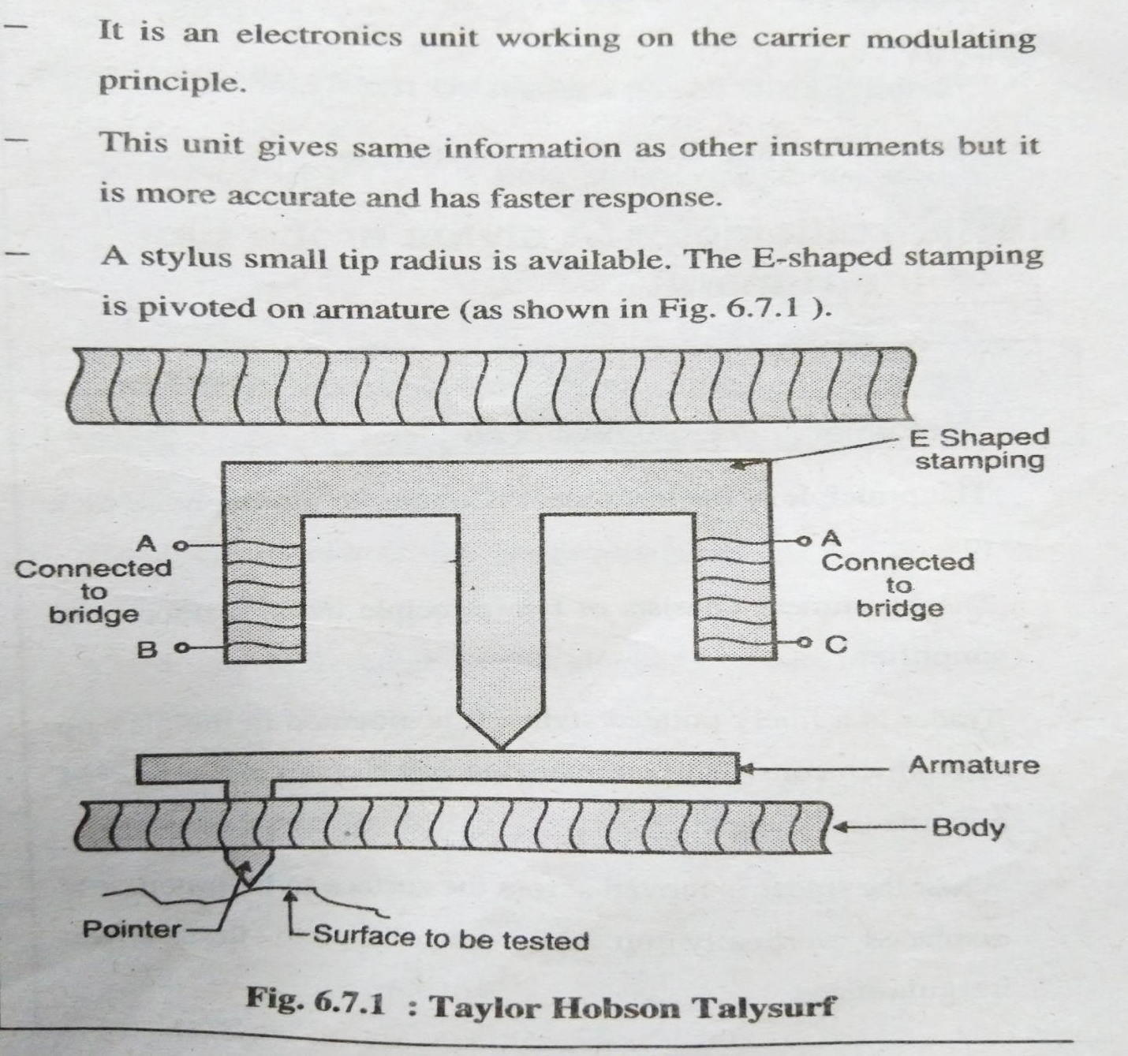
3.4d Taylor Hobson Talysurf

Slide 16
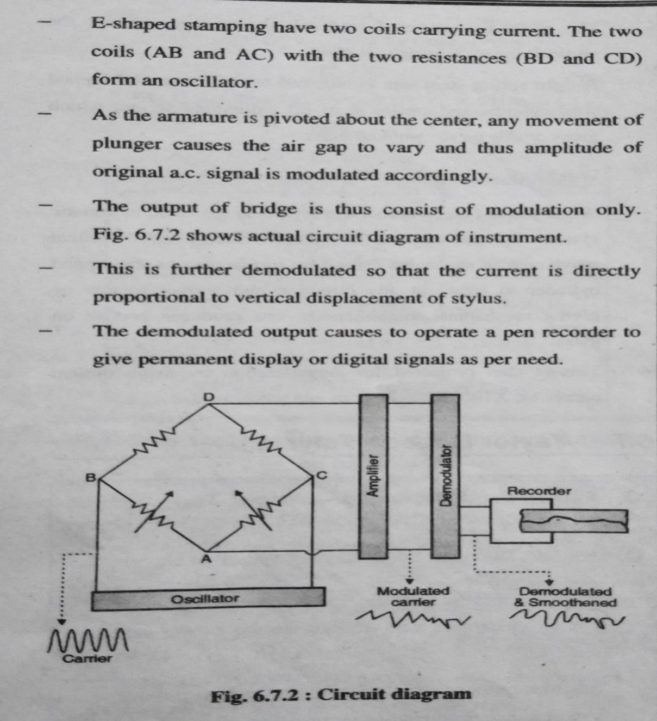
3.4dTaylor Hobson Talysurf

Slide 17
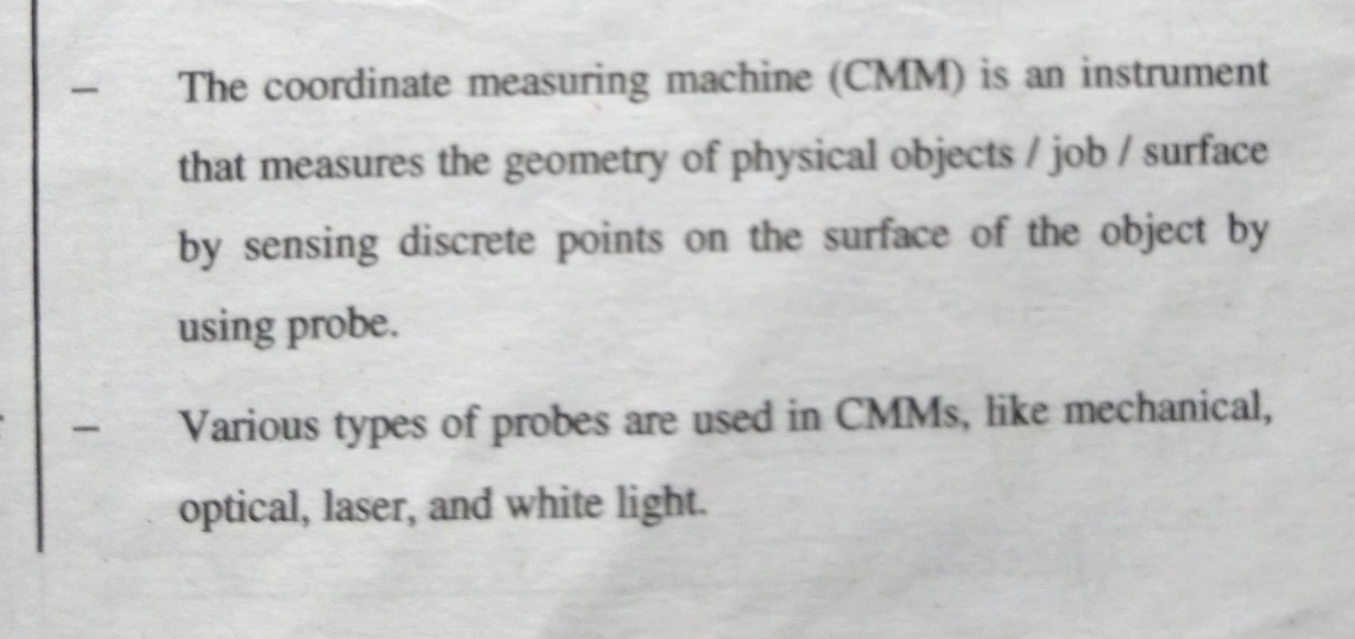
3.4e Introduction to CMM

Slide 18
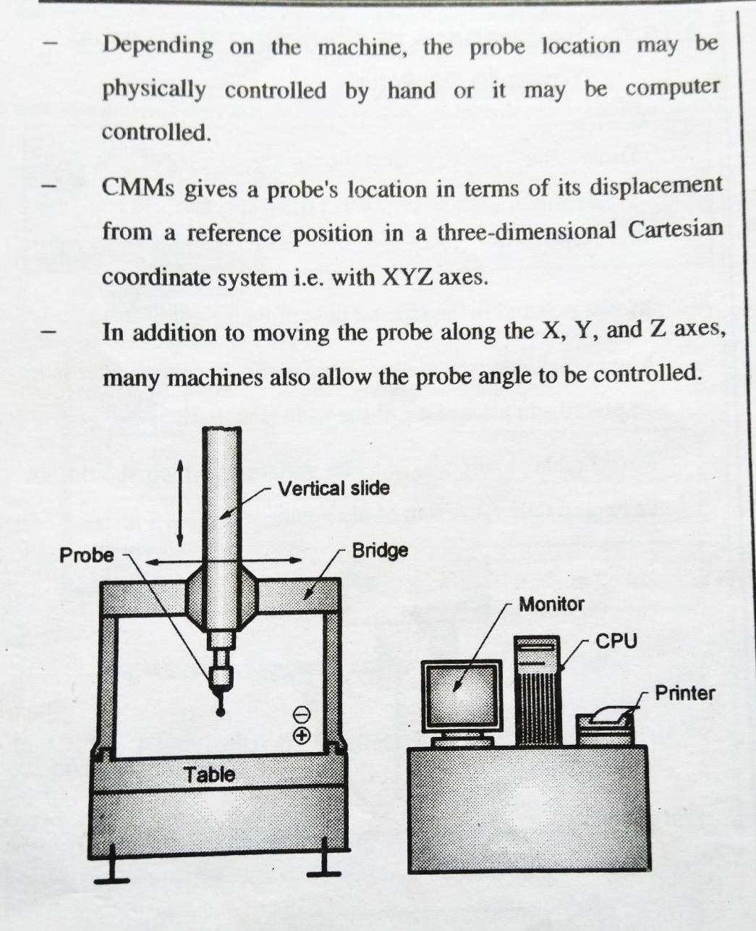
3.4e Introduction to CMM

Slide 19
3.4e Introduction to CMM
Merits of CMM
Accuracy: CMMs can produce precise measurements, even in nanometers.
Repeatability: CMMs can produce consistent measurements, which reduces variability.
Efficiency: CMMs can reduce production time by automating the inspection process.
Quality assurance: CMMs can eliminate human error and ensure that parts are manufactured to the correct specifications.
Versatility: CMMs can measure complex shapes and surfaces that are difficult to assess with other tools.
Traceability: CMMs produce digital records of measurements, which are important for quality documentation.
Non-destructive testing: Some CMMs use non-contact measurement techniques, such as lasers and cameras.

