Slide 1
Unit No. 3b Angular, Screw thread, Gear & Surface finish measurement
By :- Prof. Y.J. Potdar
Mechanical Engineering Department
YTC, Satara

Slide 2
Screw thread measurement
Screw threads are mostly used in all components of machine tools/ assemblies.
Function of screw thread is to transmit power
and motion and to act as a fasteners.
Different types of screw threads are available
and are shown in figure.

Slide 3
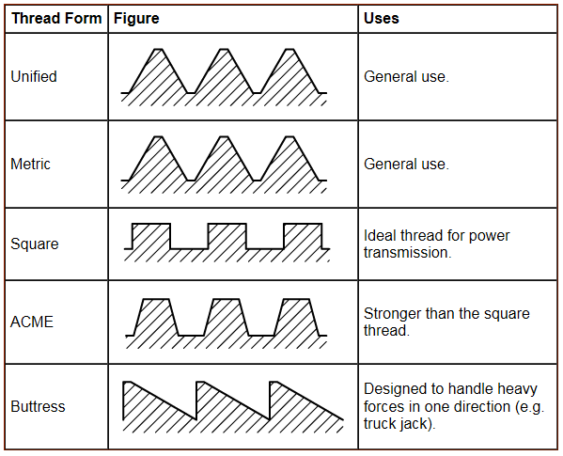
Screw thread measurement
Types of Screw Threads

Slide 4
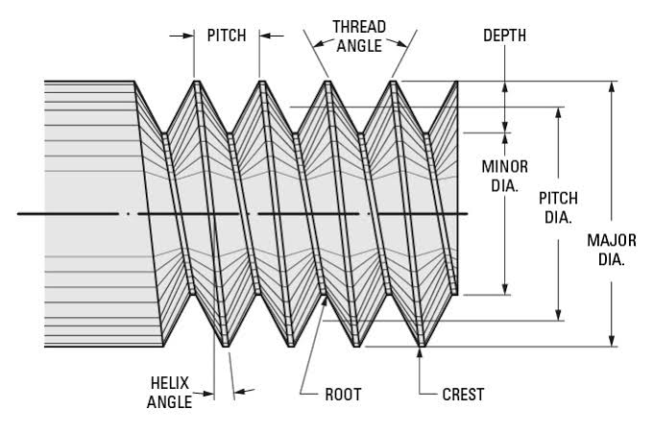
3.2a Screw Thread Terminology

Slide 5
4.1a Screw Thread Terminology
Pitch :- Pitch is the distance measured parallel to the axis between two consecutive points on adjacent threads.
Lead :- Distance advanced by the thread axially in one revolution is lead.
Flank angle (θ):- The angle between individual flank and a line perpendicular to the axis of thread
measured in axial plane is called as flank angle.

Slide 6
3.2a Screw Thread Terminology
Thread angle (α):- Angle between two adjacent flank measured in axial plane is called as thread angle.
Helix angle (β):- The angle made by helix of a thread with axis of thread is called as helix angle.
Major diameter (Dmaj) :- It is a diameter of imaginary cylindrical co-axial with screw which makes the continuous helical contact at the crests of the screw or roots of the nut.

Slide 7
3.2a Screw Thread Terminology
Minor diameter (Dminor) :- It is the diameter of an imaginary cylinder co-axial with screw which makes continuous with the root of the screw or crest of the nut.
Effective diameter :- Diameter of an imaginary co-axial cylinder which intersects the flanks of the threads such that the width of the thread and width of the space between threads are equal.

Slide 8
3.2b Working Principle of Floating Carriage Micrometer
Principle of Floating Carriage Micrometer
It works on principle of Nut & bolt/screw threads.
As drum of micrometer rotates by one revolution, it will move forward by one pitch of internal thread. The movement will be measured using number of divisions on drum and main scale i.e. micrometer principle.

Slide 9
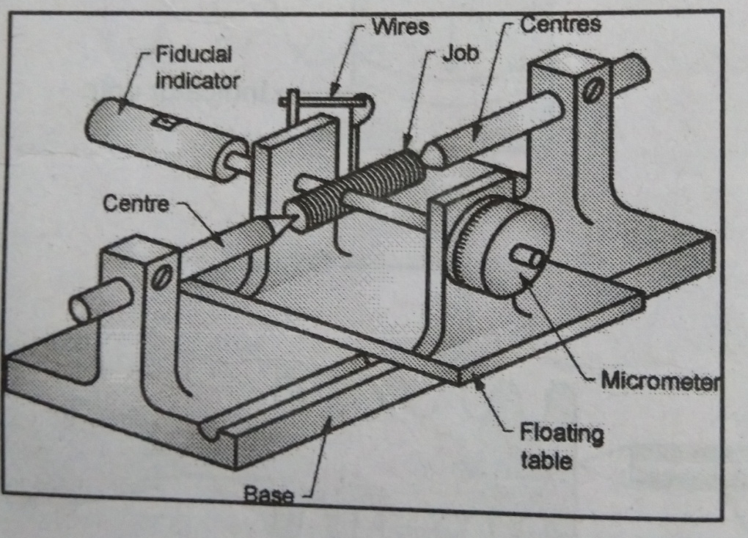
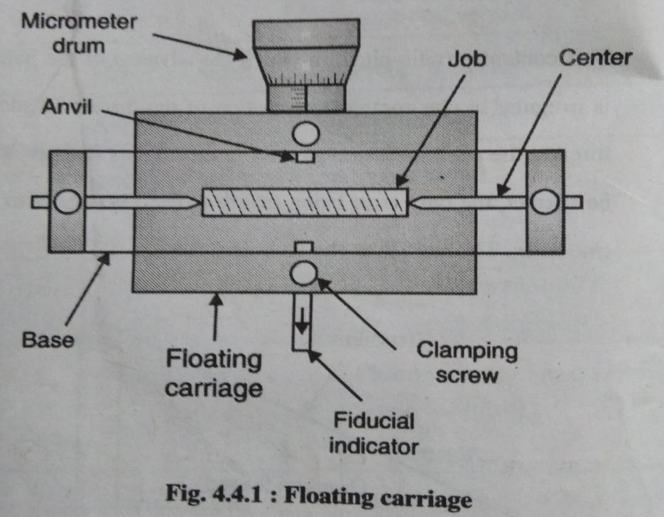
3.2b Working Principle of Floating Carriage Micrometer

Slide 10
3.2b Working Principle of Floating Carriage Micrometer
Figure shows floating carriage micrometer used for measurement of major diameter , minor diameter and effective diameter of screw thread. It consist of two centers maintained on the pillars of the base . The centers are used for fixing the job as shown in figure.
The floating body is kept on the base ,which has two pillars on it. One pillars consist of a micrometer drum having least count of 0.0002mm . The other pillar consists of a Fudicial indicator which senses the pressure applied on the anvil end.

Slide 11
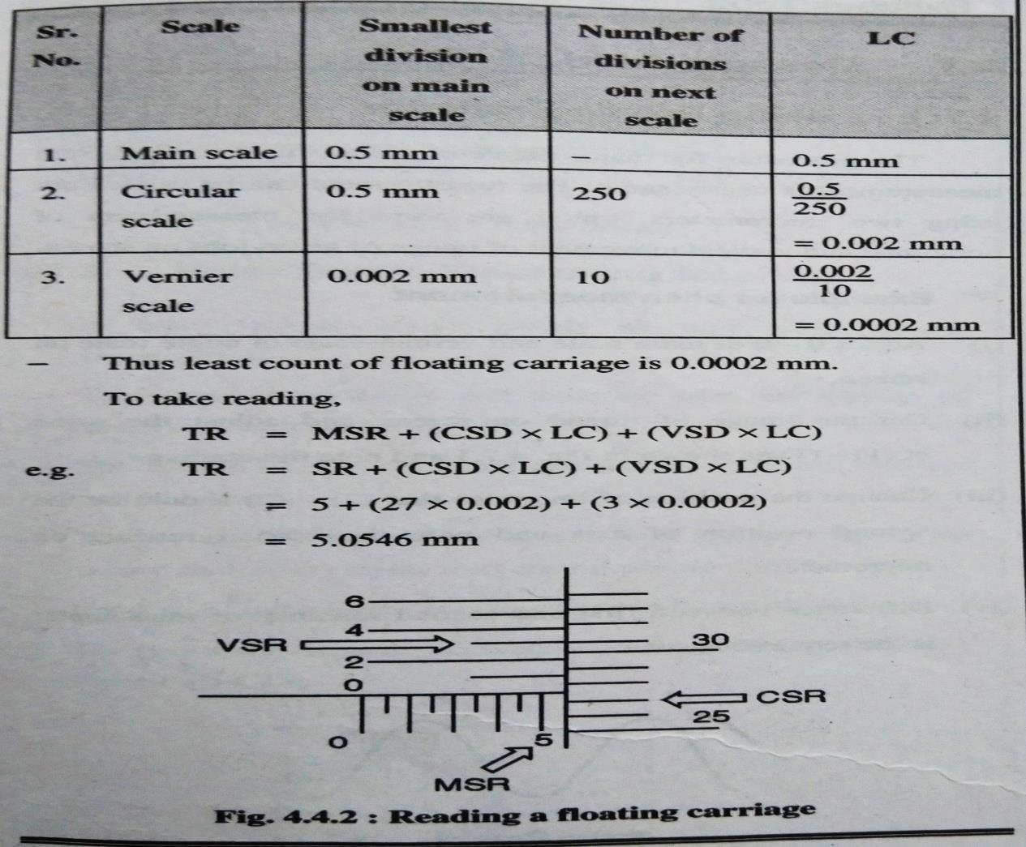
3.2b Working Principle of Floating Carriage Micrometer
Reading a Floating Carriage
Floating carriage has three scales viz. main scale, circular scale, vernier scale. LC of floating can be calculated by following process.

Slide 12
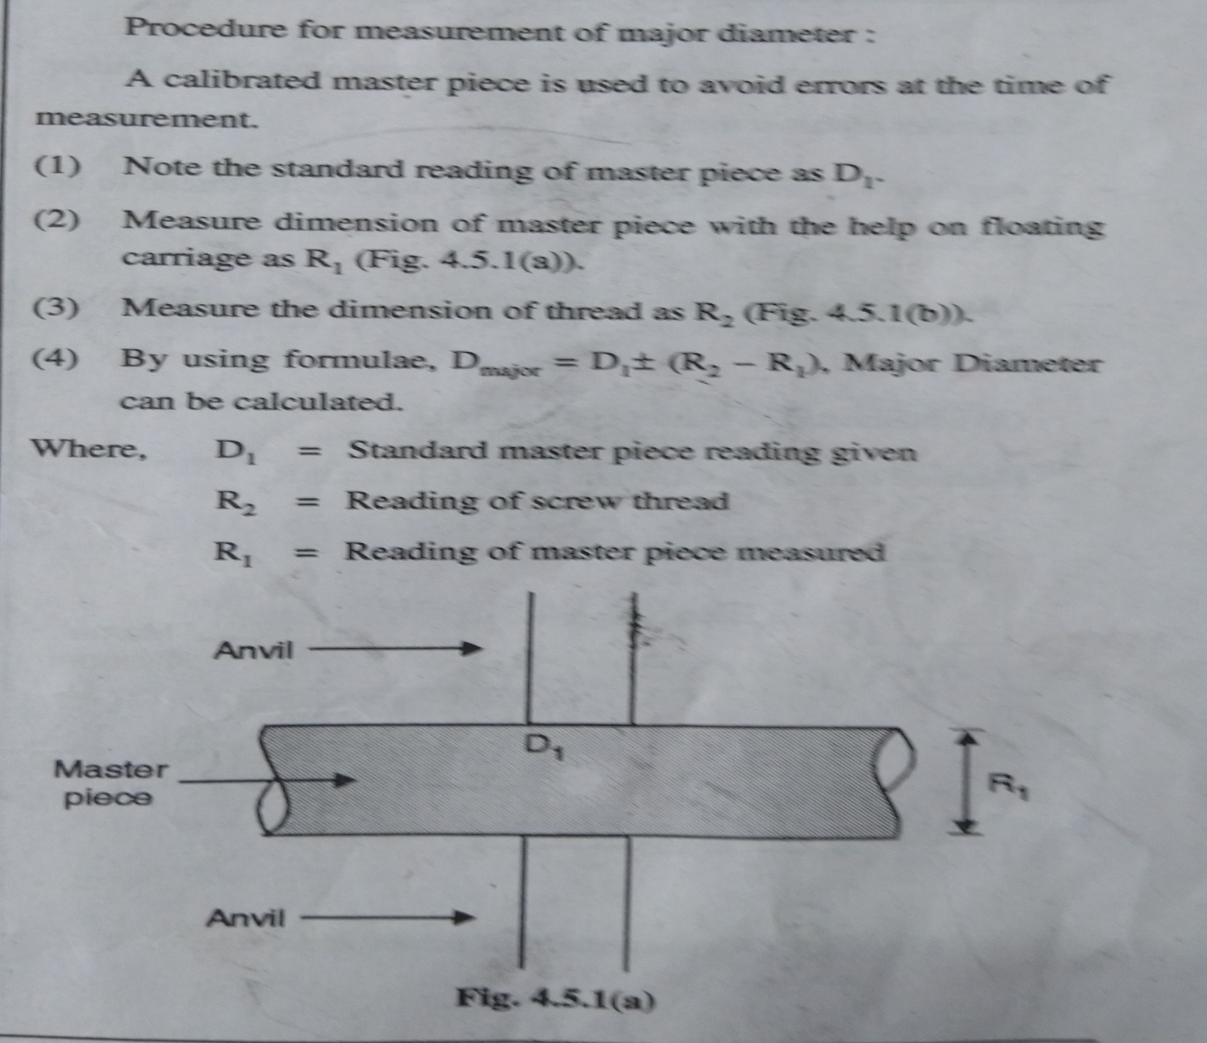
3.2 a Measurement of Major Diameter
Using Floating Carriage

Slide 13
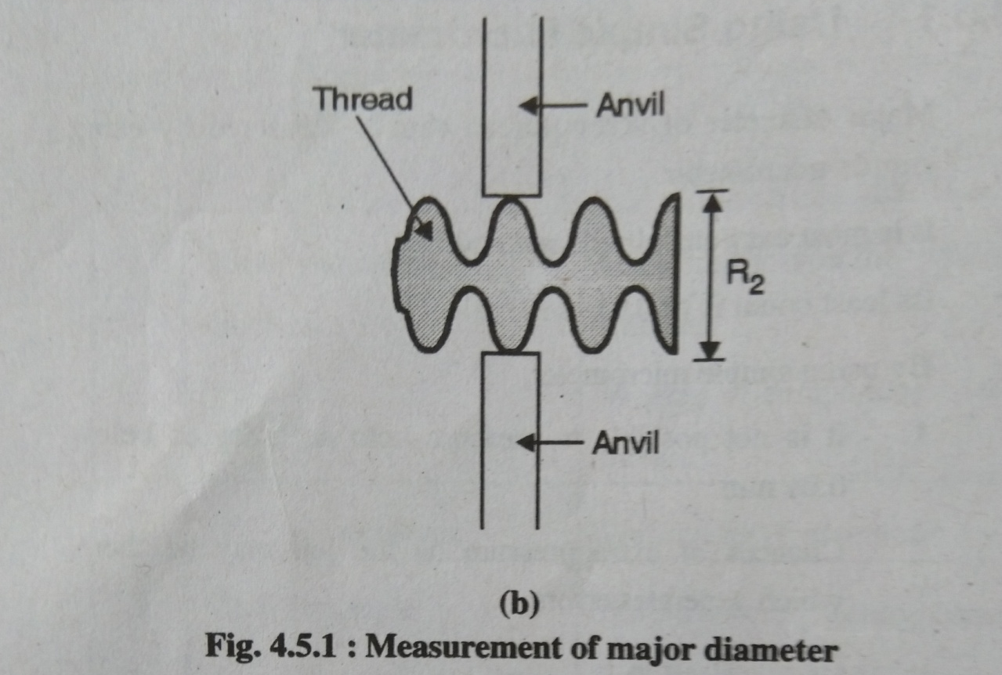
3.2. c Measurement of Major Diameter
Using Floating Carriage

Slide 14
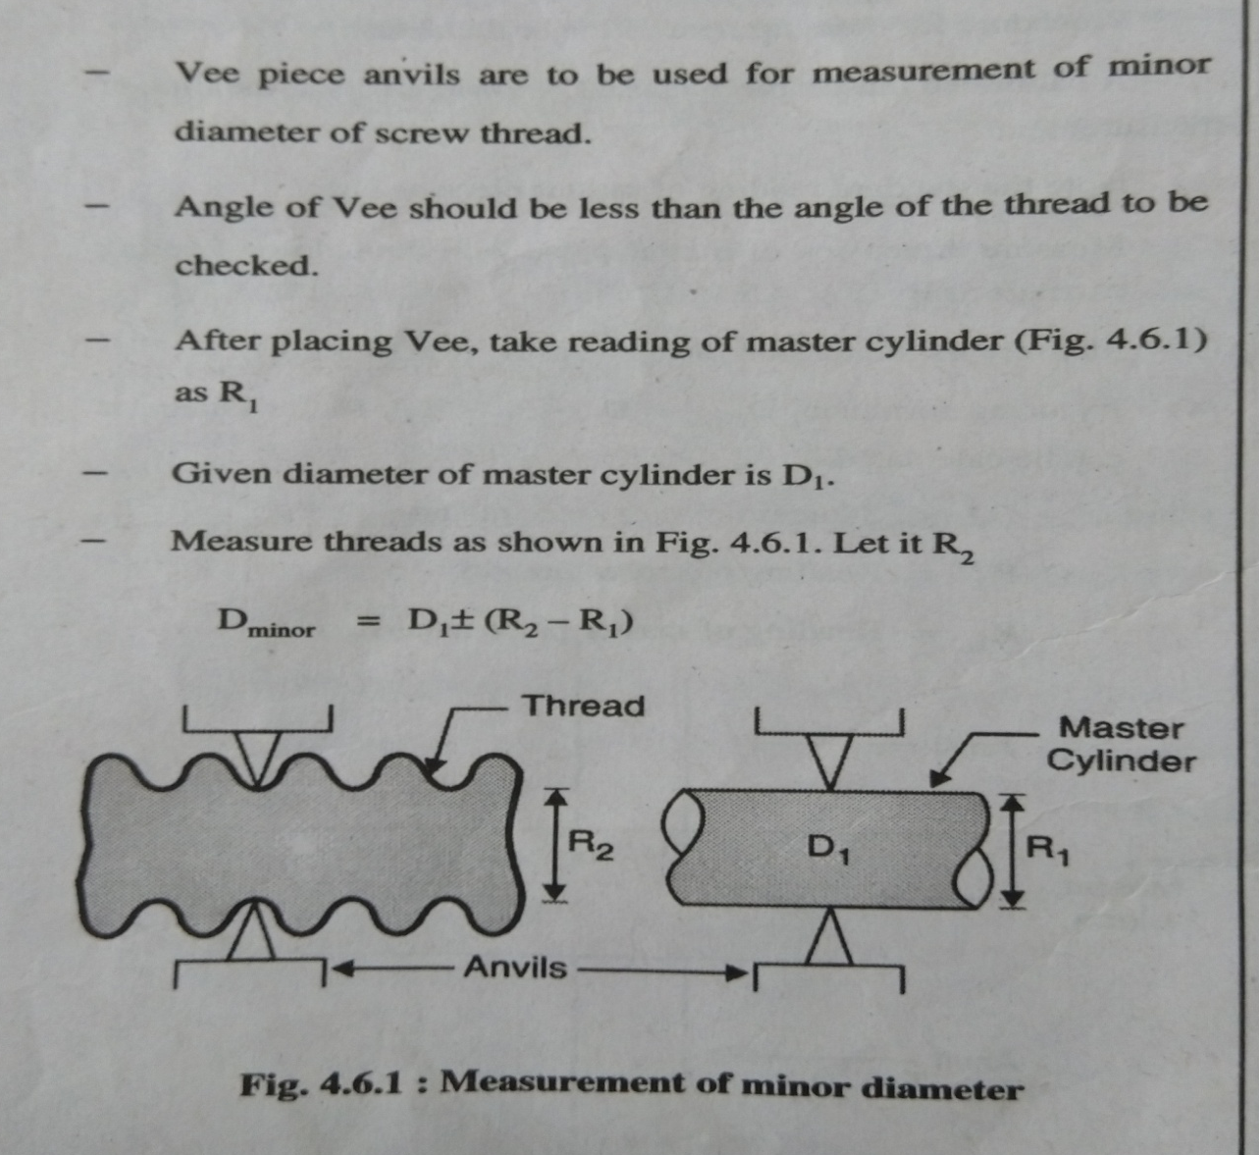
3.2 c Measurement of Minor Diameter
Using Floating Carriage

Slide 15
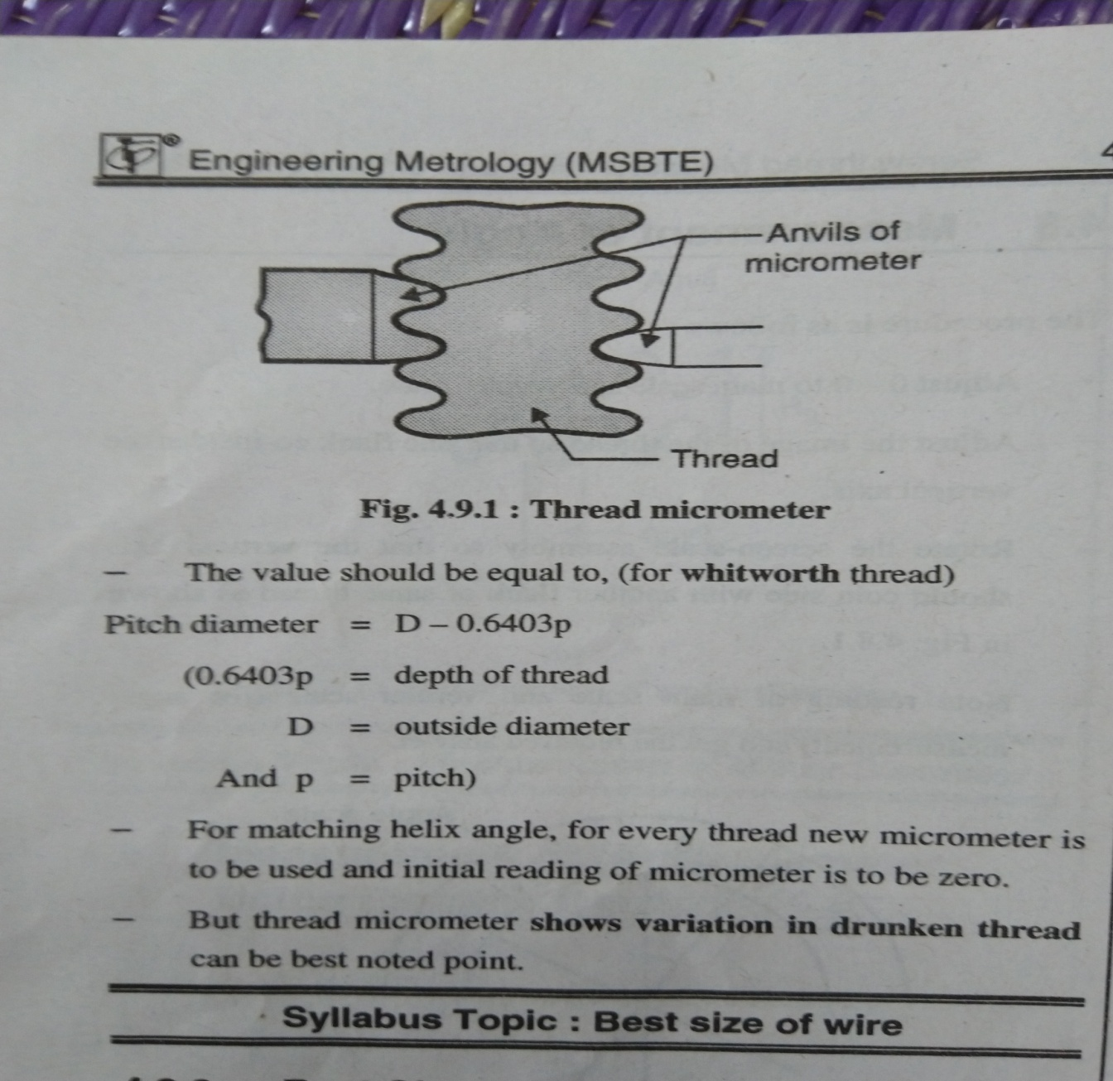
3.2 c i. Measurement of Effective Diameter
Using Thread Micrometer
It is like a simple micrometer, but anvils are of Vee shape. Care to be taken about flanks of thread should contact with Vees

Slide 16
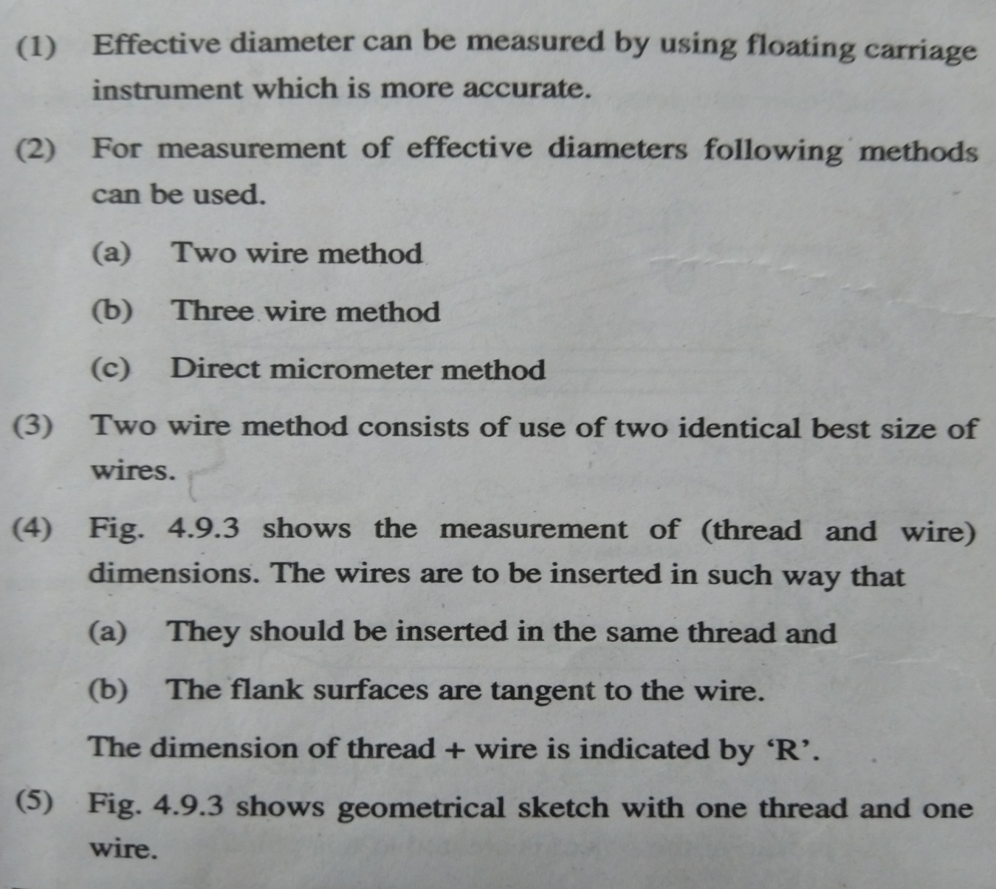
3.2 c ii. Measurement of Effective Diameter
Using Two Wire Method

Slide 17
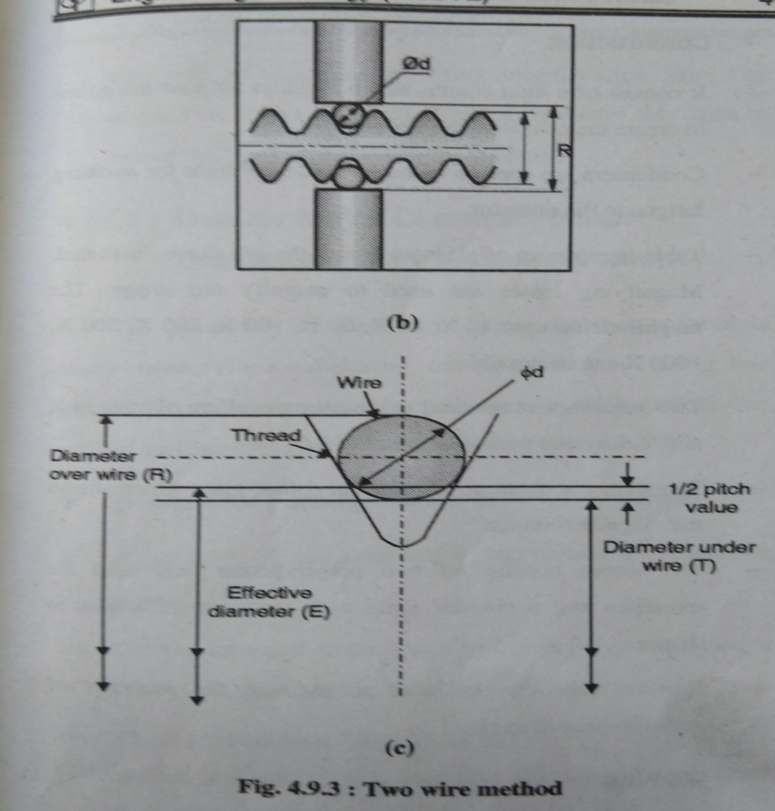
3.2 c ii. Measurement of Effective Diameter
Using Two Wire Method

Slide 18
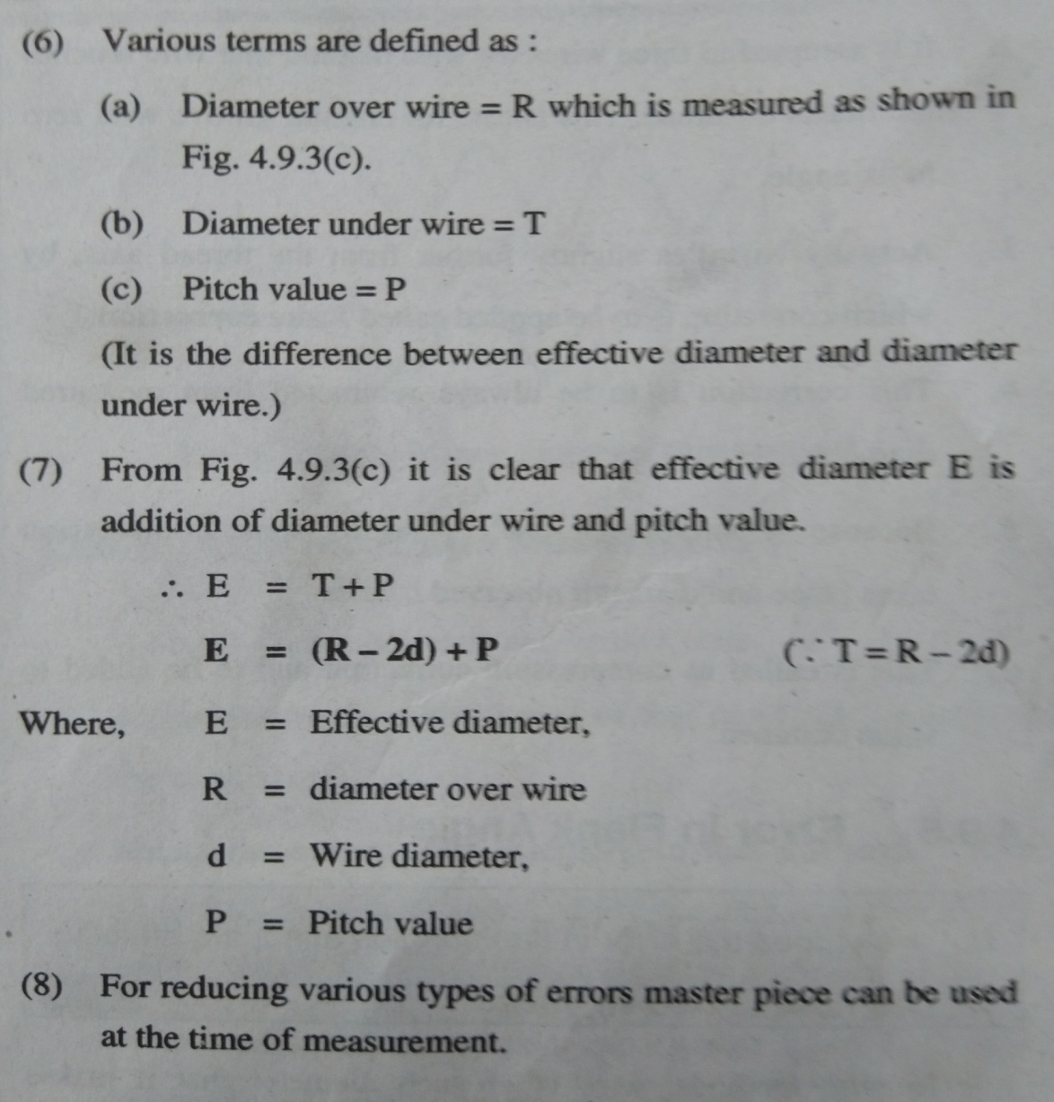
3.2 c ii. Measurement of Effective Diameter
Using Two Wire Method

Slide 19
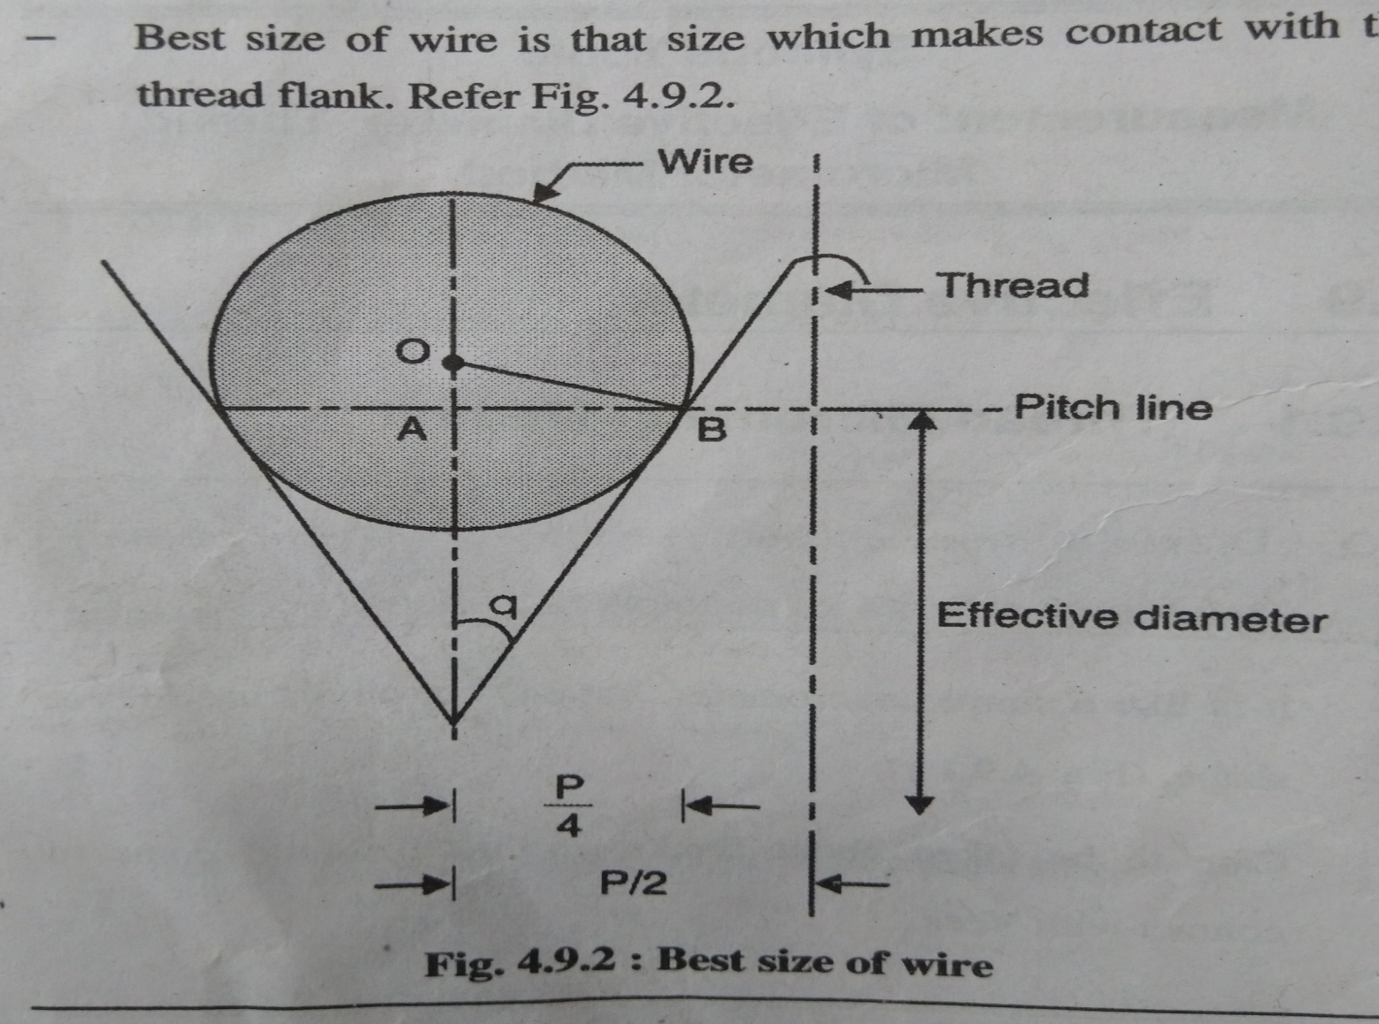
Best Size of Wire

Slide 20
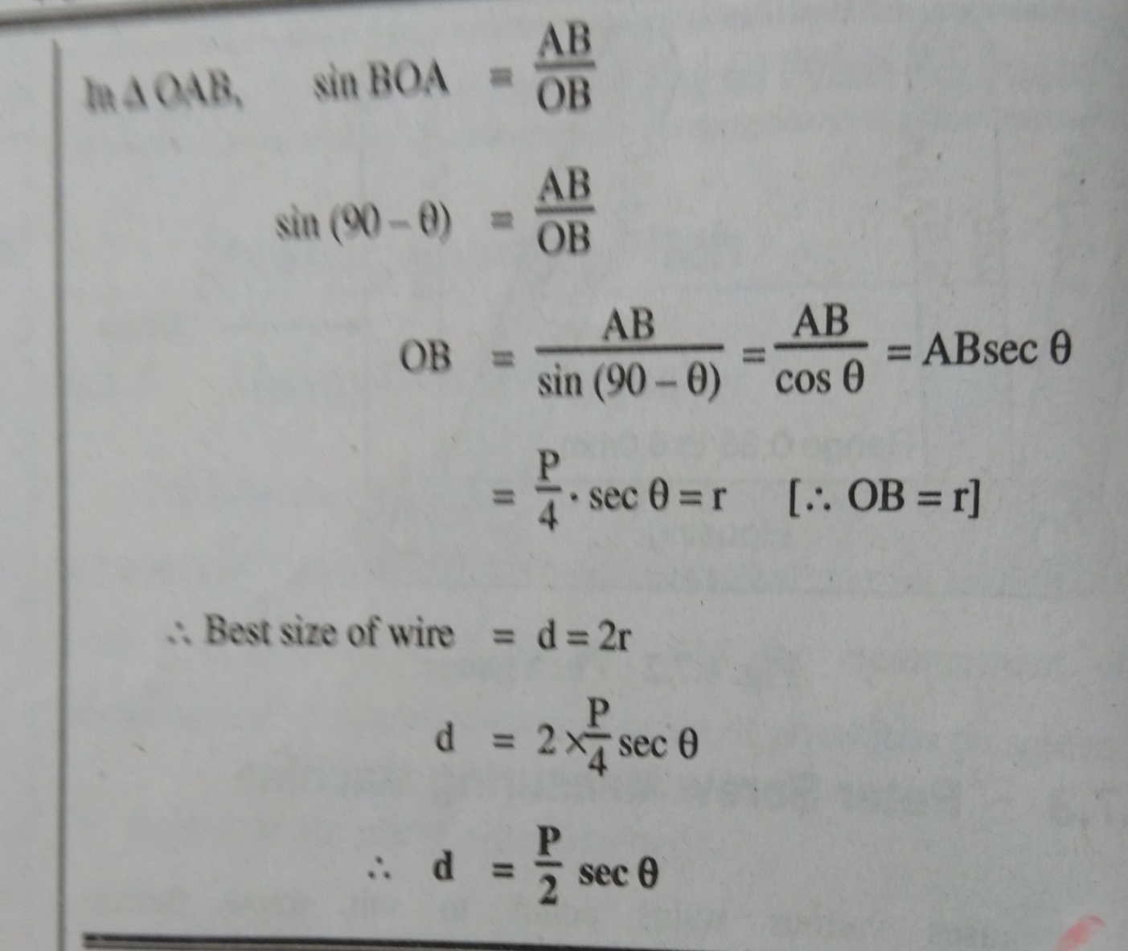
Best Size of Wire

Slide 21
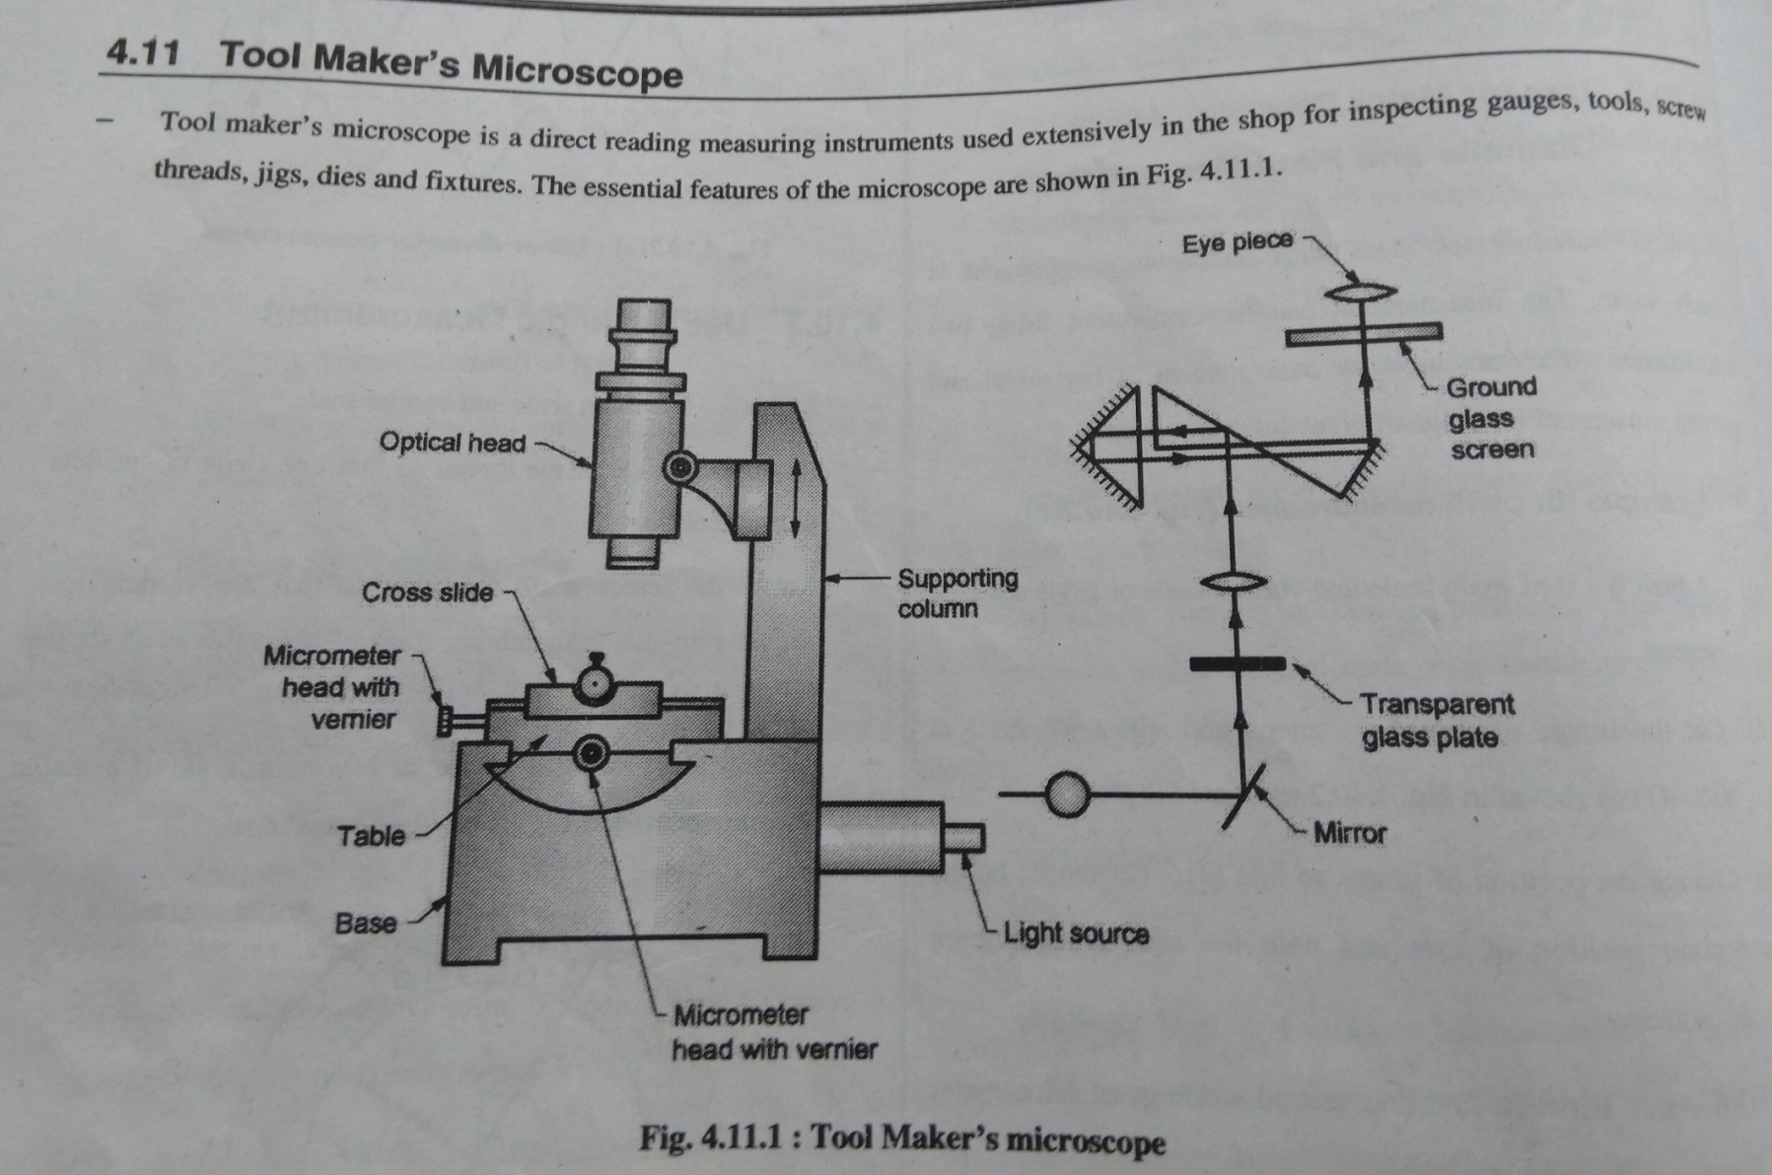
3.2d Tool Makers Microscope

Slide 22
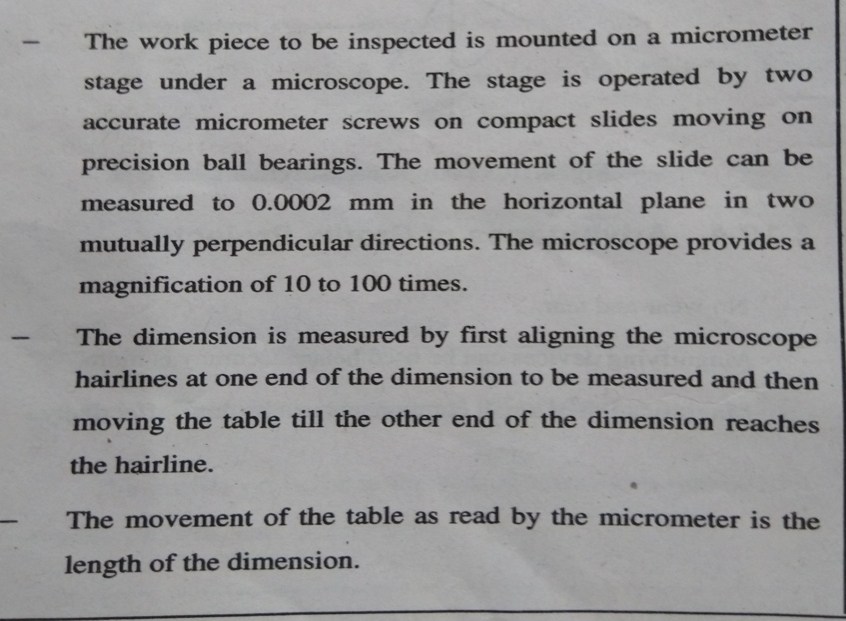
3.2d Tool Makers Microscope

Slide 23
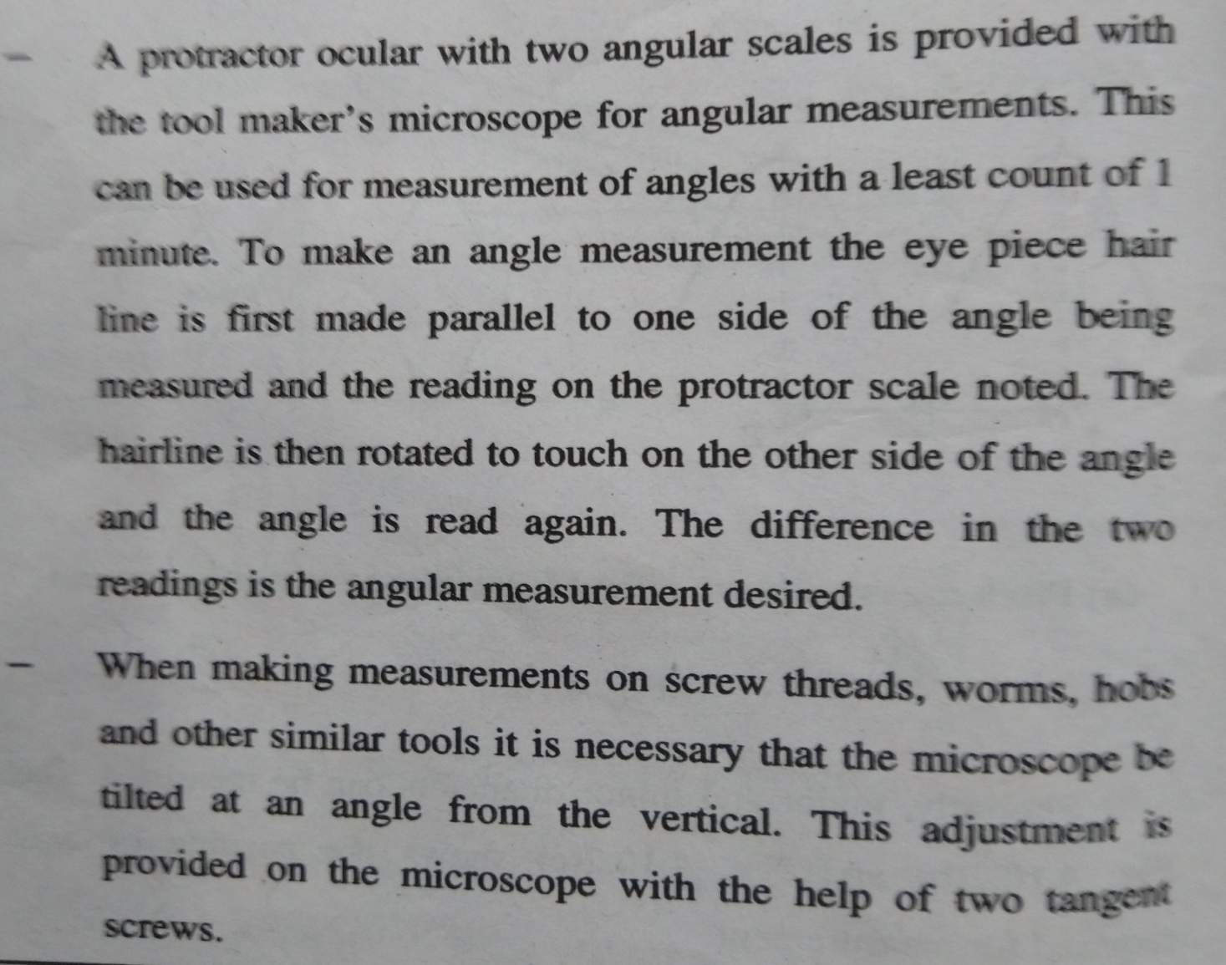
3.2d Tool Makers Microscope

Slide 24
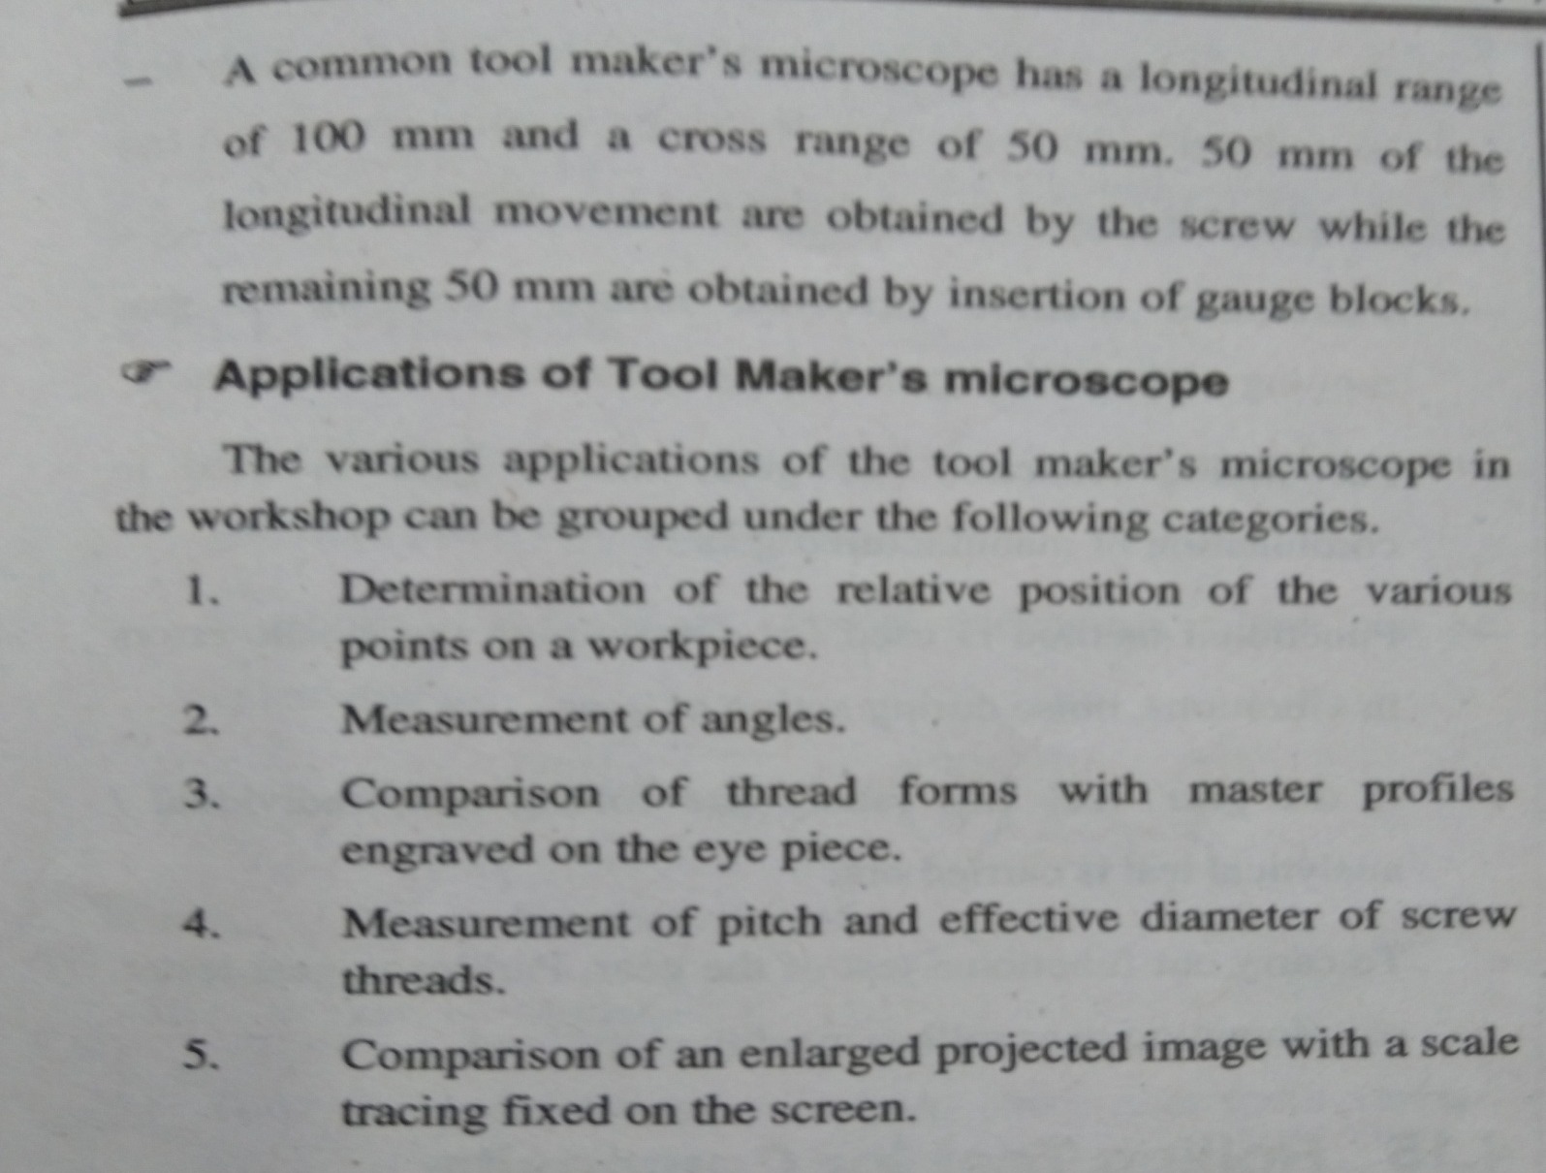
3.2d Tool Makers Microscope

