Slide 1
Unit .No.3a Angular, Screw thread, Gear & Surface finish measurements
By :- Prof. Y. J. Potdar
Mechanical Engg. Department,
YTC, Satara

Slide 2
3.1 Concept of Angular Measurement
The most important point to be noted for angle measurement is no need of absolute standard. The angle is defined as the opening between two lines which meet at a point.
The basic unit of angle measurement is right angle which is defined as the angle between two lines which intersect so as to make adjacent angles equal.
If circle is divided into 360 parts, each part is called degree (ο). Each degree is further divided into 60 parts called as minutes(‘) and each minute is divided in 60 parts called seconds ( ”).

Slide 3
3.1 Instruments for Angular Measurement
Following instruments are used for angle measurement.
1. Universal bevel protractor
2. Sine bar
3. Spirit level
4. Clinometers
5.Angle gauges
6. Autocollimator
7. Angle Dekkor

Slide 4
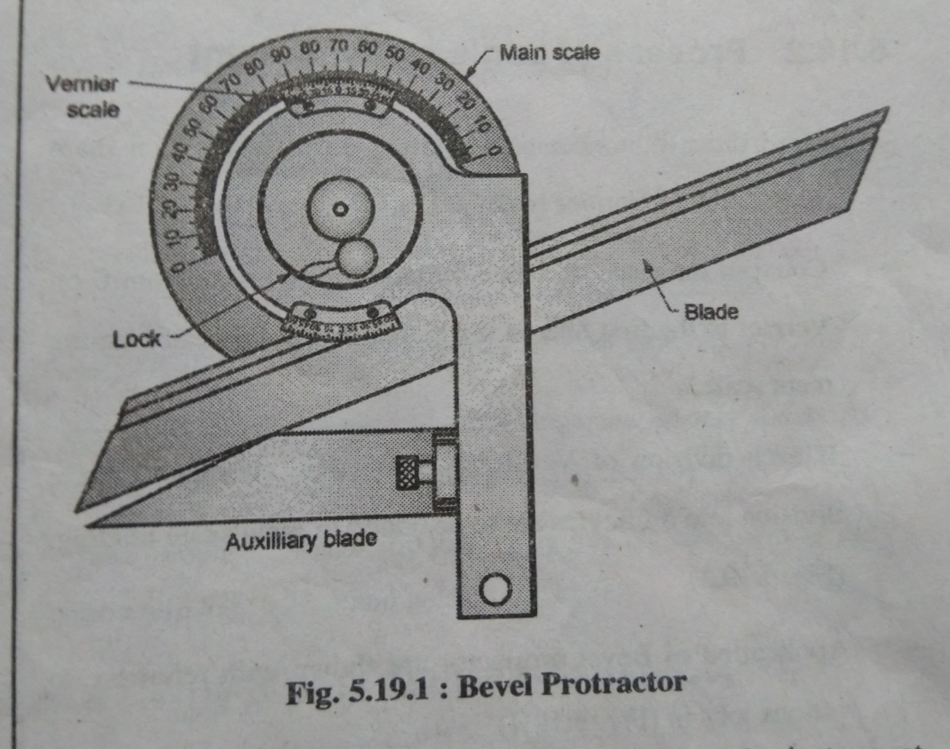
3.1a Bevel Protractor
Bevel Protractor is used for angle measurement as shown in fig.

Slide 5
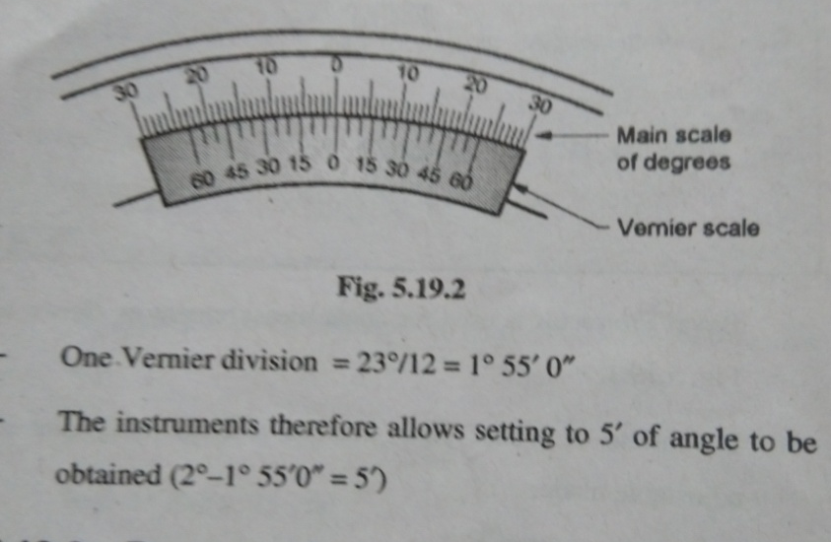
3.1a Bevel Protractor
It consists of a base plate attached to main body & an adjustable blade.
Adjustable blade can rotate about the center of the instrument & can be locked at a particular position. Acute angle attachment is also provided.
The instrument can measure from 0-360 deg. With least count 2’ to 5’.
Simple protractor measures angle in terms of degrees only.
Reading Vernier Protector
A vernier scale is provided with main scale. The main scale on the protractor is divided into degrees from 0 to 90 deg. each way.
A Vernier scale is divided up so that 12 of its divisions occupy the same space as 23deg. On main scale.

Slide 6
3.1a Bevel Protractor

Slide 7
3.1b Sine Bar
Sine bar is used for measurement of angle of given job or for setting an angle, sine bar is one of the famous instrument for angle measurement. It can be used in combination of slip gauge set & dial gauge for measurement of angle. It is made up of high carbon ,high chromium steel, & all the surfaces are grinded & lapped.
It is as shown in figure, which consists of two rollers of same diameters
fixed at a distance (L) between them , called as length of sine bar.

Slide 8
3.1b Sine Bar

Slide 9
3.1b Sine Bar Use for Small Job Measurement/Taper Plug Gauge

Slide 10
3.1b Sine Bar Use for Small Job Measurement/Taper Plug Gauge

Slide 11
3.1b Sine Bar Use for Big Job Measurement

Slide 12
3.1b Sine Bar
Why is sine bar limited below 45 degree?
Because of this sine bar is preferred for measuring angle below 45 degree.

Slide 13
3.1b Sine Bar
Care of Sine Bar
1. Proper length of sine bar is to be selected.
2. Sine bar should be free from dust, dirt etc.
3. Clamping of job should be done properly on sine bar while measuring.
4. While measuring angle , the slip gauge are to be wringed properly.
Limitations of Sine Bar
1. Used for angle measurement below 45 degree only.
2. Time consuming process of measurement.
3. Accuracy/grade of sine bar matters on accuracy of angle measured.

Slide 14
3.1c Angle Gauges

Slide 15
3.1c Angle Gauges

Slide 16
3.1c Angle Gauges

Slide 17
3.1c Angle Gauges

Slide 18
3.1c Difference between Angle Gauges & Slip Gauges

Slide 19
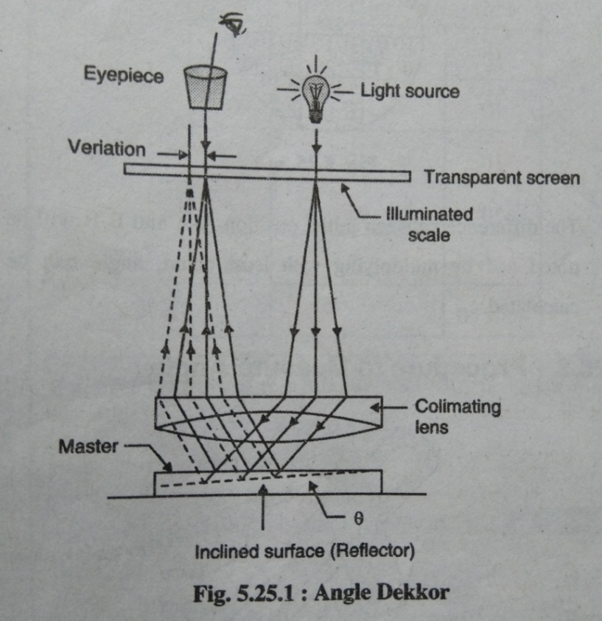
3.1d Angle Dekkor
Angle Dekkor uses light source, collimating lens, object or reflector & eyepiece in construction. Fig. shows angle dekkor

Slide 20
3.1d Angle Dekkor
Angle dekkor is an optical instrument used for measurement of small angle & angle difference. It is having very accurate approach.
Light source incidents light on the surface through transparent screen & collimating lens. The transparent screen is placed at the focal plane of objective lens. The reflected rays goes through the collimating lens & to eyepieces.

Slide 21
3.1d Angle Dekkor

Slide 22
3.1d Angle Dekkor

