Slide 1
Unit No.2
Gauges and Comparators
By :- Prof. Y. J. Potdar
Dept. of Mechanical Engineering
YTC , Satara

Slide 2
2.1 Comparators
Definition :- Comparator is a device which
1. Picks up small variation in dimension.
2. Magnifies it.
3. Displays it by using indicating devices
So that comparison be made with some standard value of dimension.
Requirements of good comparator
1. It should be compact.
2. It should be easy to handle
3. It should give quick response or quick result.
4. Its weight must be less.
5. It must be cheaper.
6. It must be easily available in market.
7. The design should be robust one.

Slide 3
2.1 Comparators
Classification of comparator
1. Mechanical comparator
It works on gears ,pinions, levers, linkages, springs etc.
2. Pneumatic comparator
It works on high pressure air, pressure difference, back pressure etc.
3. Optical comparator
It works on lens, mirrors, magnification, reflection, light source etc.
4. Electrical comparator
It works on step up, step down transformers, induction etc.
5. Electronics comparator
It works on amplifier, digital signal etc.
Uses of comparator
1. If components are to be checked at fast rate.
2. In mass production.
3. As a standards in laboratory.
4. For inspection of new jobs.
5. Can be used as working gauges.
6. To make subgroups during selective assembly of jobs.

Slide 4
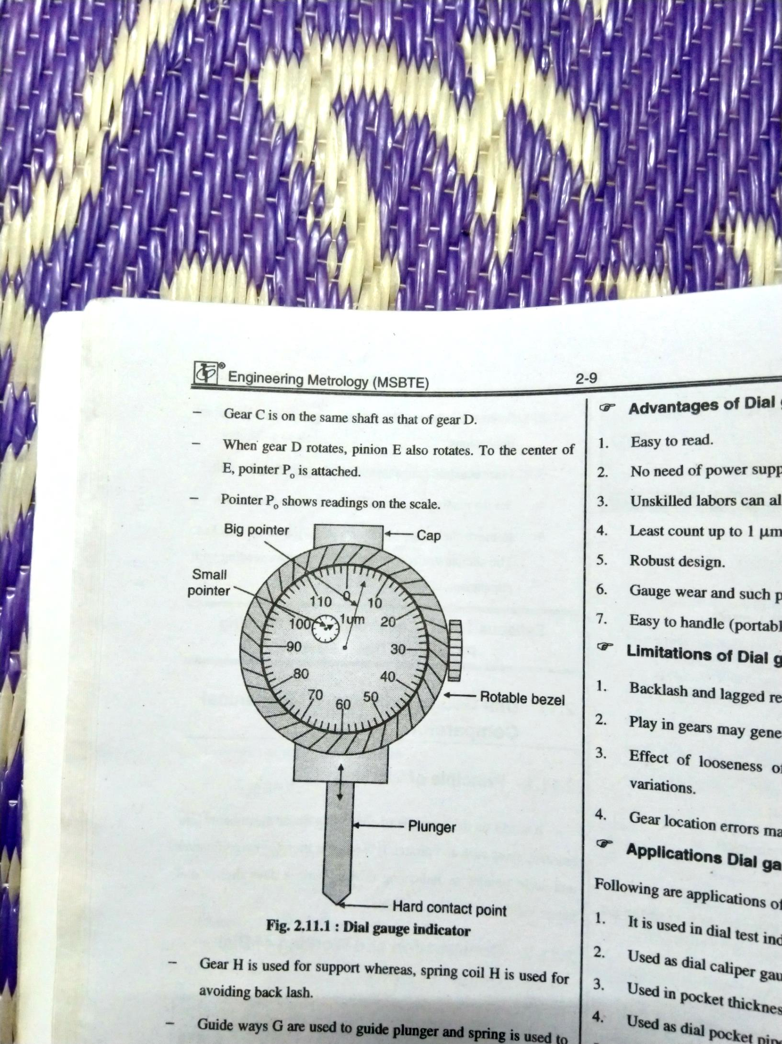
2.1 a Dial Indicator
Principle
It works on principle of converting linear movements into angular ,using rack and pinion. It uses gear train for magnification and scale pointer as indicating device.
Now a days digital dial indicators are also available.

Slide 5
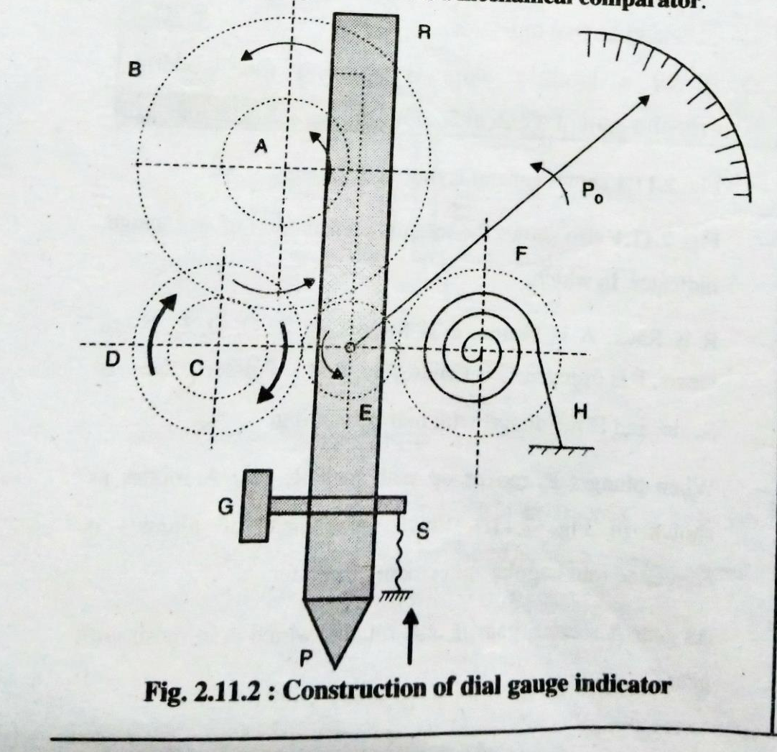
2.1 a Dial Indicator

Slide 6
2.1 a Dial Indicator
Construction and working of dial Indicator.
Fig. shows the internal construction of dial gauge indicator. In which R is rack, A is pinion, S is spring, A,B,C,D,E,F are gears, P is plunger, G is guide way, Po is pointer. Sc is the scale, H is the hair coil spring .
When plunger P, moves up with rack R, gear A rotates as shown in fig. Linear movement of plunger is converted into angular movement of pointer.
As gear A rotates, gear B also rotates, which is in mesh with gear C. Gear is on the same shaft. When gear D rotates, pinion E also rotates. To the center of E, pointer Po is attached.
Pointer Po shows readings on the scale.
Gear H is used for support whereas, spring coil H is used for avoiding backlash. Guide ways G are used to guide plunger and spring is used to maintain at O position when plunger movement is zero. Dial gauge indicator is mechanical comparator.

Slide 7
2.1a Dial Indicator
  Applications of dial Indicator.
1. It is used in dial test indicators.
2. Used as dial caliper gauges.
3. Used in pocket thickness gauge.
4. Used in dial venire unit.
5. Used as comparator in mass production.
6. Used in inspection and setting of job.
7. Used for alignment of various tools.
8. Used in Parkinson’s gear tester.

Slide 8
2.1a Dial Indicator
Advantages
Disadvantages
Easy to read
No Need of power supply
Unskilled labors can also use it
Least count up to 1um is available
Robust design
Easy to handle
Backlash error may be occurred
Play in gears may generate errors
Effect of looseness of measuring spindle guide may give variation
Gear location errors may leads to errors

Slide 9
2.1b Pneumatic Comparator
Construction of Pneumatic Comparator
Pneumatic comparator uses high pressure air, from compressor. High pressure air pipe is connected to gauging head. The gauging head can be replicable and used as per requirement of inspection of different jobs.
The high pressure air will be passing through air filter, to make it dust free. Simple manometer is used to measure backpressure generated in the system. Orifice is used to measure backpressure generated in the system.
Orifice is used in a pipeline between dip tube and avoiding backpressure to be discharged to compressor line.
Dip tube and manometer is used in water tank as shown in fig.

Slide 10
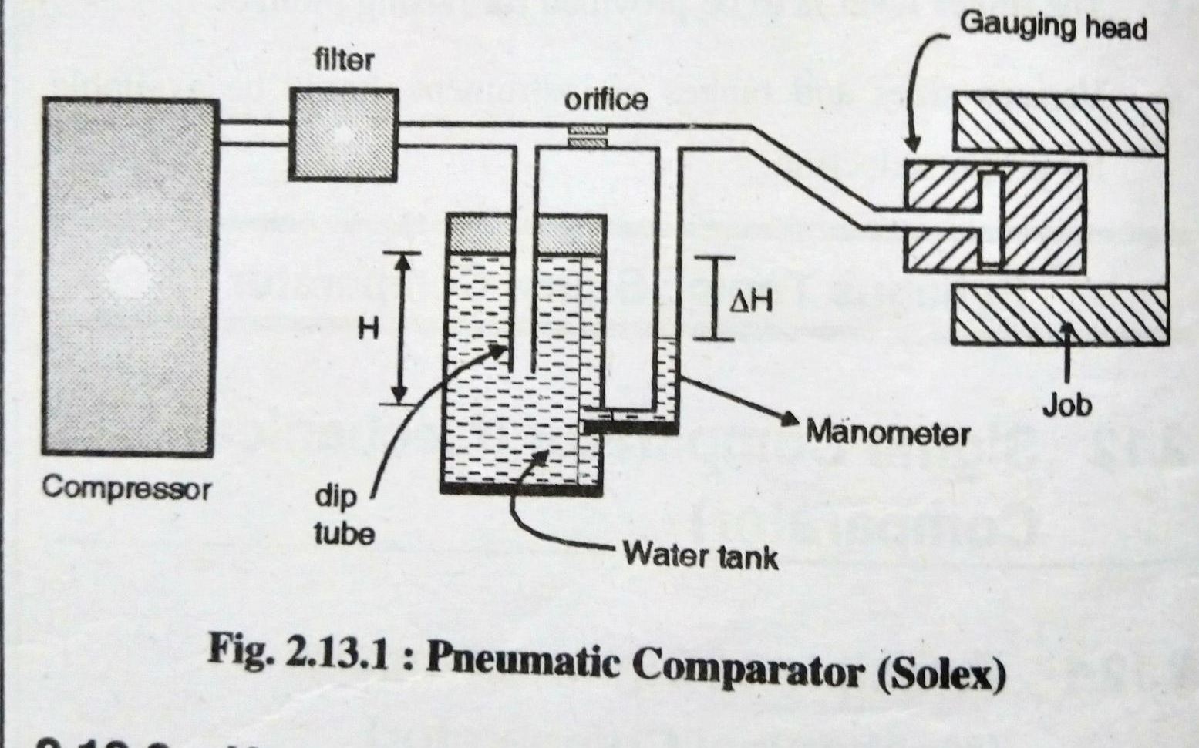
2.1b Pneumatic Comparator

Slide 11
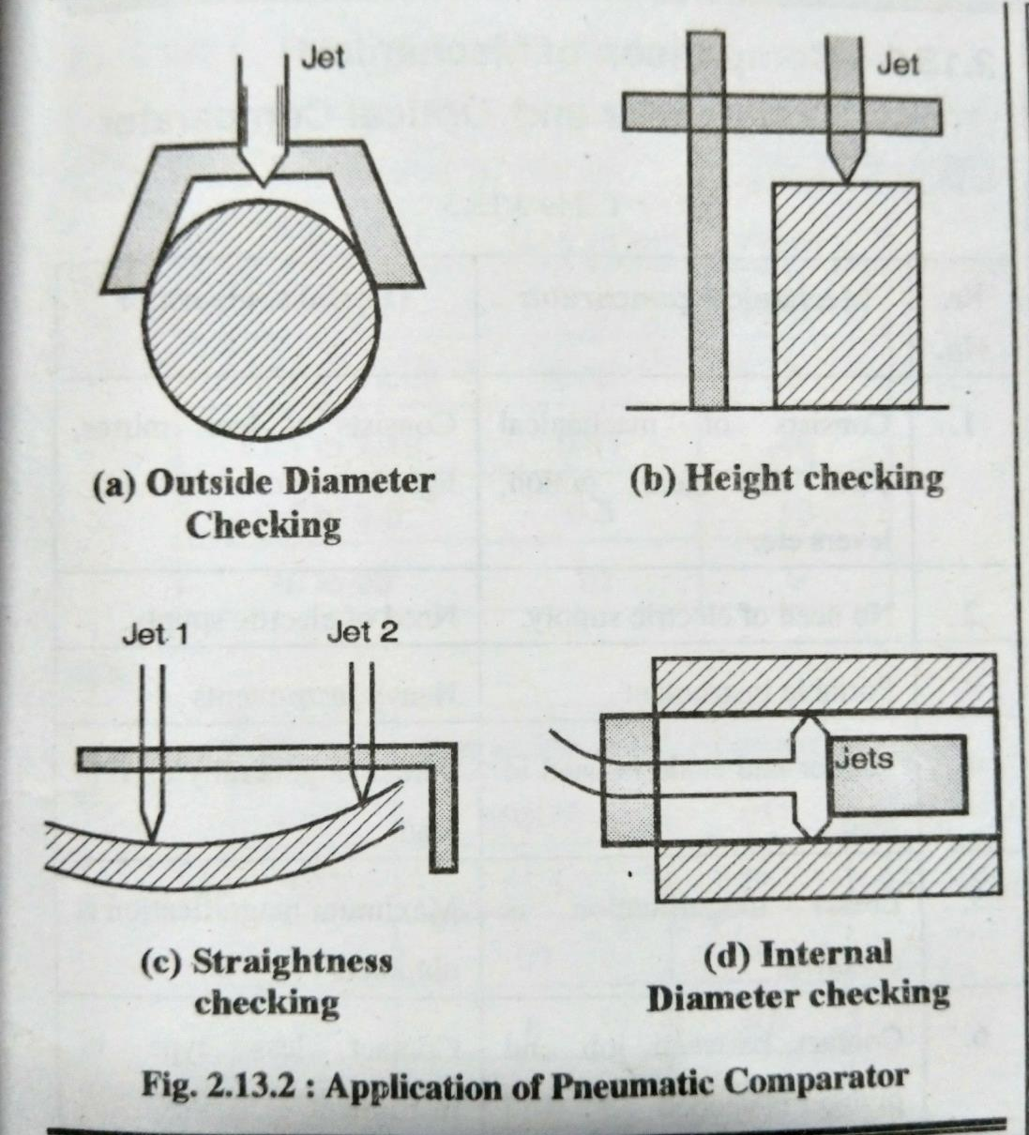
2.1b Pneumatic Comparator
Working of Pneumatic Comparator
Water is filled in tank and dip tube is inserted up to level ‘H’ High pressure and excess air may bubble out in water tank. Then air flows through control orifice to gauging head. Because of restrictions given by gauging head ,back pressure is exerted on the air.
Back pressure generated is shown by manometer i.e. by height difference ΔH. The manometer height can be calibrated by using standard gauging heads and jobs
Uses of Pneumatic Comparator

Slide 12
2.1b Advantages and Disadvantages of
Pneumatic Comparator
Advantages
No contact with job.
Small moving parts.
More accuracy.
Very high magnification.
Instrument can be placed at remote from job.
Used to check an ovality and taperness.
Disadvantages
Needs Auxiliary equipments
Scale is not uniform
Not portable
Different gauging heads are needed for different applications.

Slide 13
Difference between Mechanical & Pneumatic Comparator
Mechanical Comparator
Pneumatic Comparator
Mechanical comparators are robust & compact in design
Usually the Mechanical comparators have linear scale
Due to more moving parts friction is more
Less degree of magnification as compared to pneumatic comparators
Less costlier as compared to other comparators
Pneumatic comparators are not portable & compact in design
The scale is generally not linear
It has few moving parts so friction is less.
It is possible to high degree of magnification
Cost is high as compared to mechanical comparators.

Slide 14
Difference between Measuring Instrument & Comparator
Measuring Instrument
Comparator
Unit which compare actual value with standard value & gives out result is called comparator
Magnifications are provided
Preferred in mass production
Gives output in terms of + or – from required value
E.g. Dial gauge , Pneumatic comparator
Instrument which gives exact value of dimension of job is measuring unit.
No magnification concept
Used in all type of work
Gives exact value of job
E.g. Vernier caliper, Micrometer

Slide 15
Interchangeability :- Is defined as the ability to interchange various parts of an assembly at the time of assembling or replacing
Advantages of Interchangeability
1. Easy to manufacture in mass production.
2. East to replace the equipment's/parts.
3. Less cost of manufacturing.
4. Easy for maintenance of the job.
Selective Assembly
When various jobs are manufactured on a single machine, on the same day, by the same worker, it is the fact that all the jobs are never identical. They are varying their dimensions.
The customer need accurate jobs, precise jobs at attractive prices. For this the concept of selective assembly is used. This is a concept which does away with old ideal of inspection in which the part is identified as ‘good’ or ‘bad’. ‘Good’ parts are used for assembly, bad are thrown away as a scrap.
In selective assembly ,the components produced by a machine are classified into several groups according to size and then assembled according to their groups. This method have been adopted for both hole and shaft of a assembly.

Slide 16
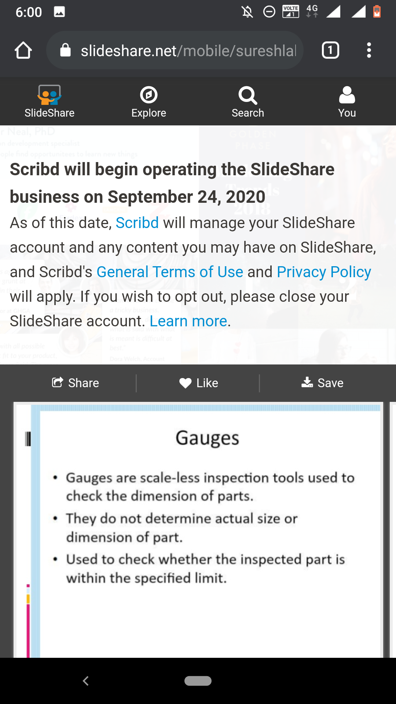
2.2 Gauges
Advantages of Gauges
These are free from errors.
These are portable.
These are independent of power supply.
There is no need of additional equipment with gauges.
Combined dimensions like length, width ,diameter, and angle can be measured.
Less expensive for mass production.
Used by unskilled worker also.

Slide 17
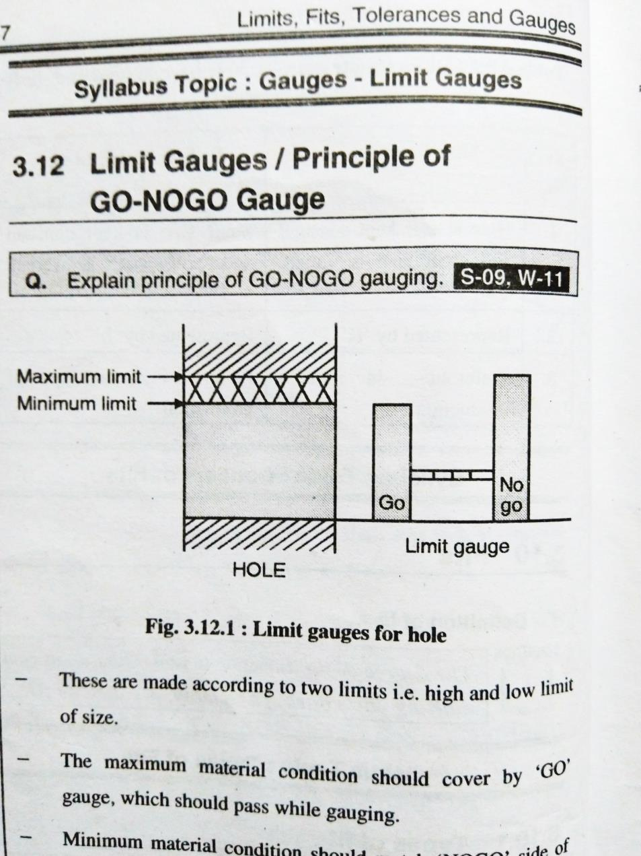
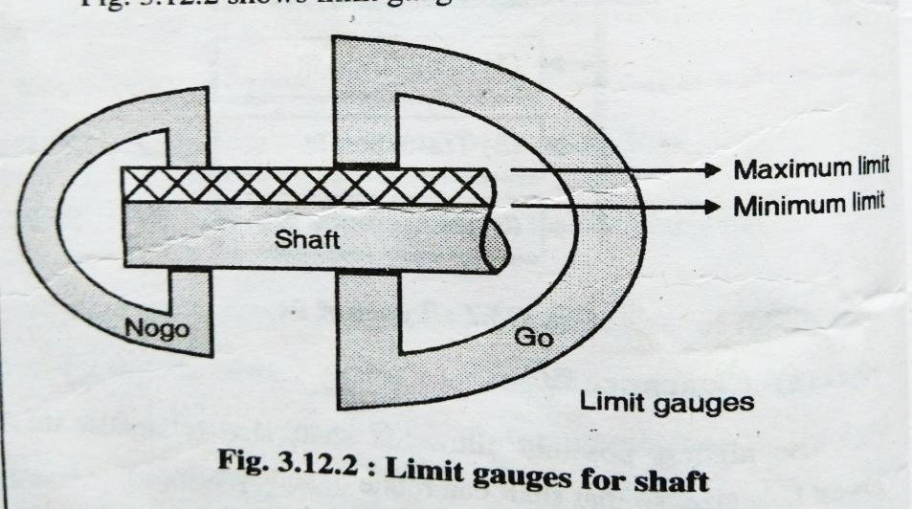
2.2 Gauges
2.2 a Limit Gauges
These are made according to two limits that is high and low limit of size.
The maximum material condition should by ‘GO’ gauge, which should pass while gauging.
Maximum material condition should match ‘NOGO’ side of gauge, which should not pass while gauging

Slide 18
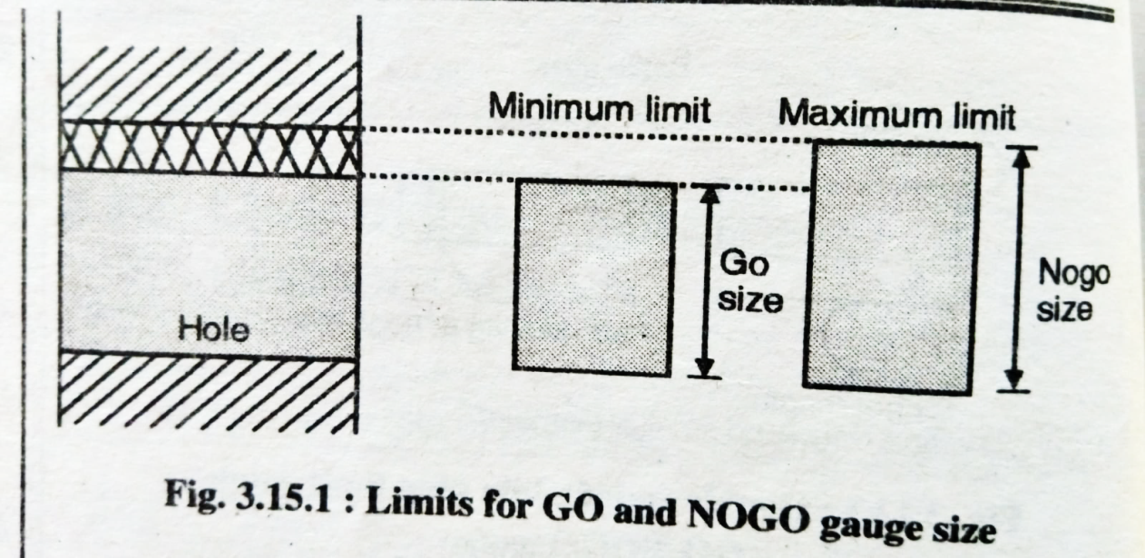
2.2bTaylor’s Principle of Gauge Design
GO’ side
‘GO’ side of gauge is corresponding to maximum material condition.
The ‘GO’ shape is to be designed such that it should check all the features of the part in one pass.
‘NOGO’ side
‘ NOGO’ side is corresponding to minimum material condition.
The ‘NOGO’ form should check only one part or feature of the component while inspection is carried out.

Slide 19
2.3 Slip Gauges

Slide 20
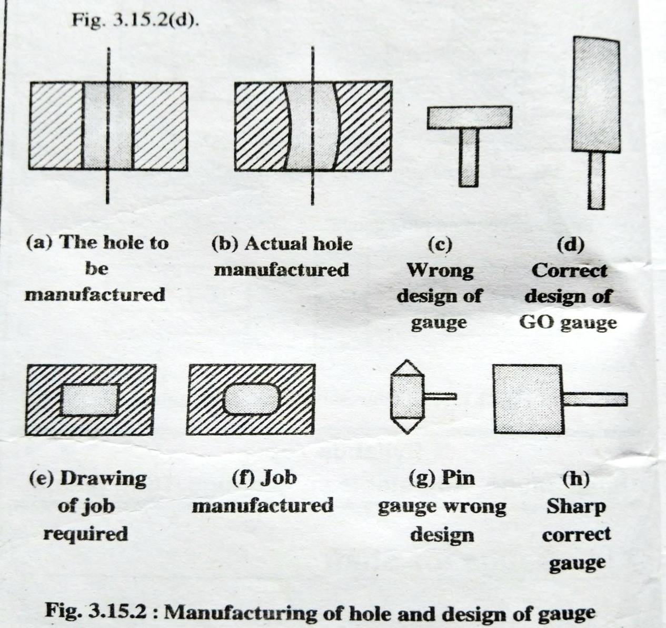
2.2bTaylor’s Principle of Gauge Design

Slide 21
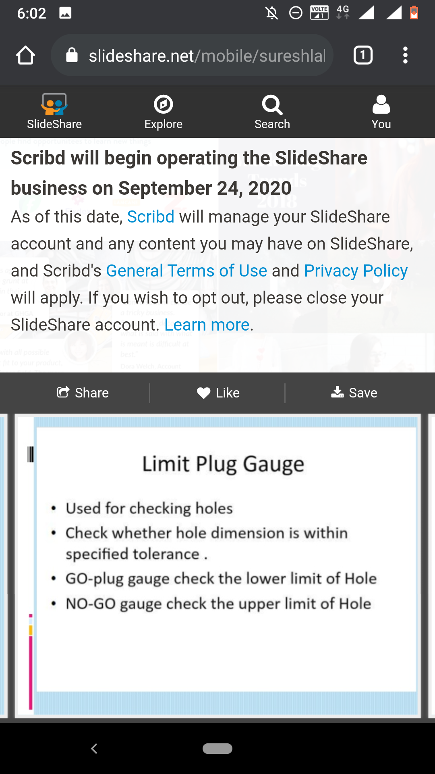
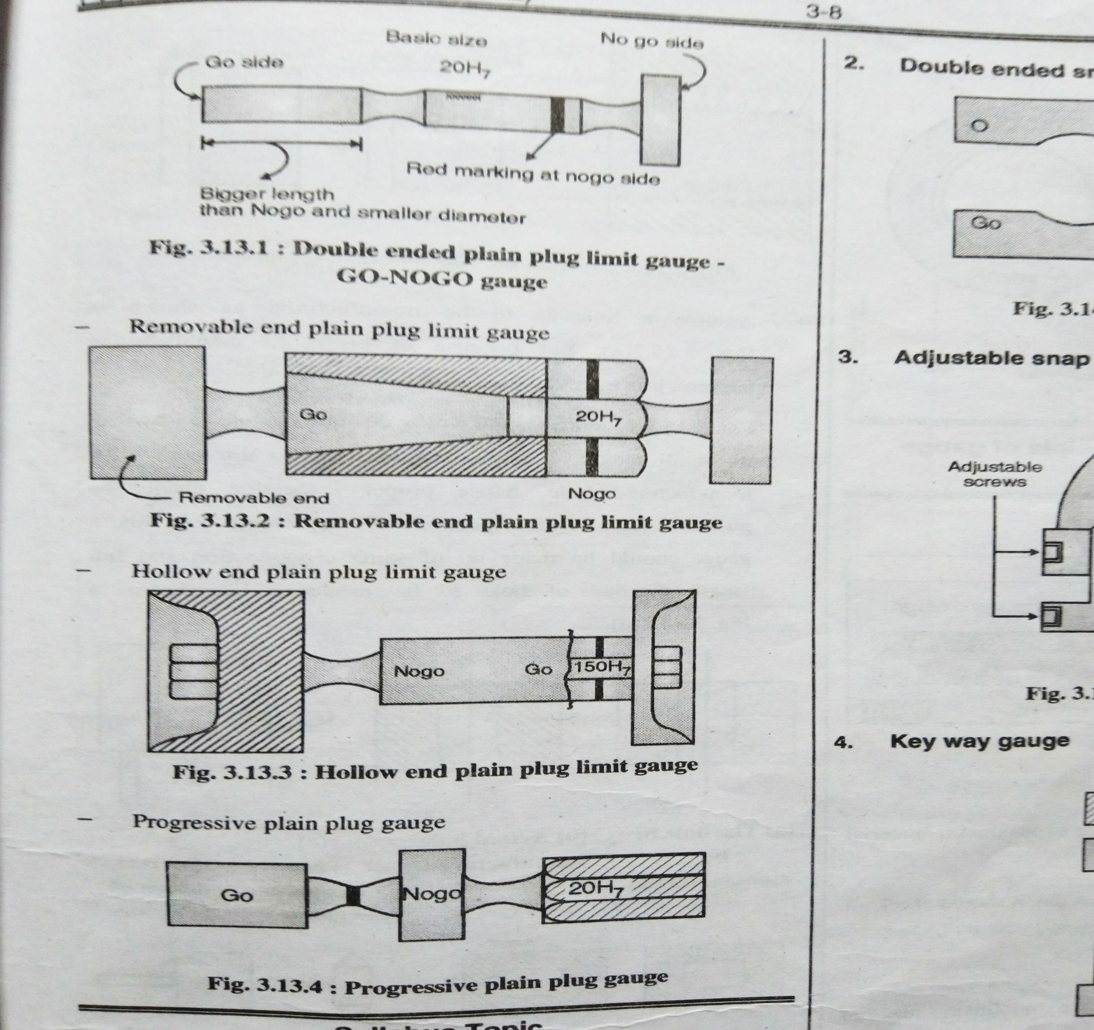
2.2c Plug Gauges

Slide 22
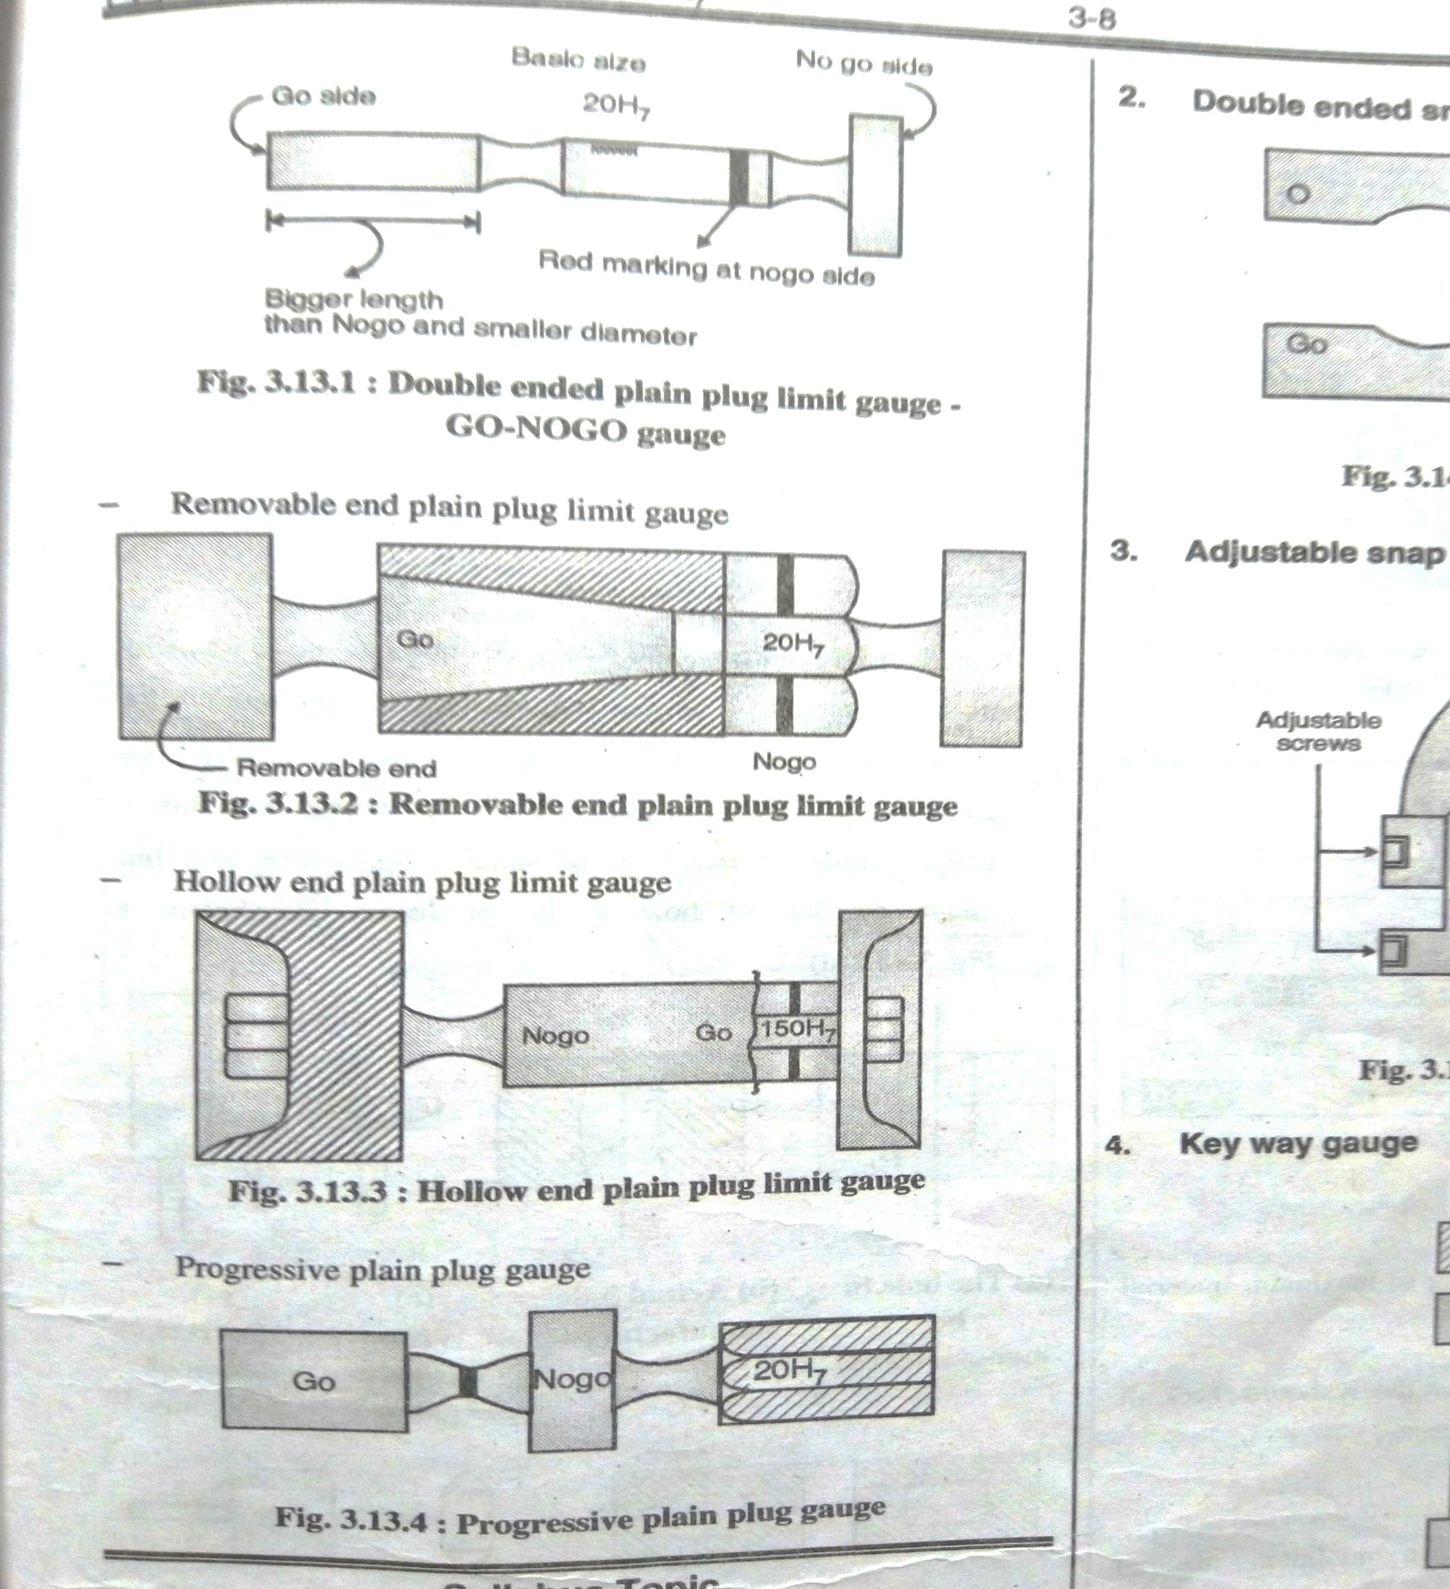
2.2c Plug Gauges

Slide 23
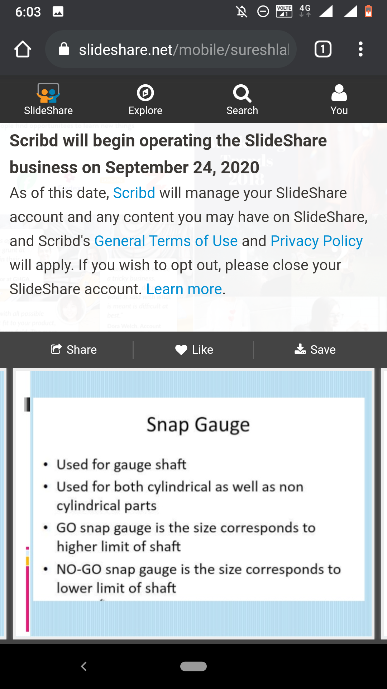
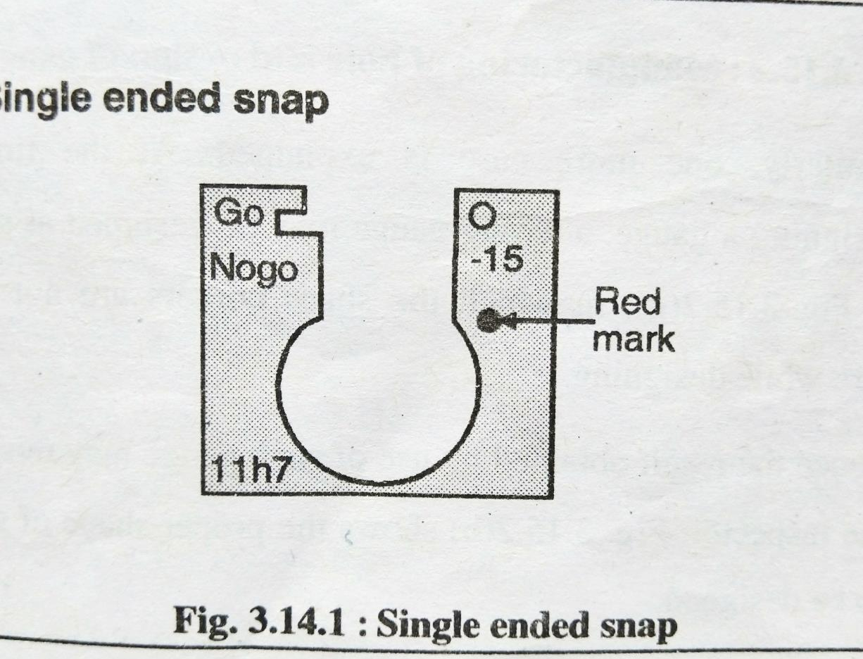
2.2d Snap Gauges

Slide 24
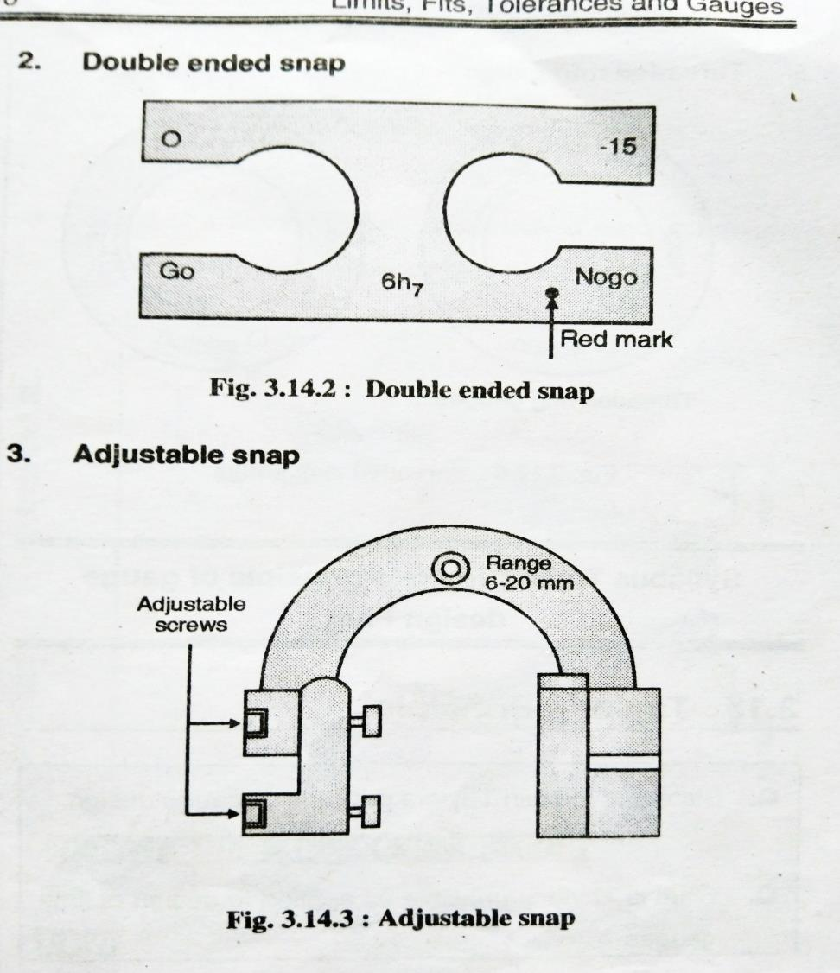
2.2d Snap Gauges

Slide 25
2.2e Ring Gauges
Ring gauge, or ring gage, is a cylindrical ring of a thermally stable material, often steel, whose inside diameter is finished to gauge tolerance and is used for checking the external diameter of a cylindrical object.^{[1]}
Ring gauges are used for comparative gauging as well as for checking, calibrating, or setting of gauges or other standards. Individual ring gauges or ring gauge sets are made to variety of tolerance grades in metric and English dimensions for master, setting, or working applications.
There are three main types of ring gauges: go, no go, and master or setting ring gauges.
Go ring gauges provide a precision tool for production comparative gauging based on a fixed limit. Go gauges consist of a fixed limit gauge with a gauging limit based on the plus or minus tolerances of the inspected part. A go ring gauge's dimensions are based on the maximum OD tolerance of the round bar or part being gauged.

Slide 26
Comparison between Gauge & Instrument
Gauge
Instrument
They will not give true reading of job
Free from electric supply
Easy to use by unskilled workers
Limited to particular jobs only
No other auxiliary equipment are needed
It is preferred in mass production
These will give true reading of job
May need electric power
Proper Training may be needed to use this
Can be used for large ranges of jobs
Auxiliary equipment supports may be needed
It is not preferred in mass production

Slide 27
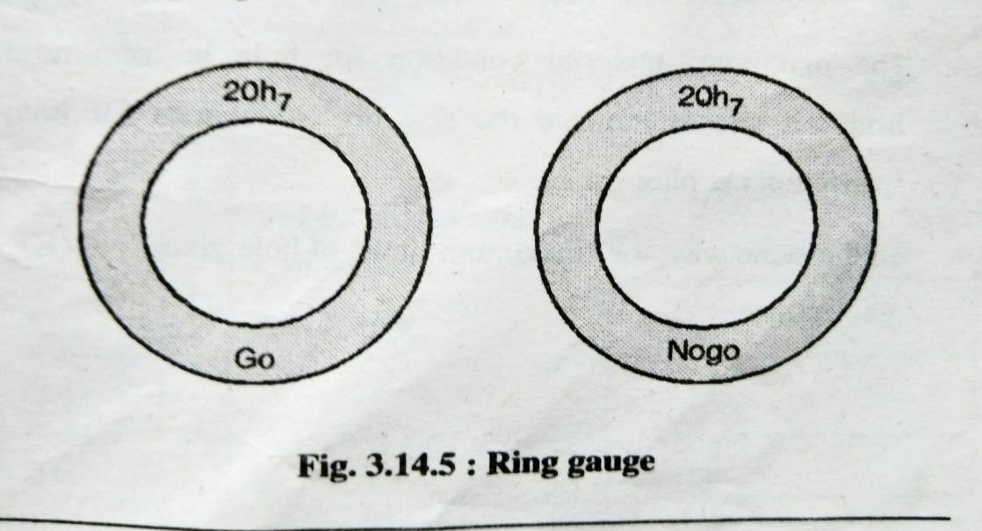
2.2e Ring Gauges
No-go or not-go gauges provide a precision tool for production comparative gauging based on a fixed limit. No-go gauges consist of a fixed limit gauge with a gauging limit based on the minimum or maximum tolerances of the inspected part. A no-go ring gauge's dimensions are based on the minimum OD tolerance of the round bar or part being gauged.
Master and setting ring gauges includes gauge blocks, master or setting discs, and setting rings are types of master gauges used to calibrate or set micrometers, optical comparators, or other gauging systems.

Slide 28
2.2 Slip Gauges
Slip gauges are also called as Johansson gauges.
The shape of slip gauge is of similar to rectangular blocks and made up of steel with cross section of 30*10mm.
Also they are divided into five grades.
a. Grade 2 - Workshop grade
b. Grade 1 - Precise working
c. Grade 0 - Inspection grade
d. Grade 00 - Highest precision grade
Calibration Grade – For special purpose calibration
The slip gauges can be used as follows
As a reference standards
For transferring dimensions
For verification of graduations on scale
For making calibrations
Also for direct measurement of a dimensions.

Slide 29
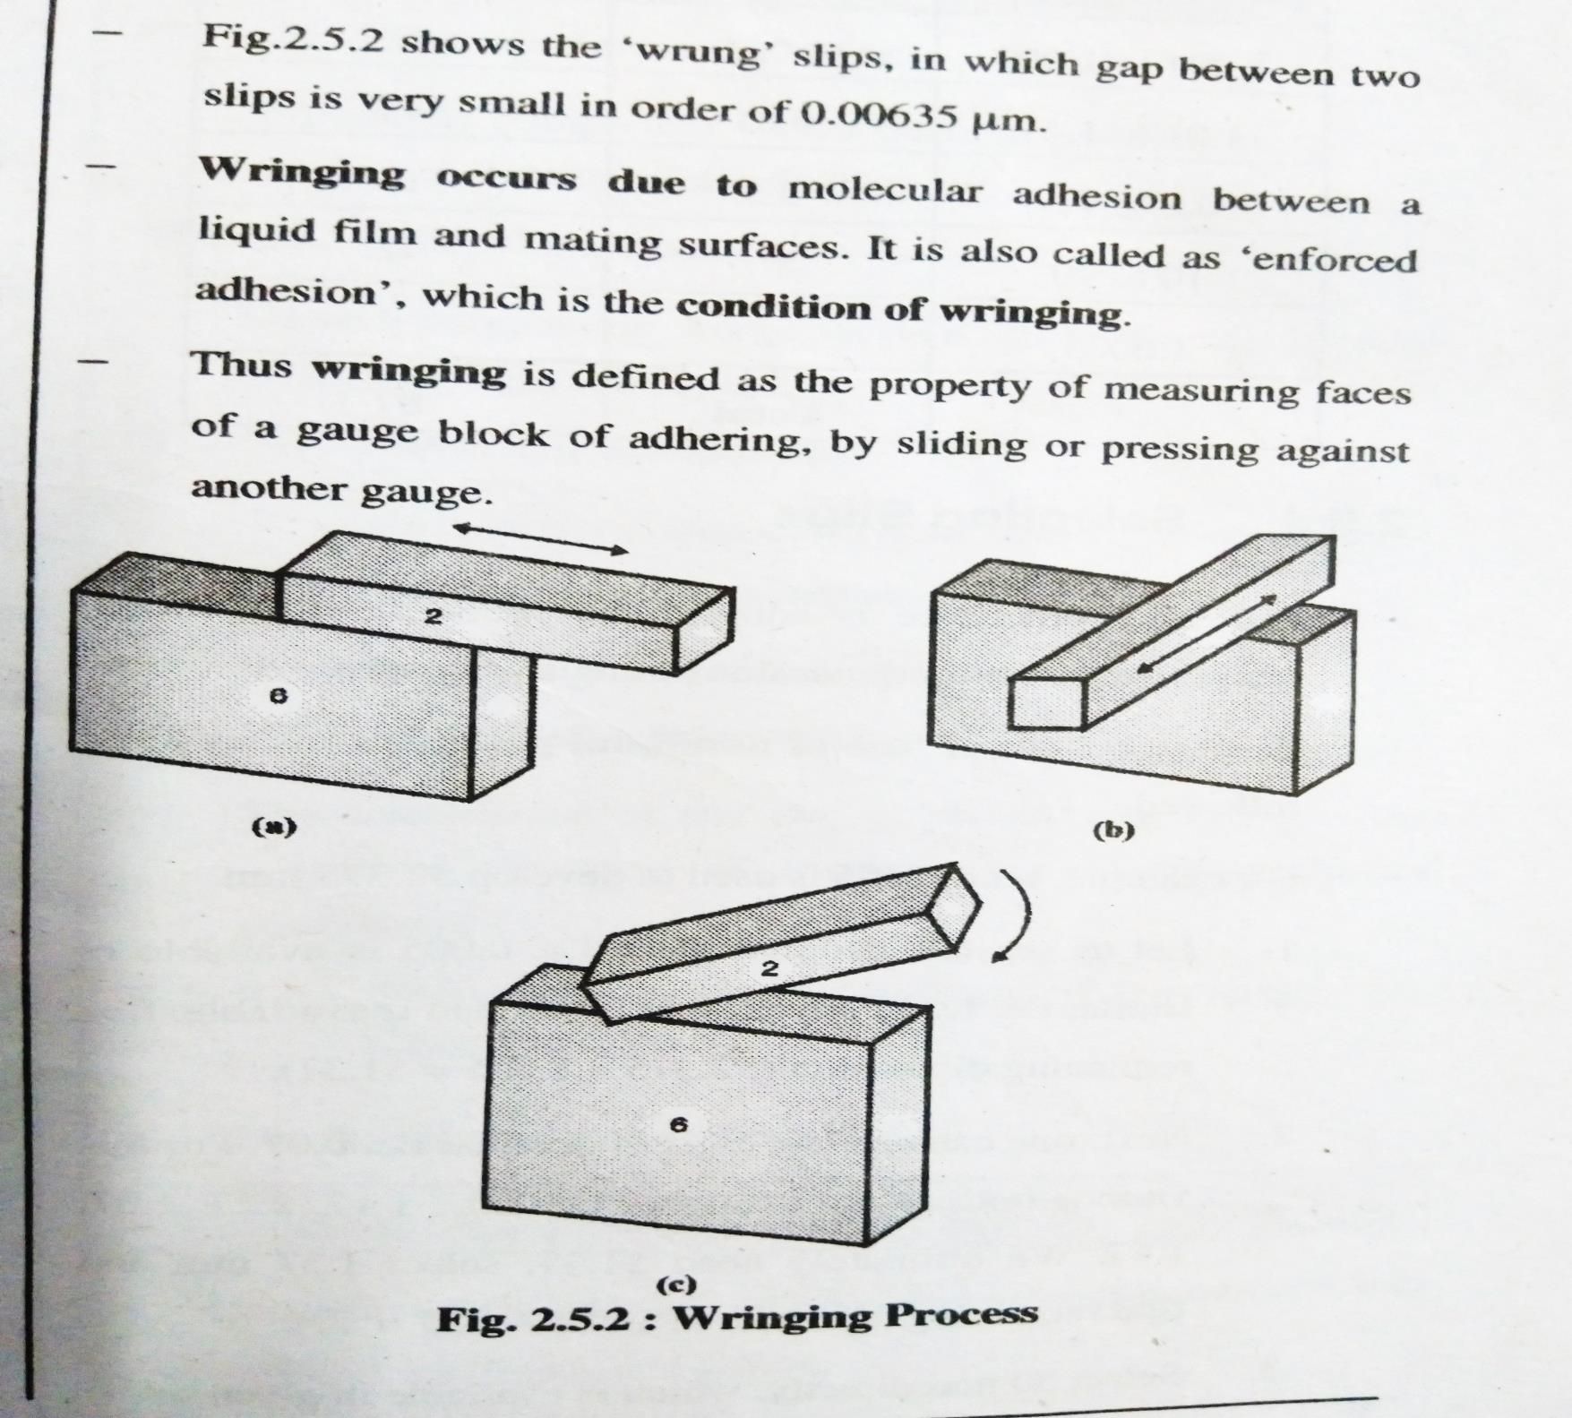
2.2 Slip Gauges
2.3aWringing Process
Wringing occurs due to molecular adhesion between a liquid film and mating surfaces.
First keep two slips on each another and slide them to know about any foreign particles present on their surfaces.(Fig. a & b)
Press the two faces into contact in perpendicular to each other
and give a small twisting motion against each other. (Fig. c)
3. While removing wrung slips, they can be slide on each other slowly.

Slide 30
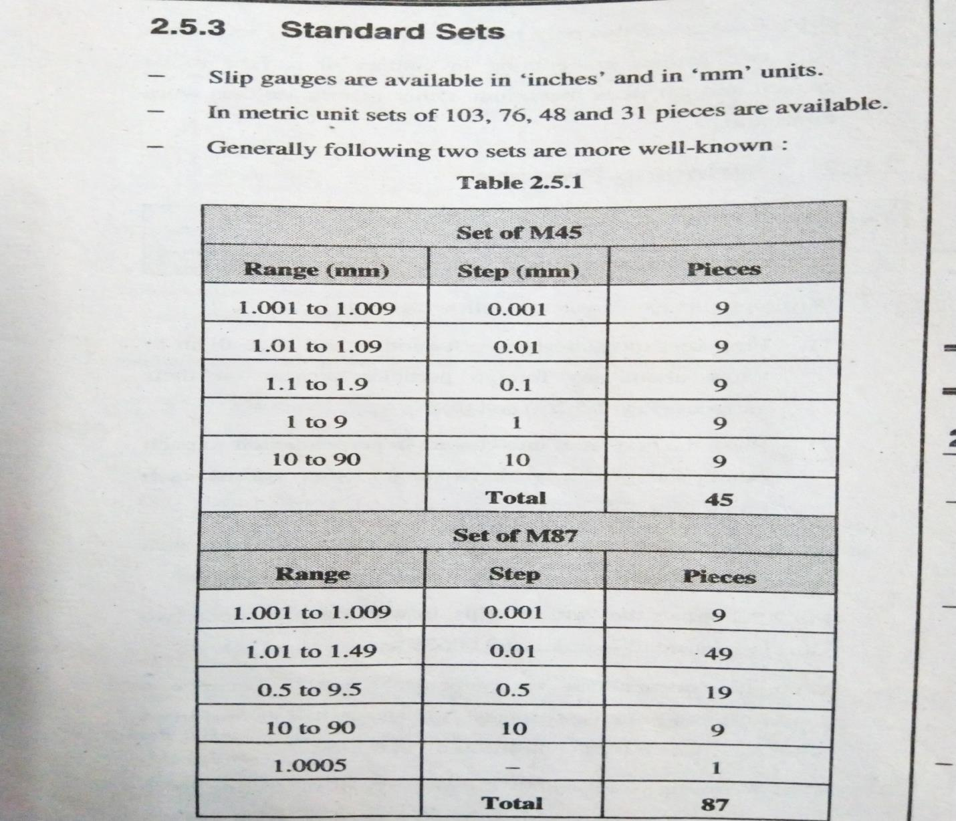
2.2a Slip Gauges

Slide 31
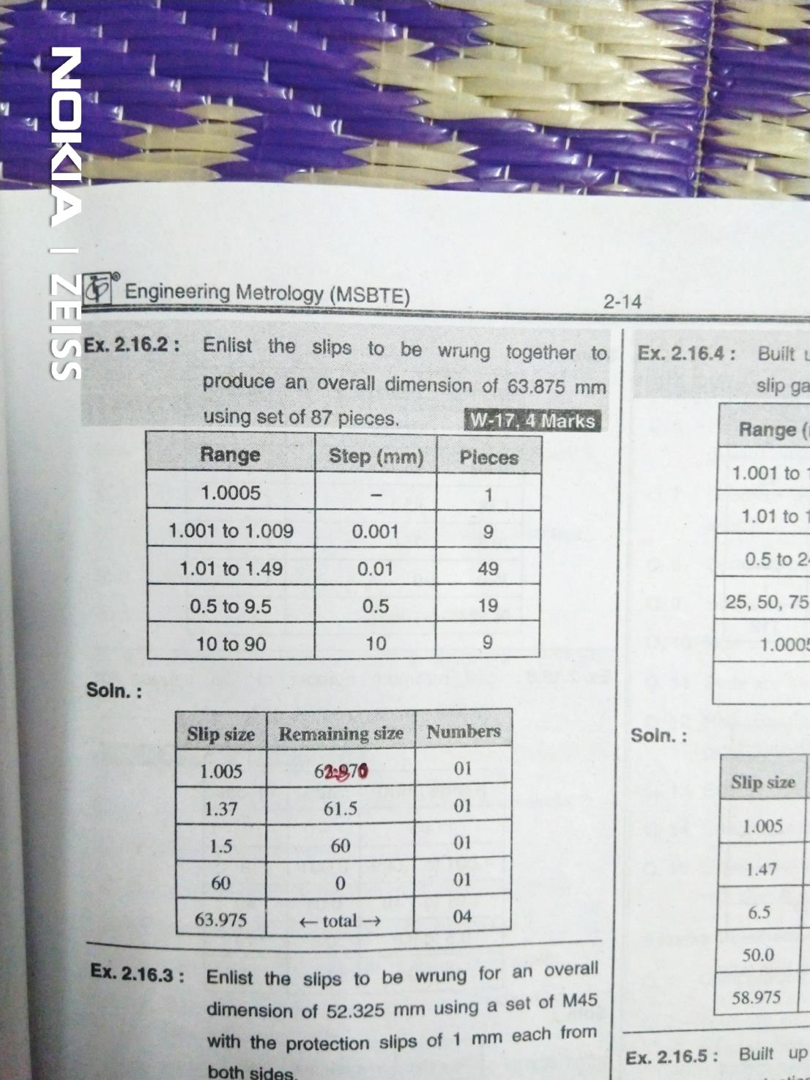
2.2a Slip Gauges

Slide 32
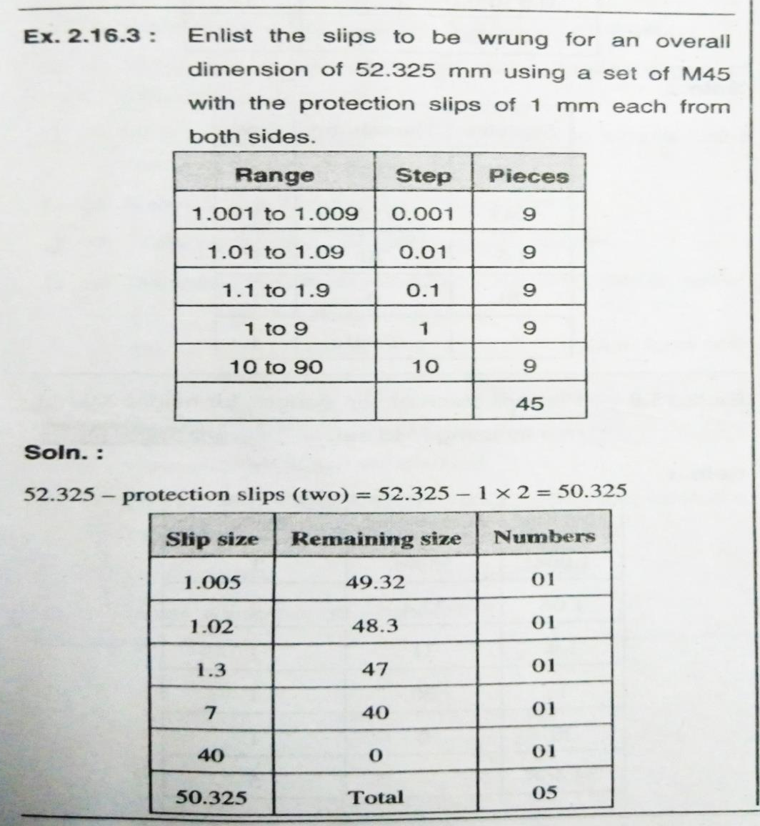
2.2a Slip Gauges

