Slide 1
Client Side Scripting Language
By Palkar N.M.

Slide 2
1.Basics of JavaScript Programming
Features of JavaScript
Object Name,
Property Method
Dot syntax
main event

Slide 3
Script:
A Script is a program that automates the execution of tasks which could alternatively be executed one-by-one by human operator.
Script can be used –
- Software Application
- Web Pages
- Shells of operating System etc.

Slide 4
Scripting Language
A Scripting Language is programming language that supports the writing of scripts.
A new style of programming language different from system programming languages.
Designed as glue language or system integration language.

Slide 5
A single statement can execute huge number of machine instruction.
Can create dynamic web pages.
A normally ‘typeless’
Build complex algorithms and data structures.

Slide 6
Types of Scripting languages
Scripting Language
Client-Side Server-Side
1.JavaScript 1. JSP
2.VBScript 2.ASP
3.PHP

Slide 7
1. Server-Side Scripting Language
huge resources of the server.
processing in the server and send plain pages to the client.

Slide 8
2.Client Side scripting Language
Not involve server processing.
Complete application

Slide 9
Different Scripting Languages
ASP
Perl
PHP
JSP
ASP.NET
VBScript
Java Script

Slide 10
Client Side Scripting Language
Placed within an HTML document in the user’s web browser.
Enable web pages to change content according to input.

Slide 11
Client Side Scripts
Executes within a user’s browser
Manage forms and form fields
Includes:-
1. Place the curser in a form field
2. Generate alerts, confirmation & messages.
3. Populate a form field
4. Highlight a form field
5. Validate form data
6. Modify choice list options
7. Hide/Show fields or sections

Slide 12
Features of JavaScript
Lightweight, interpreted programming
Language
Scripting Language, & is not Java
Interpreter Based
Case Sensitive
Object Based

Slide 13
Designed for creating network-Centric
applictions
Complementary & integrated with Java
Complementary & integrated with HTML
Open & cross platform

Slide 14
Advantages of CSS
Interactive
Quick Action
Easy to use
Freely Available

Slide 15
Disadvantages of CSS
Not Secure
Quality Assurance
Harmful

Slide 16
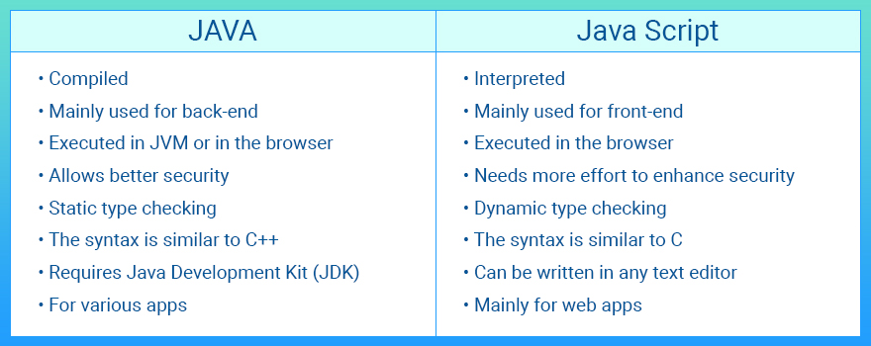
Difference Between
JavaScript & Java

Slide 17
Client Side Scripting Languages
JavaScript
VBScript

Slide 18
JavaScript
It is designed
- Add Interactivity
- Lines of interpretable
Computer code
- Programming tool
- Embedded into HTML pages
- Dynamic Text

Slide 19
JavaScript
Official Name: ECMAScript
Web Pages
Validate Data
Create Cookies
Browsers

Slide 20
JavaScript & HTML page
<!DOCTYPE html>
<html>
<body>
<script type=“text/javascript”>
Document.write(“Welcome to TY-CO”);
</script>
</body>
</html>

Slide 21
What is JavaScript Programming?
- Popular,Lightweight and an open source client Side language
- A dynamic computer programming language
- Used in many Game Development and Mobile Application Development
- Used as a part of web pages
- An Interpreted Programming Language

Slide 22
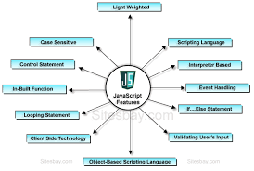
Features of JavaScript

Slide 23
Limitations of JavaScript
Does not allow the reading or writing of files.
Cannot be used for network applications.
Does not have any multithreading or multiprocessor capabilities.

Slide 24
How to write JavaScript?
Script in <head> section-
<head>
<script…>
//JavaScript code
</script>
</head>

Slide 25
How to write JavaScript?
Script in <body> section
<body>
<script….>
//JavaScript code
</script>
</body>

Slide 26
Attributes of <script> tag
Language
Type

Slide 27
A simple program
<html>
<script language=“Javascript” type=“text/javas cript”>
document.write(“Hello,world!”);
</script>

Slide 28
1.Object Name
It is a collection of named values and these named values are properties of object.
Used in web pages
Uniquely identified by a name IDs in web pages
Supports various objects like documents,forms,button,window etc.
Created with curly brackets{} with an optional list of properties.

Slide 29
<script language=“javascript”type=“text/javascript”>
var student={
name: “Vijay”,
age:21,
year:“TY”
};
</script>

Slide 30
The ‘new’ keyword is used to create instance of
An object.
<script language=“javascript”type=“text/javascript”>
Var student=new Object();
Student.name=“abc”;
Student.age=21;
</script>

Slide 31
2.Property
A property is a value associated with an object.
A Property is a “key:value” pair,
Key(a property name) is always a string.
Value( a property value) can be any data type.

Slide 32
JavaScript Code for Property
<html>
<head>
<title>Object Property</title>
<script language=“javascript”type=“text/javascript”>
var student={
name: “Vijay”,
age:21,
year:“TY”
};

Slide 33
document.write(student.name);
</script>
</head>
<body>
</body>
</html>
Output:
Vijay
Declare 3 properties
Name with value “Vijay”.
Age with value “21”.
Year with value “TY”.

Slide 34
3.Method
A set of instructions
A submit button
The Kinds of Methods that are used differ
Program for method

Slide 35
4.Dot syntax
For accessing an object properties and methods
For Example, write method:
document.write()
Separates the name of the object
First part is the name of the object and
second part is either a property or method.

Slide 36
5.Main Event
The way to start executing your code like mouse click, button click.
With the help of event handling.
Event Handling
Event handler

Slide 37
* Values and Variables
Variables can hold values of any data type.
var keyword is used to specify the data type.
Values used by javascript:
1.Number
2.String
3.Boolean
4.Null
5.Objects

Slide 38
1.Number:
- A number is a numeric value.
- e.g.:var a=20;
2.String:
- A string is a sequence of characters.
- e.g.:var city=“pune”;
3.Boolean:
- A Boolean is a value-either false or true.
- e.g.:var b=true;

Slide 39
4.Null:
- Null value means no value at all.
-e.g.:var i=null;
5.Objects:
-Instance which can access members.
-e.g.var person=(firstName: “John”,
lastName: “Doe”);

Slide 40
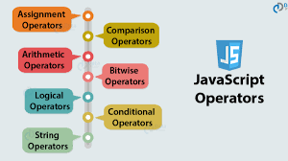
*Operators and Expressions

Slide 41
1.Arithmetic Operators
JavaScript arithmetic operator take operand (as a values or variable) and return the single value.
We are use in our routine life arithmetic operators, addition(+), subtraction(-), multiplication (*), and division (/) and some other arithmetic operator are listed below

Slide 42
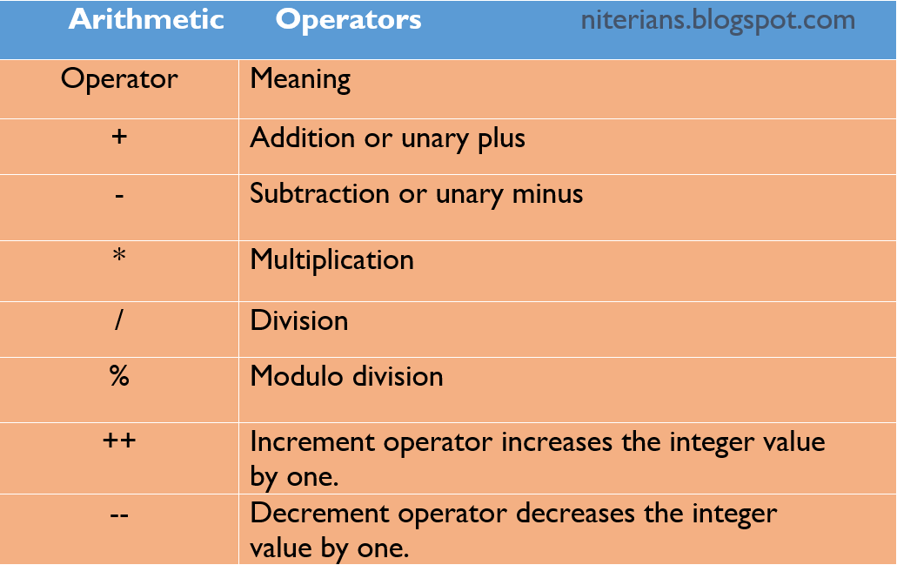

Slide 43
2.Comparison Operators
JavaScript comparison operator determine the two operands satisfied the given condition. Comparison operator return either true or false.

Slide 44
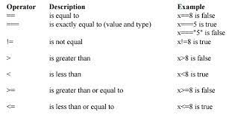


Slide 45
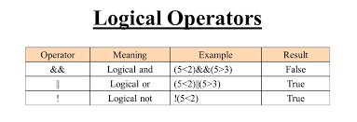

Slide 46
4.Assignment Operators
JavaScript assignment operators assign values to left operand based on right operand. equal (=) operators is used to assign a values.

Slide 47
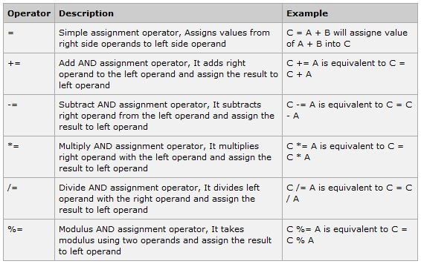

Slide 48
5.Ternary Operator/Conditional
Operator
JavaScript conditional operator evaluate the first expression(operand), Base on expression result return either second operand or third operand.
answer = expression ? answer1 : answer2; // condition ? true : false
Example
document.write((10 == 10) ? "Same value" : "different value");

Slide 49
6.Bitwise Operator
JavaScript bitwise operators evaluate and perform specific bitwise (32 bits either zero or one) expression.

Slide 50
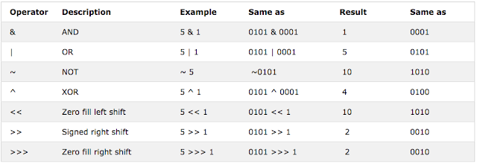

Slide 51
Expressions
1.Primary Expression
2.Function Definition Expression
3.Property Access Expression
4.Invocation Expression

Slide 52
Conditional Statements
if Statement
if….else Statement
if….else if Statement
Nested if Statement

Slide 53
1. if Statement
if is used to check for a condition whether its true or not.
Syntax
if(condition)
{
statement1
statement2
...
}

Slide 54
2.if….else Statement
else statements are used with if statements. When if condition gets fail then else statement is executed.
Syntax
if(condition)
{
statements
}
else
{
statements
}

Slide 55
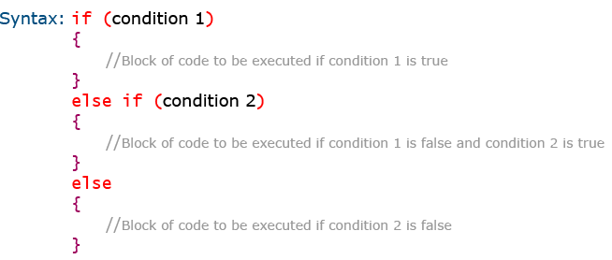
3. if….else if Statement

Slide 56
4.Nested if Statement
A nested if is an if statement that is the target of another if or else.
Syntax:
if (condition1)
{
lines of code to be executed if condition1 is true.
if(condition 2)
{
lines of code to be executed if condition2 is true.
}
}

Slide 57
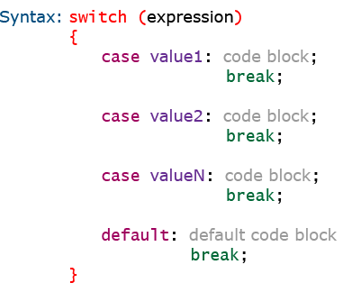
* Switch Case Statement
The switch case statement in javascript is used for decision making purposes.

Slide 58
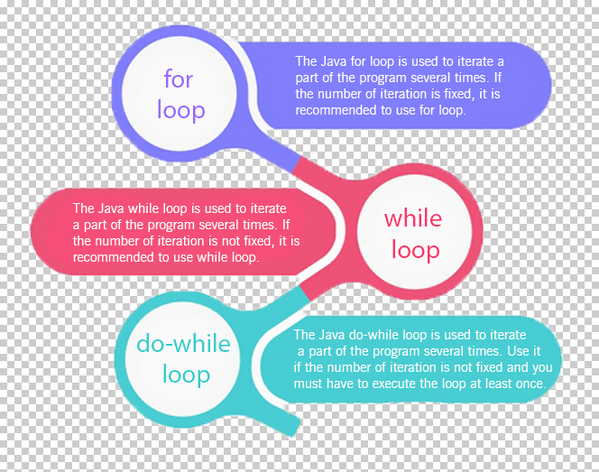
* Loop Statement

Slide 59
1. for loop
for loop is generally used when the number of iterations/repetitions are already known.
Syntax
for(initializer; condition; modifier)
{
statement-1;
.....
}

Slide 60
2.While loop
while loop checks for a given condition to be true to execute statements that it contains within it.
Syntax:
while(condition)
{
lines of code to be executed
}

Slide 61
3. do…..while Loop
do while loop first execute the statements that it contain and then check for a condition.
Syntax:
do
{
block of code to be executed
}while(condition)

Slide 62
4. Break and Continue Statement
Break Statement:
It stops the execution of a loop entirely
Continue Statement:
It terminates execution of the statements in the current loop and continues execution of the loop.

Slide 63
Querying and setting properties
The dot (.) operator or square brackets([ ]) are used to obtained values of properties.
1. By using dot operator
var price = book.price;
var name=person.lastname;
2. By using square brackets
var author=book[“author”];

Slide 64
Deleting Properties
The ‘delete’ keyword is used to delete both the value of the property and property itself.
delete person.age;
delete person[“FirstName”];

Slide 65
Property Getters & Setters
Accessor properties are represented by-
1.Getter 2.Setter
When the property is accessed, the return value from the getter is used.
get-a function without arguments,that works when a property is read.
When a value is set,the setter is called and passed the value that was set.
set- a function is called with argument when the property is set.

Slide 66
UNIT I [12 Marks]
Basics of JavaScript Programming
1. Explain any two/ four features of JavaScript?
2. Write a JavaScript to display Welcome message in JavaScript.
3. Explain the term – Object Name, Property, Method, Dot syntax, main event.
4. Explain six type of values in JavaScript.
5. What is conditional operator in JavaScript?
6. List the different types of operator in JavaScript. Describe any one in details.
7. List the different types of popup box. Explain any of it with example.
8. Write a JavaScript to display squares of 1 to 10 numbers using while loop.
9. Write a JavaScript program that accept two integers and display the larger.
10. Write a JavaScript conditional statement to sort three numbers. Display an alert box to show the result.

Slide 67
11. Write a JavaScript for loop that will iterate from 0 to 15. For each iteration, it will check if the current number is odd or even, and display a message to the screen.
12. Write a JavaScript conditional statement to find the largest of five numbers.
13. Write a JavaScript program to check from two given integers, if one is positive and one is negative.
14. Write a JavaScript program check if a given positive number is a multiple of 3 or a multiple of 7.
15. Write a JavaScript program to reverse a given string.

Slide 68
16. Write a JavaScript program to check number is Armstrong or not.
17. Write a JavaScript to display squares of 1 to 10 numbers using for loop.
18. Write a JavaScript program to find the area of a triangle where lengths of the three of its sides are 5, 6, 7.
19. Write a JavaScript program to construct the following pattern, using a nested for loop.
*
* *
* * *
* * * *
* * * * *

Slide 69
Thank You!

