Slide 1

Strength of Material (313308)
Unit No : 03
Shear Force and Bending Moment

Slide 2
Course Outcome: CO3
Draw SFD and BMD for the given structural element under given loading conditions.

Slide 3
TLO 3.1 Enlist Types of Supports& Types of Beams
TLO 3.2 Enlist types of loads acting on a beam.
TLO 3.3 Understand the relation between SF, BM and rate of loading.
TLO 3.4 Draw SFD and BMD for Simply supported beams, Cantilever beams & overhanging beams.
TLO 3.5 Locate point of maximum BM and point of contra-flexure.

Slide 4
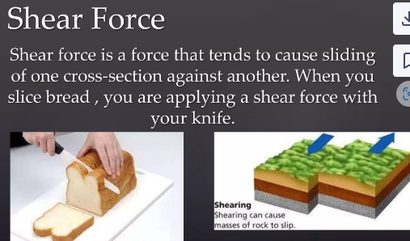

Slide 5
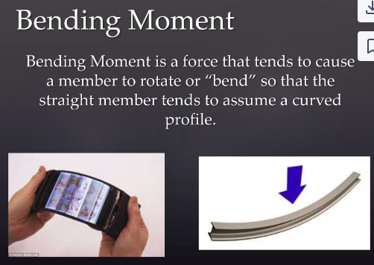

Slide 6
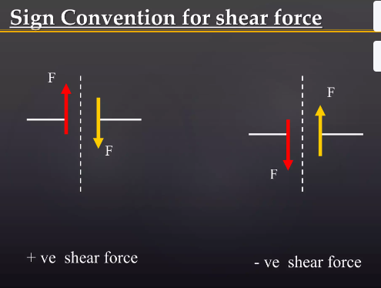

Slide 7
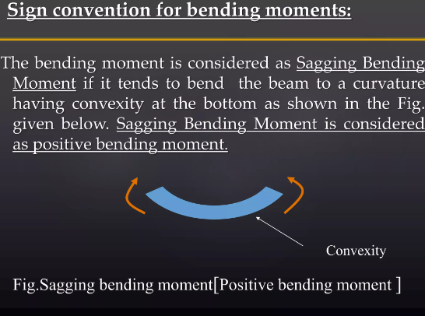

Slide 8
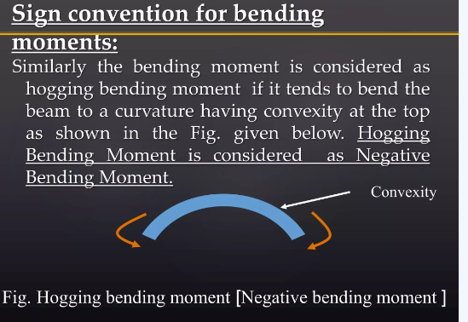

Slide 9
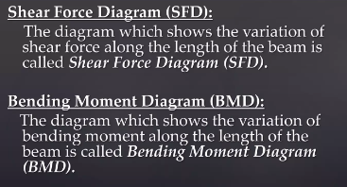

Slide 10
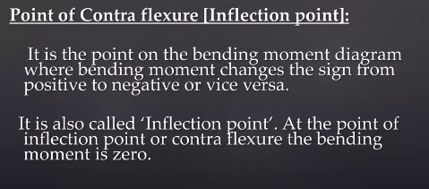

Slide 11
