Slide 1

Strength of Material (313308)
Unit No : 02
Simple Stress, Strain and Elastic Constants

Slide 2
Course Outcome: CO2
Analyze the structural behaviour of given structural components under various loading conditions....

Slide 3
TLO 2.1 Understand concept of stresses and strains in deformable bodies.
TLO 2.2 Understand Hook’s law, elastic limit, Linear and lateral strain, Poisson's ratio.
TLO 2.3 Determine modulus of elasticity, modulus of rigidity and bulk modulus for given material.
TLO 2.4 Articulate practical significance of stress- strain curve for given material under given loading conditions for their relevant use.
TLO 2.5 Concept of single shear, double shear & punching shear.
TLO 2.6 Compute the total deformation for given homogeneous (compound ) sections under axial load.
TLO 2.7 Determine the stresses in each material for given composite section.
TLO 2.8 Compute strain along x, y and z-direction for a given bi-axial or tri-axial stress system.
TLO 2.9 Determine volumetric strain & change in volume forgiven cube or cuboid.

Slide 4
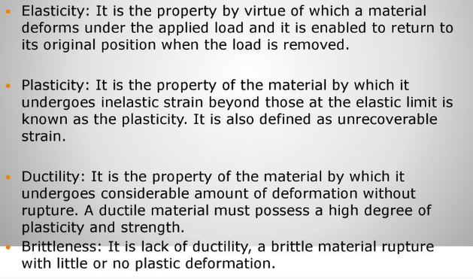
Properties of Material

Slide 5
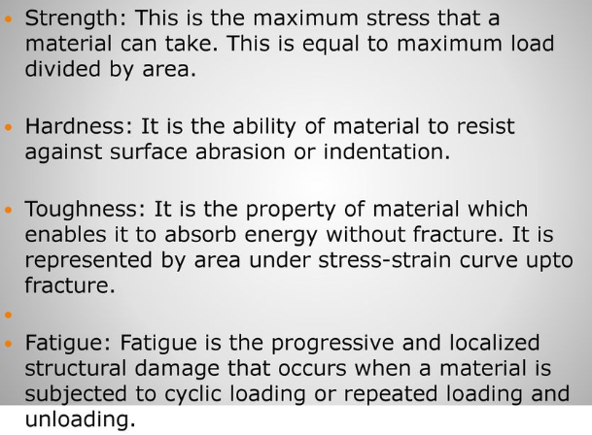

Slide 6
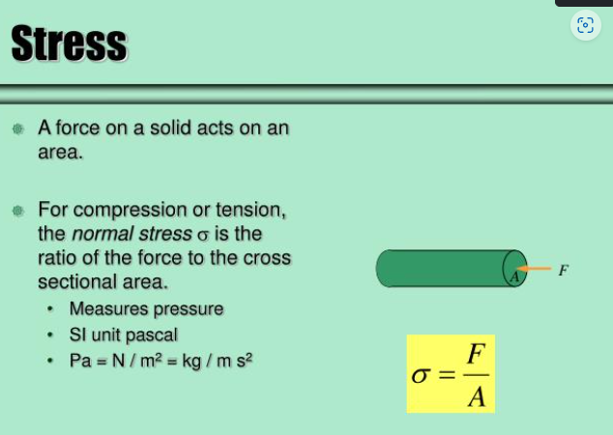

Slide 7
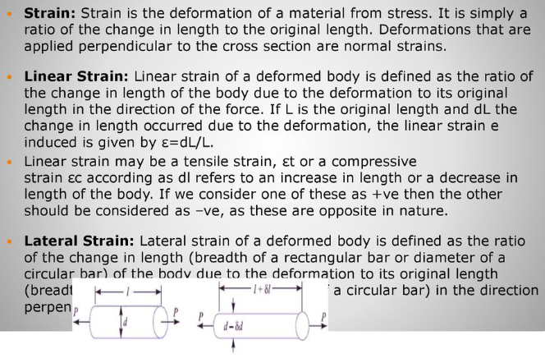

Slide 8
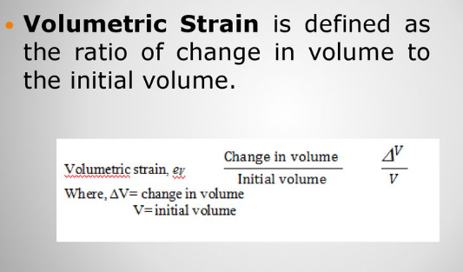

Slide 9
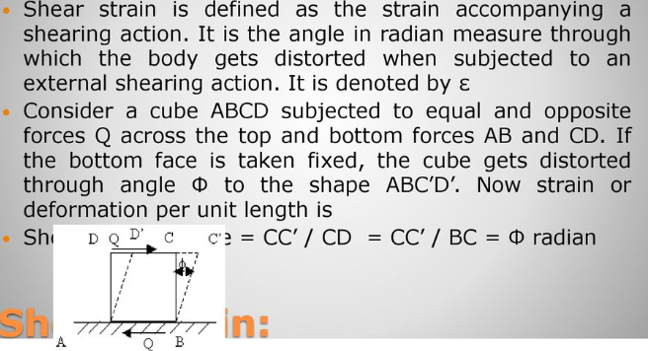

Slide 10
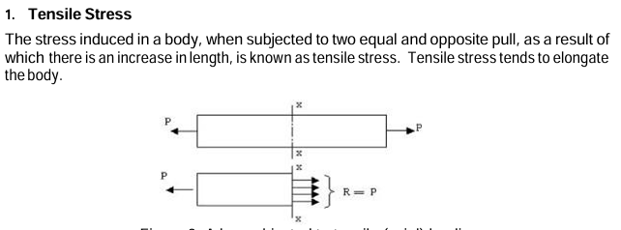
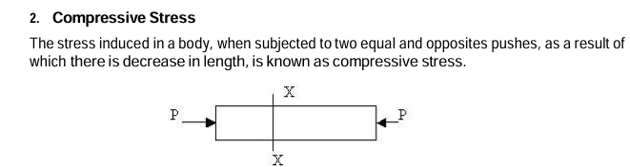
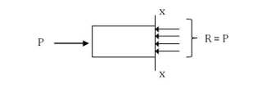

Slide 11
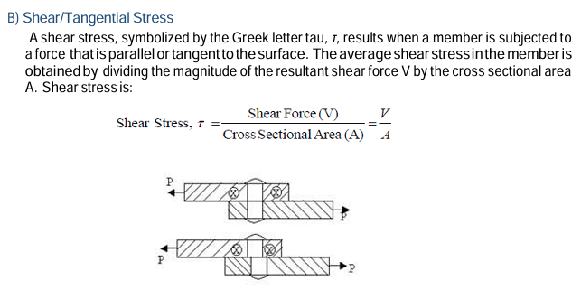

Slide 12
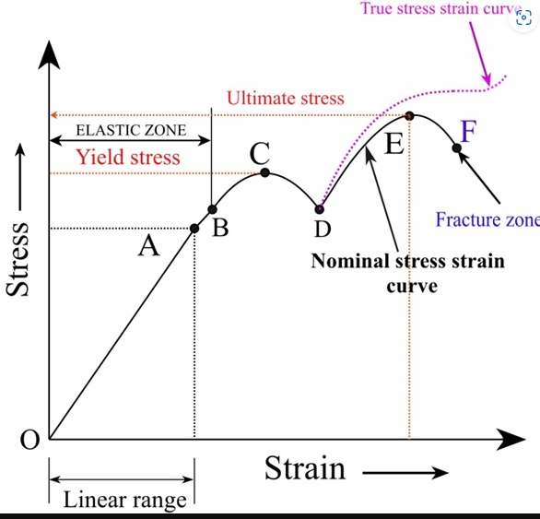
Stress-Strain Curve for Mild Steel

Slide 13
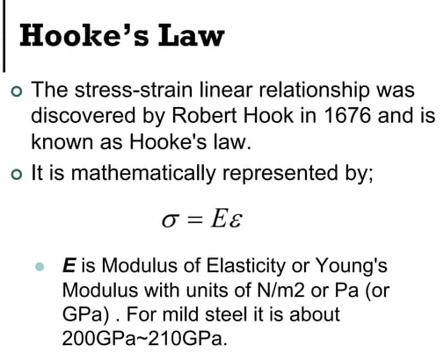

Slide 14
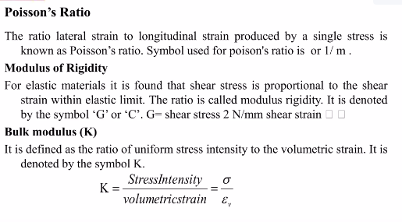

Slide 15
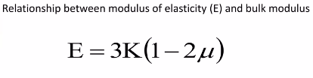
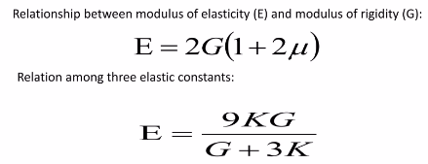

Slide 16
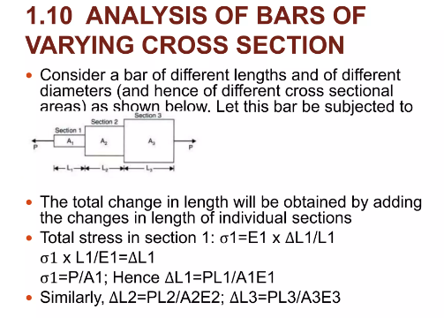

Slide 17
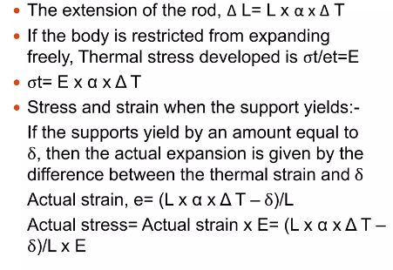

Slide 18
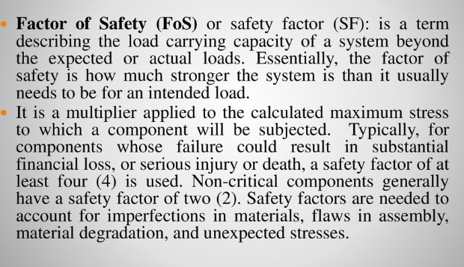

Slide 19
