Slide 1
Thermal Engineering
Unit No 1 Fundamentals of Thermodynamics

Slide 2
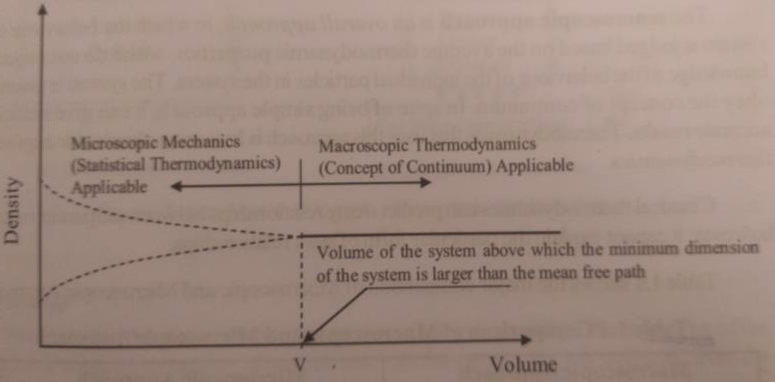
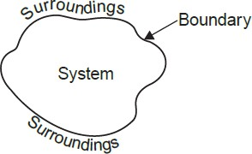
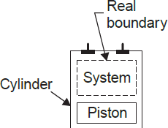
Concept of continuum is a kind of idealization of the continuous description of matter where the properties of the matter are considered as continuous functions of space variables.
THERMODYNAMIC SYSTEMS
System, Boundary and Surroundings
System:
A system is a finite quantity of matter
Boundary.
The actual envelope enclosing the system is the boundary of the
system. The boundary may be fixed or it may move, as and when a system containing a gas is compressed or expanded.
Surroundings contain everything other then the system.
Universe: A system and surrounding together comprise a universe
Type of thermodynamic systems

Slide 3
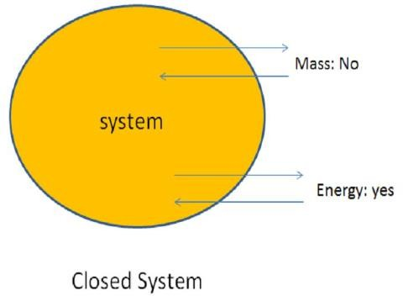
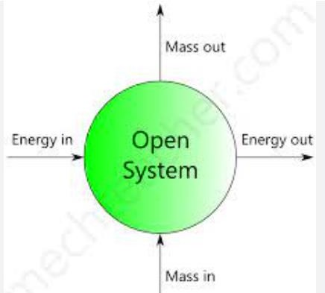
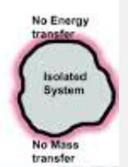
Closed System:
Open System
Isolated System
Closed System:
system does not permit any mass transfer. But only the energy transfer takes place.
Open System
An open system both mass and energy transfer take place.
Isolated SystemAn isolated system , which is not affected by surrounding is call isolated system.
Adiabatic System
.

Slide 4
Homogeneous System
A system which consists of a single phase is termed as homogeneous system. Examples :Mixture of air and water vapour, water plus nitric acid
and octane plus heptane.
Heterogeneous System
A system which consists of two or more phases is called a heterogeneous system. Examples :Water plus steam, ice plus water and water plus oil.
Thermodynamic property and State (2 marks)
Thermodynamic property Any observable characteristics required to
describe the conditions or state of a system is known as Thermodynamic property of a system.
Differentiate Intensive and Extensive Property
 | Extensive properties | Intensive properties
mass of a system | dependent on | independent of
additive. | yes ,additive. | Not additive.
Example: | mass(m),volume(V) ,Energy(E),Enthalp y(H) | Example:Pressure(P),Tempera ture(T),De nsity
. State: Is the condition of the system at any particular moment.
It is the condition of a system as defined by the values of all it’s properties.
It gives a complete description of the system.
Any operation in which one or more properties of a system change is called change of state .

Slide 5
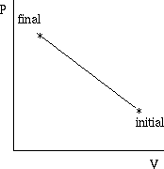
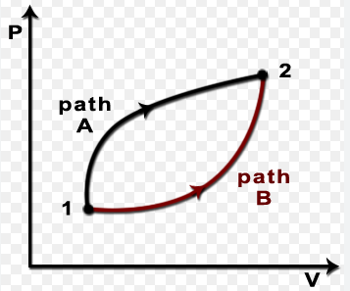
Path : A thermodynamic property that depends on the path between the initial and final state is known as the path function. The path functions depend on the path taken or covered between two (initial and final) states.
Phase. A phase is a quantity of matter which is homogeneous throughout in chemical composition and physical structure
MACROSCOPIC AND MICROSCOPIC POINTS OF VIEW
Macroscopic approach—(Macro mean big or total)
Microscopic approach—(Micro means small)
Detail | Macroscopic approach | Microscopic approach
approach | concerned with overall behaviour. | structure of the matter
analysis | mathematical formulae. | statistical methods
values of the properties | average values. | changes in properties
describe a system | ew properties are needed. | Large number of variables

Slide 6
THERMODYNAMIC EQUILIBRIUM
A system is in thermodynamic equilibriumif the temperature and pressure at all pointsare same ; there should be no velocity gradient ;
Thermal equilibrium. The temperature of the system does not change with time andhas same value at all points of the system.
Mechanical equilibrium. There are no unbalanced forces within the system or betweenthe surroundings. The pressure in the system is same at all points and does not change withrespect to time
.
Chemical equilibrium. No chemical reaction takes place in the system and the chemicalcomposition which is same throughout the system does not vary with time.
THERMODYNAMIC PROCESS
Path and Process:
The series of state through a system passes during a change of state is Path of the system.
PROCESS: change of state undergone by a system from one
equilibrium state to another state.
We can allow one of the properties to remain a constant during a process. Isothermal Constant Temperature (T)
Isobaric Constant Pressure (P)
Isochoric Constant Volume (V) Isentropic Constant Entropy (s) Isenthalpic Constant Enthalpy (h)

Slide 7
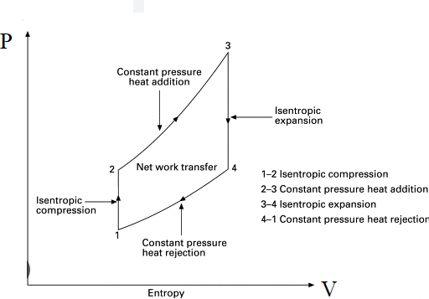
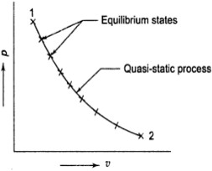
Processoccurs :an energy transfer at a steady state.
A process may be
non-flow process: non-flow in which a fixed mass within the defined boundary isundergoing a change of state.
Example : A substance which is being heated in a closed cylinder undergoes
flow processmass is entering and leaving through the boundary
of an opensystem.
quasi-static process
A quasi-static process is one in which the deviation from thermodynamic equilibrium is infinitesimal.
Characteristics:
refrred to a slow process.
happens at an infinite slow rate,
has all of its static in equilibrtum.
thermodynamic equilibrium with its surrounding at all times
Non -Quasi-static process.

Slide 8
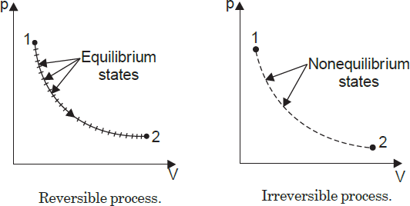
If a process is carried out in such a way that at every instant the system departs finitely from thermodynamic equilibrium
REVERSIBLE and IRREVERSIBLE PROCESSES:
Reversible process. A reversible process (also some times known as quasi-static process) is one which can be stopped at anystage and reversed so that the system and surroundings are exactly restored to their initial states.
This process has the following characteristics:
It must pass through the same states on the reversed path as were initially visited on the forward path.
This process when undone will leave no history of events in the
surroundings.
It must pass through a continuous series of equilibrium states.
Examples.
(i) Frictionless relative motion.
(ii) Expansion and compression of spring.
Irreversible process.
An irreversible process is one in which heat is transferred through a finite temperature.
Examples.
(i) Relative motion with friction (ii) Combustion
(iii) Diffusion (iv) Free expansion
(v) Throttling (vi) Electricity flow

Slide 9
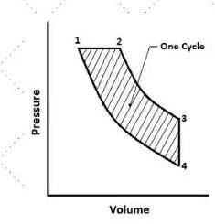
CYCLE
Thermodynamic cycle refers to number of processes in sequemce bring back the system to its original volume, then the system is said to be a cycle.
In fig a system starts from state 1 and then undergoes (1-2) , (2-3) , (3- 4) ,(4-1)
And its returns bake to its original position.
 | Point Function | Path Function
change of the path | is independent | depends on the path
magnitude of such quantity | depends on the state. | area under the curve
 | These are exact differential. | inexact differential.
Ex: | like pressure(P), volume(V),Temp.(T), | Heat and work
ENERGY, WORK AND HEAT
Energy :Energyis a general term embracing energy in transition and stored energy.
Work
Work is said to be done when a force moves through a distance.
W = F× x N - m
Sign convention :

Slide 10
_ If the work is done by the system on the surroundings, e.g., when a fluid expandspushing a piston outwards, the work is said to be positive.
Work output of the system = + W
_ If the work is done on the system by the surroundings, e.g., when a force is applied to arotating handle, or to a piston to compress a fluid, the work is said to be negative.
Work input to system = – W
Heat is the transfer of thermal energy between systems, while work is the transfer of mechanical energy between two systems
Heat is defined as form of energy that can be transferred from one system to another but there must be a temperature difference between these two systems.
Heat is usually represented by 'Q' in(kJ)
2
∫₁ δ𝑄= Q1–2
Sign convention :
Heat received by the system = + Q
Heat rejected or given up by the system = – Q.
 | Heat | Work
Grade of energy | poor | high
source | Produced any where | requires
Converted into works | friction | fully
Motion of molecules | Radom | ordered
States | Form of energy | Transferring energy.
Zeroth law of thermodynamics’ states that if two systems are each equal in temperatureto a third, they are equal in temperature to each other.
a = b and b = c, then a = c.
ApplicationofFirstLawtoNon-flow/ Closed system
1. Constant volume process

Slide 11
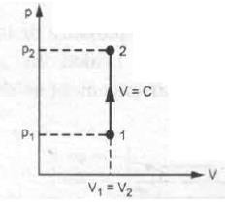
Constant pressure process
Constant temperature process
Reversible adiabatic process
Polytropic process
1.Constant volume process
If heat is supplied at constant volume then the pressure and temperature of system will increase but
there is no any expansion or compression
gas
Work done d W=0
of
Generalgasequation^{𝑝𝑉} = C
p , V and T relations
𝑇
𝑝₁₌ 𝑝₂
𝑇₁ 𝑇₂
Heat supplied to the system = m𝑐_{𝑣}(𝑇₂ − 𝑇₁)
Change in internal energy(Changeinenthalpy) du = dQ = m 𝑐_{𝑣}(𝑇₂ − 𝑇₁)
Change in entropy
𝑇₂
∆S = m 𝑐 In ( )
𝑣
𝑇
1
Constant pressure or isobaricprocess
Generalvgas equation^{𝑝𝑉} = C
𝑇
p , V and T relations
𝑉₁ ₌ 𝑉₂
𝑇₁ 𝑇₂
Heat supplied to the system = m𝑐_{𝑝}(𝑇₂ − 𝑇₁) Work done d W= p (𝑉₂ − 𝑉₁)
Change ininternal energy (Changeinenthalpy) dh = d Q = m 𝑐_{𝑝}(𝑇₂ − 𝑇₁)
Changein entropy
𝑇₂
∆S = m 𝑐 In ( )
𝑝
𝑇
1
Constant temperature or isothermal process (Frictionless piston and cylinder)

Slide 12
General gas equation^{𝑝𝑉} = C
𝑇
p , V and T relations 𝑝₁𝑉₁ = 𝑝₂𝑉₂
Heat supplied = work delivered
𝑉₂
𝑝₁
dQ = dW = 𝑝 𝑉 In ( )
= 𝑝 𝑉 In ( )
1 1
𝑉
1 1
𝑝
1 2
Change in internal energy(Change inenthalpy)
∆U= 0
Change in entropy
𝑉₂
𝑝₁
∆S = m R In ( )
= m RIn( )
𝑉₁ 𝑝₂
Reverse Adiabatic Process
{insulated frictionless piston and cylinder arrangement} no heat transferdQ = 0
Generalgasequation 𝑝𝑉^{𝛾}= C
p , V and T relations 𝑝 𝑉^{𝛾} = 𝑝 𝑉^{𝛾}
1 1 2
2
𝑉₁
𝛾−1 𝛾−1
( )
𝑃₂
𝑉₂
= ( )
𝑃₁
Heat delivered
Q = 0
Work output of the system
_{dW =}𝑝₁𝑉₁ −𝑝₂𝑉₂
𝛾−1
Change in entropy
∆S = 0
Polytrophic Process (non-flow polytropic process)
All the processes like isobaric, isochoric, isothermal, adiabatic, etc. may be described byequation
p𝑉^{𝑛} = C Where ‘n’ = Index of process.
If n = 0, then p𝑉⁰= C p=C
…Isobaric
If | n = 1, then p𝑉¹= C | pV=C | … Isothermal
If | n =∞ , then p𝑉∞= C | V =C | … Isochoric

Slide 13
If n =𝛾 , then p𝑉^{𝛾} = C replace𝛾byn.
p , V and T relations 𝑝₁𝑉^{𝑛} = 𝑝₂𝑉^{𝑛}
V =C… Isentropic
1 2
𝑇₂ ₌ 𝑉₁
𝑛−1
𝑃₂
𝑛−1
𝑇₁ 𝑉₂
( ) = ( )
𝑃₁
Heat transfer
dQ =∆U + dw
Change in internal energy(Change inenthalpy)
∆U = m 𝑐_{𝑣}(𝑇₂ − 𝑇₁)
Work output of the system
_{dw =} 𝑝₁𝑉₁ −𝑝₂𝑉₂
𝑛−1
Zerothlaw of thermodynamics’ states that If two bodies A and B are thermal equilibrium with third system C Then the bodies A and B are thermal equilibrium with each other
a = b and b = c, then a = c.
Steady Flow Energy Equation[SFEE] Consider a steady flow open system as shown
Assumptions :
The following assumptions are made in the system analysis :
The mass flow through the system remains constant.
Fluid is uniform in composition.
The only interaction between the system and surroundings are work and heat.
The state of fluid at any point remains constant with time.
In the analysis only potential, kinetic and flow energies are considered.

Slide 14
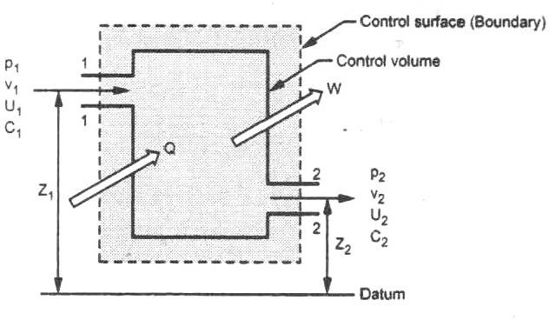
where, Q = Heat supplied (or entering the boundary) per kg of fluid,
W = Work done ^{𝑘𝐽}
𝑘𝑔
C = Velocity of fluid ,
Z = Height above datum,
p = Pressure of the fluid,
u = Internal energy per kg of fluid, and
pv= Energy required for 1 kg of fluid.
This equation is applicable to any medium in
A1andA2bethecross-sectionalareaatinletandoutlet p₁and p₂be the pressure at inlet and outlet.
v_{I} and v₂be the specific volume at inlet and outlet.
U₁andU₂betheinternalenergyatinletandoutlet.
C1 and C2 be the velocity for fluid at inlet and outlet.
If Q is the amount of heat interaction W is the work output
Total energy entering the system = P.E +K.E +I.E +F.E + Heat energy
_{𝐶}2
= gz1 + ¹ + 𝑢₁+ 𝑝₁ 𝑣₁+Q
2
Total energy living the system = P.E +K.E +I.E +F.E + Work
_{𝐶}2
2
According to first law of thermodynamics,
= gz2 + ² + 𝑢₂+ 𝑝₂ 𝑣₂+W
Total energy Total energy [entering the system] = [ leaving the system]

Slide 15
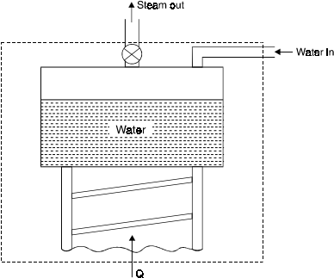
_{𝐶}2
_{𝐶}2
gz1 + ¹ + 𝑢₁+ 𝑝₁ 𝑣₁+Q = gz2 + ² + 𝑢₂+ 𝑝₂ 𝑣₂+W
2
2
∴[ h = u + pv]
_{𝐶}2
_{𝐶}2
gz1 + ¹ + h1+Q = gz2 + ² + h2 +W
2
For energy flow per unit of mass
2
_{𝐶}2
_{𝐶}2
m( g𝑧₁
₊ 1
+ ℎ₁ + Q) = m (𝑔𝑧₂ +
2
2
+ ℎ₂ + W )
2
for the unit of kJ/ kg
_{𝐶}2
_{𝐶}2
g𝑧₁
1000 2000 1000 2000
m(
𝑔𝑧₂
+ ¹ + ℎ₁ + Q) = m ( + ² + ℎ₂ + W )
Application of Steady Flow Energy Equation
Boiler :( Steam generator)
Internal energy (U) exists and flow energy exists due to movement of
_{𝐶}2
water . the P.E (g𝑧) and K.E ( ¹ ) is is negligible
2
∴ Q = (ℎ₂ − ℎ₁ )kJ
Condenser: Condenser is to transfer the heat from steam to coolant.
_{𝐶}2
There is no work done , change in P.E (g𝑧) and K.E ( ¹ ) is is
negligible
2

Slide 16
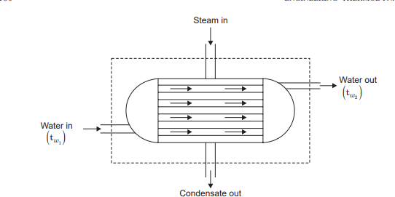
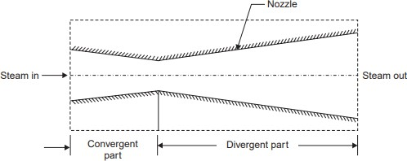
Q = (ℎ₂ − ℎ₁ )kJ
Nozzle : Increases the velocity of kinetic energy of the working substance at the constant pressure drop.
No work done by the system (W=0)
There is no heat transfer taking place (Q =0) There is no potential energy (z1= z2)
_{𝐶}2 _{𝐶}2
1
2
+ ℎ₁ =
2
2
+ ℎ₂
Turbine: converts the P.E into mechanical work.
z1= z2 , C1 = C2
Turbine is fully insulated .There fore , there is no heat transfer

Slide 17
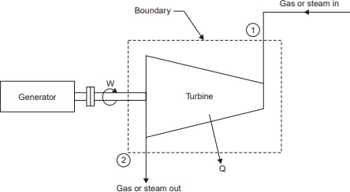
Q = 0
Air compressor :
Centrifugal Compressor No heat transfer
_{𝐶}2
change in P.E (g𝑧) and K.E ( ¹ )
2
W = ℎ₂ − ℎ₁
Reciprocating Compressor
Applying energy equation to the system,
: ∆P.E = 0 and ∆K.E = 0
since these changes are negligible compared with other energies. ∴
h1 – Q = h2 – W (−𝑊𝑖𝑠 work done on the system)
State the limitations of first law of thermodynamics?
First Law places no restriction on the direction of a process.
It does not ensure whether the process is feasible or not.
This law does not differentiate heat and work. It is concerned with the quantity of energy and the transformation of energy from one form to another with no regard to its quality. THROTTLING PROCESS AND JOULE- THROTTLING PROCESS AND JOULE-THOMPSON POROUS PLUG EXPERIMENT
Throttling process involves the passage of a higher pressure fluid through a narrow constriction. The effect is the reduction in pressure and increase in volume. This process is adiabatic as no heat flows from and to the

