Slide 1
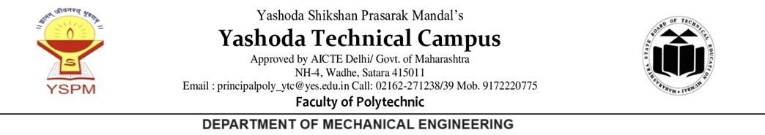
MANAGEMENT – 22509
Unit No : 01
Introduction to Management Concept and Managerial Skills

Slide 2
Course Outcome:
Use basic management principles to execute the daily activities.

Slide 3
Unit No.-1:
Introduction to Management Concept and Managerial Skills.
UO-1:
Explain the concept and importance of management .

Slide 4
CONTENT
1. Concept of Management
2. Definition of Management
3. Role of Management
4. Importance of Management
5. Characteristics of Management

Slide 5
Objectives
After this session you should be able to –
Describe the significance and relevance of management.
State the importance of management.
Explain the role of management.
List the management characteristics

Slide 6
Concept of Management
* Management is the art of getting work done through people to accomplish goal. It requires a range of skills to coordinate
* Management is a science because management techniques are concepts based on measurements and factual determinations
* Management is a process of effectively utilizing resources.

Slide 7
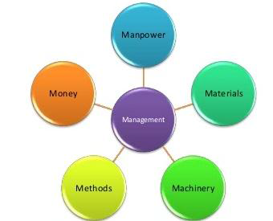
Concept of Management
Optimum utilization of resources.
Art of getting work done through people.
Is a science.

Slide 8
Definition of Management
Mary Parker Follet : Management is the art of getting things done through people.
2. George R Terry: Management is a process consisting of planning, organizing, actuating and controlling performed to determine and accomplish the objectives by the use of people and resources.
3. Ralph C Devis : Management is the function of executive leadership anywhere”.
4. Donald J Clough: Management is the art and science of decision making and leadership.

Slide 9
Role of Management
1. The role of the management is to ensure that the goals of the organization are achieved.
2. These changes which reflects in both tangible and intangible forms can be met by management only.
- Tangible changes deals with change in technology, size of organization and specialization in work and theories.
- Intangible changes are changes in attitude, human values, culture, etc
3. Management ensures that all the activities are designed effectively for the attainment of the organizational goal.
4. Management encourages all individual activities that will lead to reaching organizational goals.

Slide 10
Importance of Management
Optimum utilization of resources:
Management brings all the available resources -men, money, machines, materials and methods together for optimum utilization.
2. Expansion and diversification:
Management helps the organization to achieve its goals efficiently, systematically, easily and quickly. It helps the organization to face competition to grow, expand and diversify.
3. Reduction of employee’s absenteeism and turnover:
Management motivates people by Providing different incentives to the employees which include positive, negative, monetary and non-financial incentives. These incentives increase the willingness and efficiency of the employees.
4. Utilization of the benefits of science and technology:
Management utilizes the advancements made in the field of Science and Technology to provide industries with the latest machines and the consumers with the latest products

Slide 11
Management, Administration and Organization
Management: An art of managing people and their work, for achieving a common goal by using the optimum resources. It creates an environment under which the manager and his subordinates can work together for the attainment of objectives of organization.
Administration: Administration relates to top level of management. They are the either owners or business partners who invest their capital in starting the business. The functions of administration are legislative and largely determinative. It does not need technical ability. It is mainly concerned with decision making, policy making and making necessary adjustments. It coordinates finance, production and distribution.
Organization: Organization is the framework of management. Management carries out the policies of Administration through the frame work of organization. Without efficient organization, no management can perform its function smoothly. Organization is concerned with the building, developing and maintaining of a structure of working relationships in order to accomplish the objectives of the

Slide 12
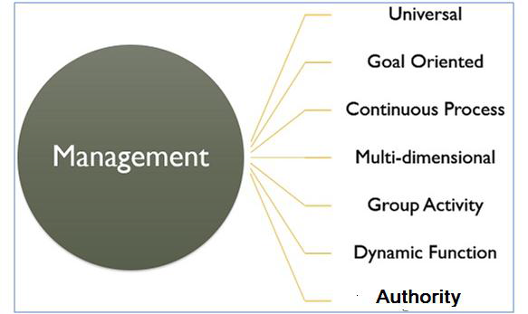

Slide 13
Summary
*Management is the art of getting work done through people. It is a science based on measurements and factual determinations
*Management ensure that the goals of the organization are achieved, can met the tangible and intangible changes and motivates the people.
*Management is important for optimum utilisation of resources with minimum wastages, Encouraging people to work in team , Improving quality of life of worker.
*Management characteristics are goal oriented, universal, continuous process, group activity and dynamic function.

