Slide 1

MANAGEMENT – 22509
Unit No : 01
Introduction to Management Concept and Managerial Skills

Slide 2
Course Outcome:
Use basic management principles to execute the daily activities.

Slide 3
Unit No.-1:
Introduction to Management Concept and Managerial Skills.
UO-2:
State the Principles and Level of Management
UO-3:
Explain the functions of Management.
UO-4:
Suggest the suitable type of organisation structure for the given
examples

Slide 4
CONTENT
PART ONE
1. F. W. Taylor’s Principles of management
2. Henri Fayol’s Principles of management.
PART TWO
1. Levels of management.
2. Functions of management

Slide 5
Principles of Management.
Principles of management are broad and general guidelines for managerial decision making and behavior of employees towards organization. These are the essential to form the foundations of successful management .
Following two theories are important-
F.W.Taylor: Principles of scientific management
Henry Fayol: Principles of modern management

Slide 6
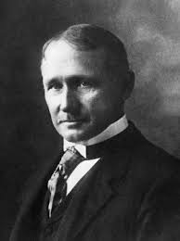
F. W. Taylor
F. W. Taylor
Frederick Winslow Taylor was a American Mechanical Engineer.
Born on 20 March 1856 and died on 21 March 1915.
He is regarded as father of scientific management, and was one of the first management consultant.
He started his carrier as machinist in 1875. His experience from the bottom most level in organization gave him an opportunity to know the problems of workers.
Taylor principles concerns with increasing efficiency of production as well as increasing the higher productivity also.

Slide 7
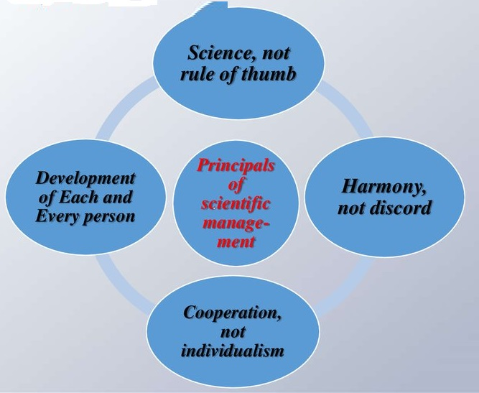
F. W. Taylor’s Principles of Management
F. W. Taylors Principles of Management
(Scientific Management)
Management means-
Science, Not Rule of Thumb
Development of each and every person to his or her greatest efficiency
Harmony, Not Discord
Cooperation, Not Individualism

Slide 8
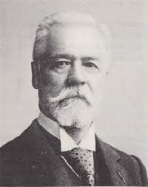
Henri Fayol
Henri Fayol
Henri Fayol was a French mining engineer.
Born on 29 July 1841 and Died on 19 November 1925
He is regarded as Father of general management.
Fayol's work was one of the first comprehensive statements of a general theory of management known as Fayolism.
He proposed that there were five primary functions of management and fourteen principles of management.

Slide 9
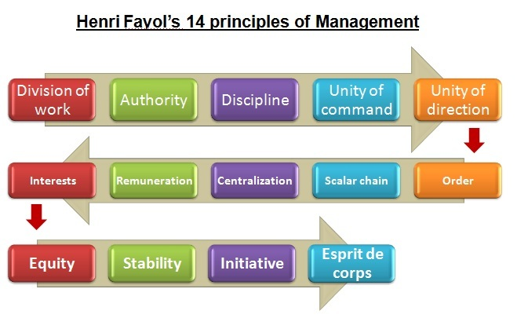
Principles of Scientific Management

Slide 10
Summary
1. F. W. Taylors Principles of Management:
1. Science, Not Rule of Thumb 2. Harmony, Not Discord 3. Cooperation, Not Individualism
4. Development of each and every person to his or her greatest efficiency
2. Henri Fayol’s Principles of Management:
1. Division of Work 2. Authority and Responsibility. 3. Discipline
4.“Unity of command 5. Unity of direction 6. Remuneration of personnel
7.Subordination of individual interest to general interest 8. Centralization
9. Scalar chain 10. Order 11. Equity 12.Stability of tenure of personnel

Slide 11
Unit No.-1:
Introduction to Management Concept and Managerial Skills.
UO-3:
Explain the functions of Management.

Slide 12
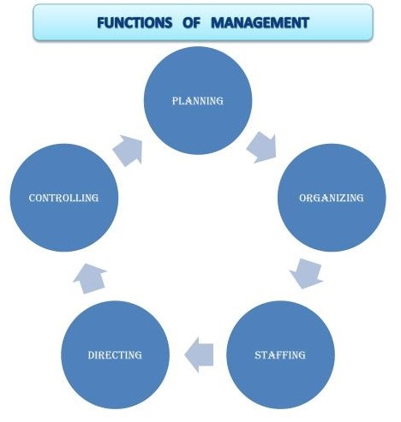
Functions of Management
Functions of Management
Planning
Organizing
Staffing
Directing
Controlling

Slide 13
Functions of Management
Functions of Management
Planning: Planning is deciding in advance what to do, how to do it, where to do it and who is to do it.
Organizing: Organizing refers to dividing the work into convenient tasks, and grouping them properly.
Staffing: Staffing is a process of recruitment, selection & training of employees.
Directing: Directing is a process in which the managers instruct, guide and overview the performance of the workers.
Controlling : Controlling is a monitoring, comparing, correcting, performance and taking action to ensure desired results.

Slide 14
Unit No.-1:
Introduction to Management Concept and Managerial Skills.
UO-4:
Suggest the suitable type of organisation structure for the given examples

Slide 15
Organization
Organization :
A social unit of people , systematically structured and managed to achieve the collective goals on a continuing basis.
Need of Organisation:
In organisation management determines the relationship between functions and position, and subdivides roles and responsibilities with appropriate authority to carry out defined task.
Organisation Structure:
plan that outlines who reports to whom and who is responsible for what.
shows the authority and responsibility relationship between the various positions of the organization set of planned relationships ( Formal task allotted )between groups .Related to functions , physical and personal factors .
should not be static but dynamic, subject to change from time to time.

Slide 16
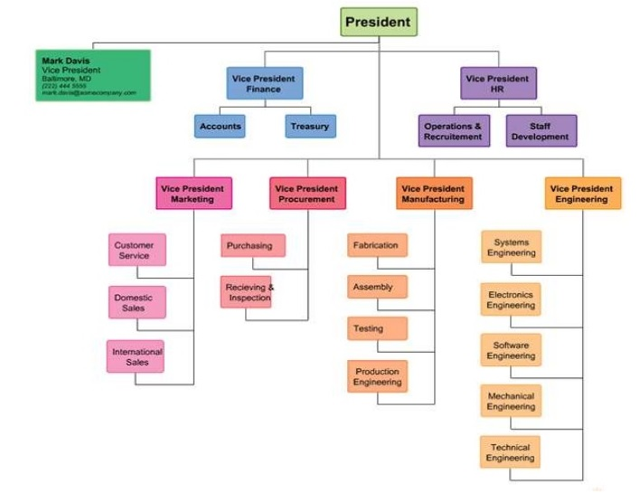
Organization Structure For a large and complex organisation ( A vehicle manufacturing organisation)

Slide 17
Principles of Organization :
1 ) Objectives 2) Specialization
3) Span of control 4) Exception
5) Scalar principle 6) Unity of command
7) Delegation 8) Responsibility
9) Authority 10) Efficiency
11) Simplicity 12) Flexibility
13) Balance 14) Stability
15) Communication 16) Unity of direction

