Slide 1
Evolution of CNC:
With the availability of microprocessors in mid 70’s the controller technology has made a tremendous progress.
The new control systems are termed as computer numerical control
(CNC) which are characterized by the availability of a dedicated computer and enhanced memory in the controller.
These may also be termed “soft wired numerical control”.

Slide 2
Advantages of CNC as compared to NC.
• Part program storage memory.
• Part program editing.
• Part program downloading and uploading.
• Part program simulation using tool path.
• Tool offset data and tool life management.
• Additional part programming facilities.
• Macros and subroutines.
• Background tape preparation, etc.

Slide 3
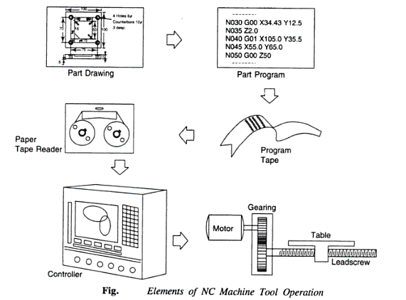
The controls in the old NC control do not exist any more

Slide 4
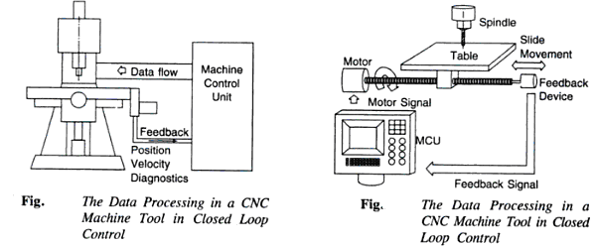
The controls in the CNC machine tools.

Slide 5
Features of CNC
Storage of more than one part program
Various forms of program input
Program editing at the machine tool
Fixed cycles and programming subroutines
Interpolation
Positioning features for setup
Cutter length and size compensation
Acceleration and deceleration calculations
Communications interface
Diagnostics

Slide 6
The Basic Elements Of The CNC Machines
Program of Instruction
The Machine Control Unit (MCU)
Machine tool

Slide 7
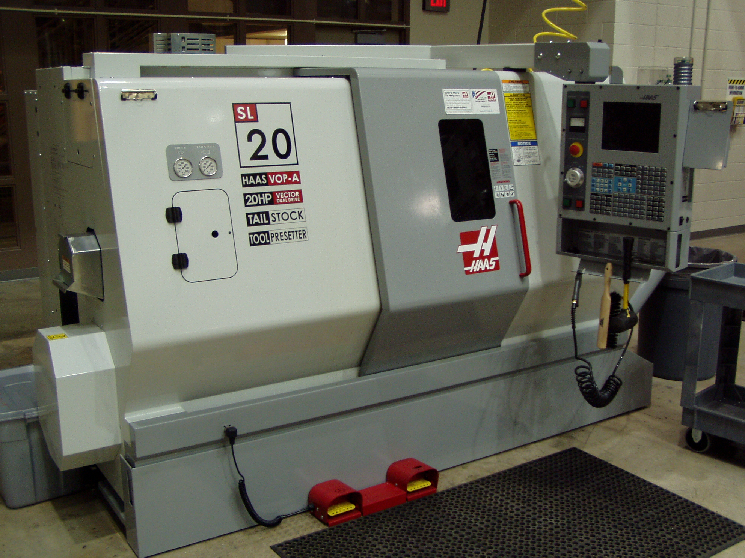

Slide 8
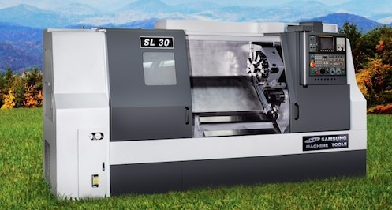

Slide 9
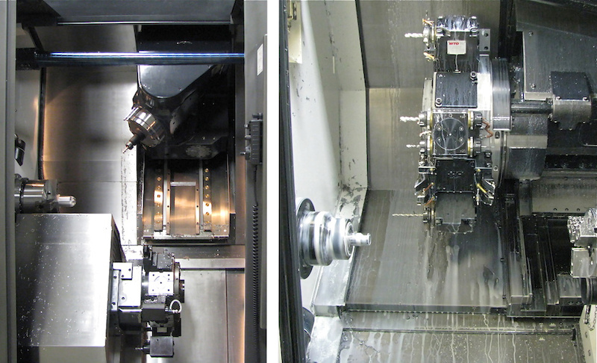
TURRET HAED FOR CNC TURNING MACHINE

Slide 10
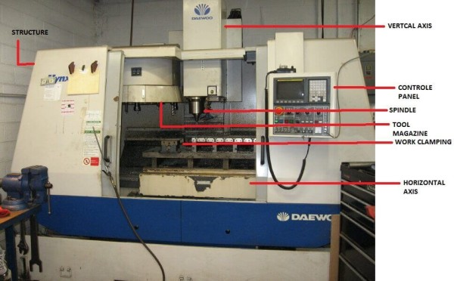

Slide 11
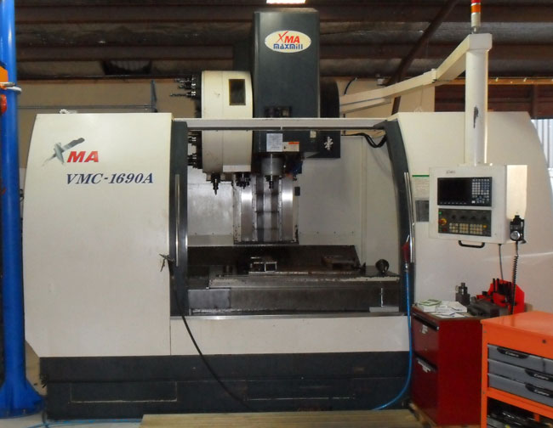

Slide 12
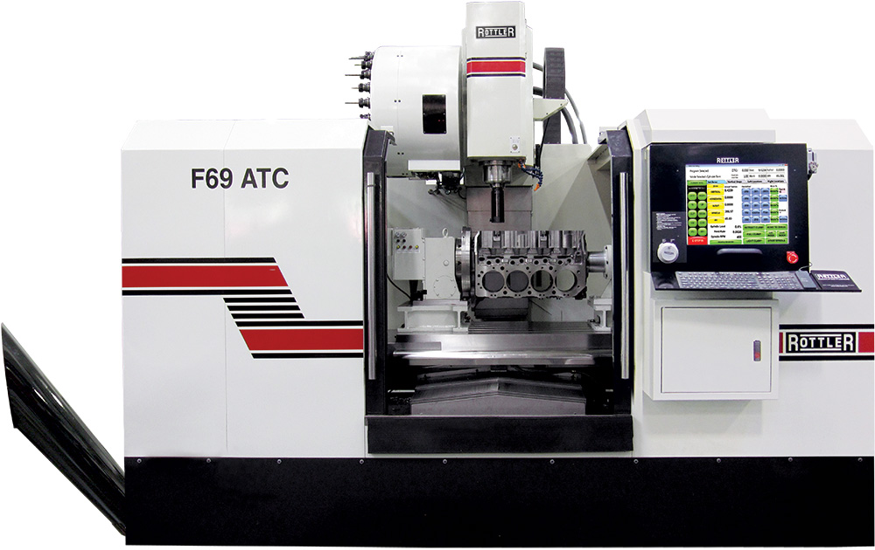

Slide 13
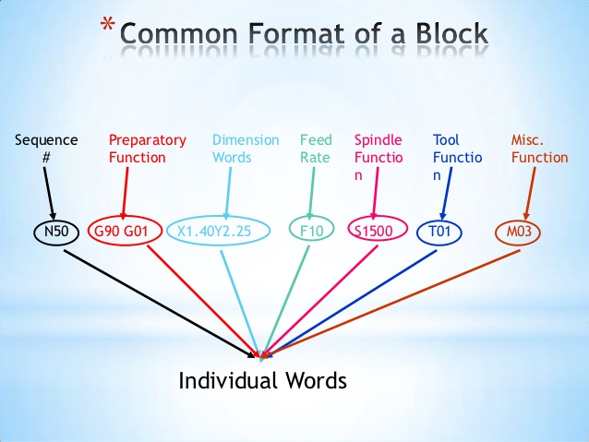
PART PROGRAM

Slide 14
Classification Of CNC Machine Tools
Based on Control System Characteristics.
- Point to point position system
- Straight Line System
- Contour System

Slide 15
Classification Of CNC Machine Tools
(2)Based on Positioning Co-ordinates
-Absolute System
-Incremental System

Slide 16
Classification Of CNC Machine Tools
(3)Based on Feedback or Type of Control System
-Open Loop Control System.

Slide 17
Classification Of CNC Machine Tools
(2)Based on Feedback or Type of Control System
-Closed Loop Control System.

Slide 18
Classification Of CNC Machine Tools
(3)Based on Structure of control circuit
-Analogue System
-Digital system

Slide 19
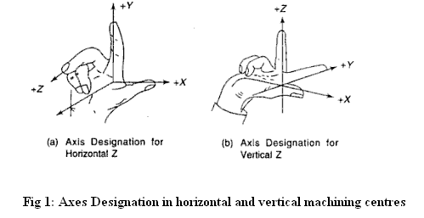
Axis Identification of CNC machines

Slide 20
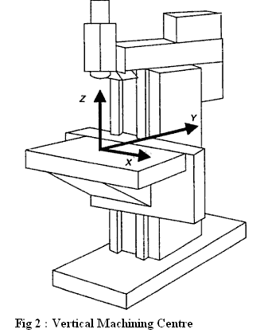
Axis Identification of CNC machines

Slide 21
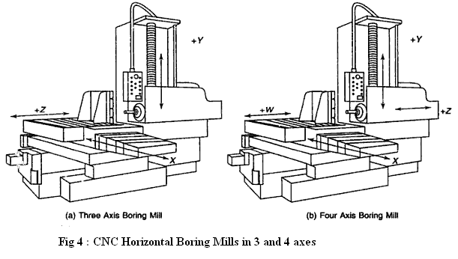
Axis Identification of CNC machines

Slide 22
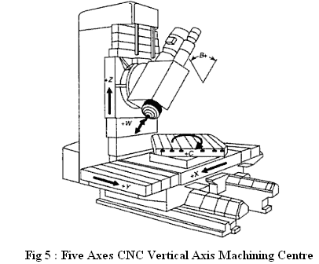
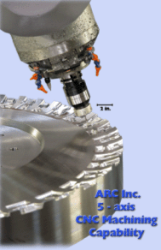
FIVE AXES CNC MACHINES

Slide 23
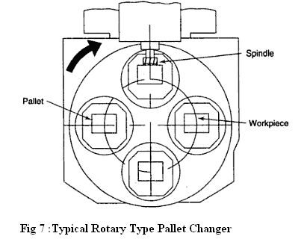
ROTARY TYPE PALLET CHANGER CNC MACHINE

Slide 24
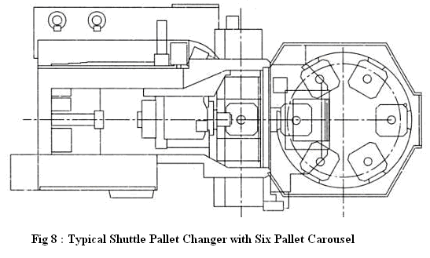

Slide 25
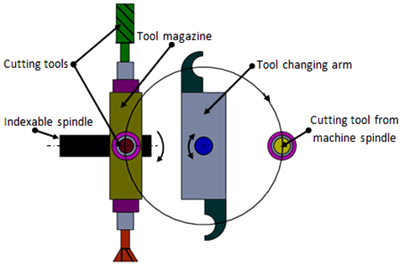
CNC Tool Changers

Slide 26
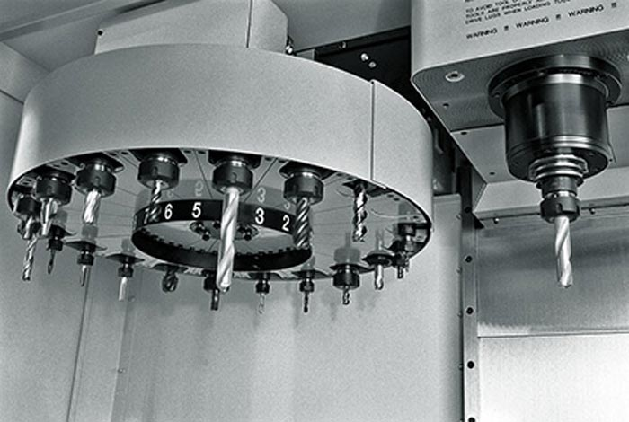

Slide 27
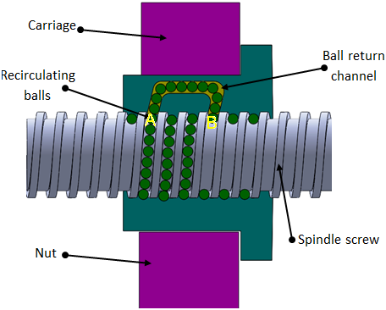
Recirculating Ball-screw.

